Slide 1
BEHAVIORAL HEALTH SERVICES DIVISION – HEALTH CARE AUTHORITY
Supportive housing MANAGER – lisa howley
Supportive Housing Coordinator – Cathy Trujillo
2026

Slide 2
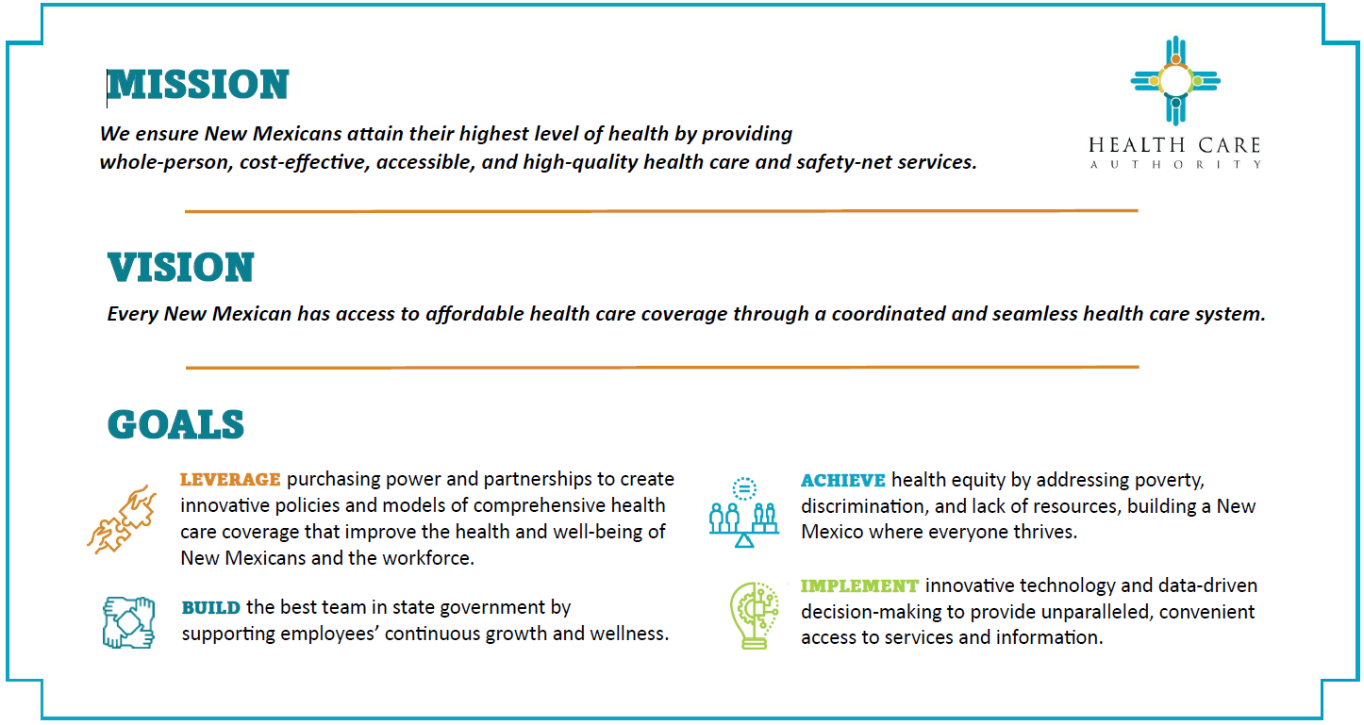

Slide 3
United States Interagency Council on Homelessness (USICH) – Facts
People without a home typically die about 30 years earlier; higher rates of acute and chronic conditions
50% of people are 1 paycheck away from homelessness, 1 crisis away – medical emergency or automobile accident
40-60% of people experiencing homelessness have a job
People with minimum wage jobs must work 86 hours a week to afford a 1-bedroom unit
Only 37 affordable homes are available for every 100 extremely low-income renters (NM 32-40k shortage, per MFA strategic plan in 2021)
70% of the lowest wage households spend half their income on rent
Every $100 increase in median rent is associated with a 9% rise in homelessness
Notes:
What are we working to address?
USICH – Independent federal agency within the executive branch
Facts put into perspective the problem and need for programs. Homelessness is prevalent and real. Often the problem outpaces the response; however, the dedication, passion and efforts of providers is also very real.

Slide 4

Housing Programming Overall
Housing resources can be a very complex field to navigate. NM has various stakeholders and various programs.
The fund source dictates the definition of homelessness, program eligibility criteria and processes for these programs.
Housing NM, state housing authority and quasi-governmental agency, receives Emergency Solution Grant (ESG) funding from US Department of Housing & Urban Development (HUD. MFA’s ESG funding - Emergency Housing Assistance Program (EHAP) supports for homeless shelters.
https://housingnm.org/, MFA website – Rapid Rehousing, HOME, NM Housing Trust Fund, Recovery Housing Program, Low Income Housing Tax Credits (LITHC), HOPWA,, Linkages PSH
The NM Coalition to End Homelessness (NMCEH), non-profit agency, receives Continuum of Care/Balance of State funding from HUD for permanent supportive housing, transitional housing, and rental assistance. NMCEH has an application process for providers.
NM State Departments utilize funding (SGF or federal grants) for programming
PED utilizes McKinney Vento funding and support homeless liaisons in schools
CYFD funds Transitions supportive housing programming and vouchers.
HCA (Formerly HSD)
DWS – Office of Housing & Production
Municipalities/Localities – City or County
Notes:
Federally funded programming has definition of homelessness that is a bit more restrictive. Chronically homeless 12 months or 4x in last 3 years that equals 12 months. VISPDAT Coordinated Entry

Slide 5

Behavioral Health Services Division – Health Care Authority
BHSD oversees several supportive housing and housing assistance programs.
Significant and fast growth to funding and programs in most recent years.
Budget has increased dramatically since FY19 - $3.4M, FY24 & FY25 $12M, FY26 over $16M.
Programs are funded and supported with State General Funds and a federal grant (1), PATH.
FY2025, the supportive housing budget was over $12.2M with over $11M SGF.
FY24 & FY25- 65 contracts, 35+ providers and new programming.
FY26 – Over $16M with 69 contracts, 35+ providers, 15 program areas
Notes:
To be a housing program under BHSD, there needs to be some element of BH in the eligibility criteria.
2004 first SH Coordinator; 2010 $1M; 2019 $3.4
Program eligibility varies for each program, and programs range in service type .
Projects for Assistance in Transition from Homelessness
FY25 - $800k federal $
FY26 - $300K federal – 2% of entire budget; Linkages 62% of b

Slide 6
Range/Types of Programming
Permanent Supportive Housing
(Linkages, Set Aside Housing Program/Local Lead Agencies)
Housing Assistance
MIAEP, Fresh Start Rental Assistance
Transitional Housing
Crisis Housing
Recovery Housing
(Oxford House)
Shelters
Outreach
Training
SSI/SSDI Outreach Access to Recovery (SOAR)
Notes:
Training – BHSD contracts with LLTI; available to anyone interested
Fair Housing, SH Basic/Advanced, UORRA, CPSW SH Endorsement,
Transitional housing – federal definition is 9-24 months
Programs under BHSD have eligibility criteria that includes a behavioral health diagnosis, typically SMI

Slide 7
What is Supportive Housing?
Subsidized rental housing affordable to the lowest levels of income (at or below 30% Area Median Income)
Linked with flexible supportive services to support tenancy and address other needs
A SAMHSA evidence-based practice for recovery and resiliency

Slide 8

Linkages
Permanent
Supportive Housing Program

Slide 9
Linkages
Permanent Supportive Housing Program
Program created in 2007 with an initial State General Fund Legislative Allocation of $300,000
Began in Three Sites/65 Vouchers
Santa Fe
Albuquerque
Silver City/Deming
Joint Venture:
Health Care Authority formally known as Human Services Department/Behavioral Health Services Division manages the Support Service Agency providers.
Housing NM formally known as Mortgage Finance Authority manages the housing administrators, agencies responsible for vouchers.
BHSD contracts with MFA who subcontracts with housing administrators.
Services Agencies
HCA/HSD
Housing NM/MFA
Housing Authorities
Notes:
This program was created by BHSD in 2007 with a $300k state general fund legislative allocation; 3 sites, 65 vouchers.
FY20 – 1.65M, FY21 - $3.8M; FY23 - $4.3
Different than Section 8 and PSH vouchers that are federally funded.
Because the Program is NOT Federally funded the State rules have more flexibly in the Eligibility Criteria. So Applicants/Clients
DO NOT have to meet the HUD Definition of Chronic Homelessness
DO NOT have to go through the HUD Coordinated Entry System
The screening criteria are the 3 in this Slide.

Slide 10
Linkages Growth
State General Funds continue to support the Linkages Program, and funding has since 2007 increased from $300k to over $10.2 million in SFY2026.
Funding increased significantly from $1.7M to $3.8M in SFY2021, which allowed for two additional sites and voucher capacity increases for all existing sites. 160 to 318 voucher capacity.
SFY2023 ($500k), SFY2024 ($1M), and SFY2026 ($5M) increases. Increases supported site expansion, increases to voucher capacity, higher allowance for rent, hotel/motel vouchers and furniture stipends. 553 Voucher Capacity
Notes:
FY21 – 2 additional sites, Clovis and Gallup; increased voucher capacity from 160 to 318
FY23 – funding applied to increased rent; 110-115% FMR allowable per voucher; 338 vouchers
FY24 – funding applied to hotel/motel vouchers; program service area coverage expansion by existing providers; 396
FY20 – 1.65M, FY21 - $3.8M; FY23 - $4.3M ($500k); FY24 – $5.3M hotel/motel vouchers; FY25 - $5.3M stipends
396 vouchers
Provider feedback informs policy updates – excessive occupancy, rental allowance, stipends

Slide 11


What is Linkages?
Linkages is a permanent supportive housing (PSH) program.
Tenant-based rental assistance voucher program.
Individuals who meet eligibility criteria are issued a voucher that is partial or full subsidy for a housing unit of the individual’s choice.
The voucher will support up a rent amount of up to 115% of Fair Market, per HUD guidelines.
The individual, Linkages client, is the lease holder.
The client will work with both a Support Service Agency and Housing Administrator who each have specific roles.
Notes:
NEW

Slide 12
Linkages Supportive Housing Program
Eligible individuals receive a rental assistance voucher and support services, monthly house visit.
Program Eligibility
Diagnosis of Serious Mental Illness; or, Co-occurring (SMI and Addiction Disorder) which has resulted in a functional impairment, and,
Homelessness or precariously housed, and
Extremely low income, at or below 30% AMI, per HUD guidelines
10 Linkages sites and 11 Support Service Agencies
Notes:
- Albuquerque Health Care for the Homeless (Albuquerque/Bernalillo); First Nations Community Health Source (Albuquerque/Bernalillo); Hidalgo Medical Services (Silver City/Grant, Deming/Luna); La Clinica De Familia (Las Cruces/Dona Ana); Amador Health Center (Las Cruces/Dona Ana); Hopeworks (Albuquerque/Bernalillo); The Life Link (Santa Fe); PMS (Farmington/San Juan; Gallup/McKinley); Teambuilders (Taos); Mental Health Resources (Clovis/Curry, Portales/Luna)

Slide 13
Homeless or Precariously Housed
People who are living in a place not meant for human habitation, in emergency shelter, in transitional housing or are exiting an institution where they temporarily resided for up to 90 days and were in shelter or a place not meant for human habitation prior to entering that institution.
People who are losing their primary nighttime residence, which may include a motel or hotel or a doubled- up situation, within 14 days, and lack resources or support networks to remain in housing.
Families with children or unaccompanied youth who are unstably housed and likely to continue in that state.
Living situations that include excessive occupancy in a unit. Excessive occupancy is occupancy in excess of the lease and/or local regulations. An Excessive Occupancy Declaration must be included with the Certificate of Eligibility. Excessive occupancy applies to those with their own lease and is different than “doubled-up situation[s]” noted above.
The following subcategories apply to families with children or unaccompanied youth who have not had a lease or ownership interest in a housing unit in the last 60 or more days, have had two or more moves in the last 60 days, and who are likely to continue to be unstably housed because of disability or multiple barriers to employment.
Homeless or precariously housed families with children may be considered eligible only by an adult (18 years or older) being diagnosed with SMI (minor children with Severe Emotional Disturbance are not a qualifying situation).
Unaccompanied Youth must be 18 years of age and able to legally sign a Lease and diagnosed with a Severe Mental Illness.
Notes:
Does not follow federal guidelines/homeless definition.
No CES or VISPDAT

Slide 14
Linkages Program
From Client Eligibility to Move In
14
Step 1
Support Services Agency -- Intake & Program Eligibility:
In reach/Outreach to individuals with Serious Mental Illness (SMI), homeless/precariously housed, and extremely low-income level
Complete Linkages Application with applicant
Verification of Homelessness and SMI Disability
Household Composition Form
Verification of Income and Government Benefits (via SSI/SSDI, Food Stamps, etc. ) for all Household Members
Signed Releases of Information
Signed Linkages Program Participation Agreement
Provide Orientation to Tenant Responsibilities for Applicant
Step 2…..Refer to Housing Administrator with
Certificate of Linkages Eligibility Form and supporting documentation
Notes:
Disqualifiers – criminal history
1 national sex offender registry
2 If any member of the household has been convicted of producing or manufacturing methamphetamine in a housing unit.

Slide 15
Linkages Program
From Client Eligibility to Move In
Step 2
Housing Administrator – Rental Assistance Payment
Support Services Agency – Housing Search and Ongoing Services
Assist/Support Linkages applicant at Housing office (Support Services Case Manager)
Rental Calculation and Certification Form (Housing Administrator)
Linkages Voucher is issued
Linkages Tenant Responsibility Agreement (Housing Administrator)
Linkages participant housing search (Support Services Case Manager)
HQS Inspection and approval of unit (Housing Administrator)
Housing contracts executed:
A. Rental Assistance Agreement between the HA and Property Manager (Housing Administrator);
B. Lease between participant and Property Manager
Client Moves In Apartment
Notes:
90 days to secure housing; extensions up to 150-180 days. Re-apply if voucher expires.
Voucher does not expire after application (PSH).
Eviction is not cause for voucher termination.
Moves possible.
Security deposits, application fees, renters insurance and utilities covered.

Slide 16
Linkages Program Applicant Process & Partners
SERVICES HOUSING
Step I
Support Services Agency Role
Phase A: Eligibility, Referral of Linkages Applicant
In reach/Outreach to individuals with SMI and experiencing homelessness
Determines & Certifies consumer eligibility
Refers /Accompanies consumer to the Housing
Administrator with documentation
Phase B: After Linkages Client Voucher Issuance
Assist /Accompany consumer with housing search and move in
Assist consumer with hotel/motel stay during housing search, if necessary.
Assist consumer with move-in and orient to lease & property rules
Provides support services and eviction prevention as needed
Conducts monthly home visits - 1 minimum required
Liaison with property manager regarding tenant-landlord relations
Step 2
Housing Administrator Role
Issues housing rental voucher
to Linkages consumer and
Rental Agreement with Property Manager
Conducts Housing Quality Standards and annual recertifications
*****
Rental Property Manager/Landlord Role
(selected by Linkages participant)
accepts Linkages rental voucher
executes lease with participant
Notes:
Linkages Program Intake to Housed Process
Step 1, Phase A: Eligibility – Services Provider
Step 2, Referral to Housing Partner for a Voucher (if there is an open Voucher available)
Step 3, Phase B: Case Management and Monthly Home Visits Service Provider
Voucher supports units at or below 115% FMR.
16

Slide 17
Linkages Program Housing Administrators (HAs) & Support Services Agencies (SSAs)
Albuquerque: Barrett Foundation (HA) HopeWorks (SSA) First Nations Community Healthsource (SSA) Albuquerque Health Care for the Homeless (SSA) 177 vouchers Silver City/Deming: Supporting People In Need SPIN (HA) Hidalgo Medical Services (SSA) 38 vouchers Clovis: Alianza (HA) Mental Health Resources (SSA) 19 vouchers Santa Fe: The Life Link (HA/SSA) 123 vouchers Rio Rancho: Barrett (HA) Teambuilders (SSA) 15 vouchers | Las Cruces: Mesilla Valley Community of Hope (HA) Amador Health Center (SSA) 82 vouchers Farmington: San Juan County Partnership (HA) Presbyterian Medical Services (SSA) 29 vouchers Taos: Dream Tree (HA) Teambuilders (SSA) 26 vouchers Gallup: San Juan County Partnership (HA) Presbyterian Medical Services (SSA) 29 vouchers Roswell: Alianza (HA) La Casa (SSA) 15 vouchers
11 Support Service Agencies; 7 Housing Administrators

Slide 18
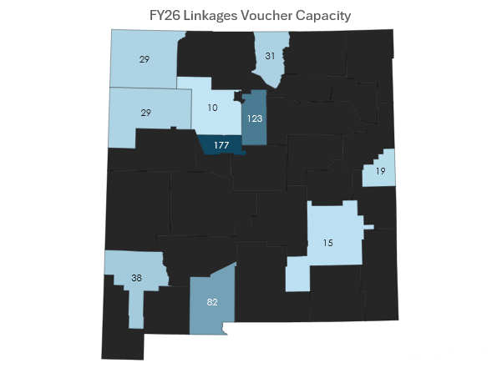
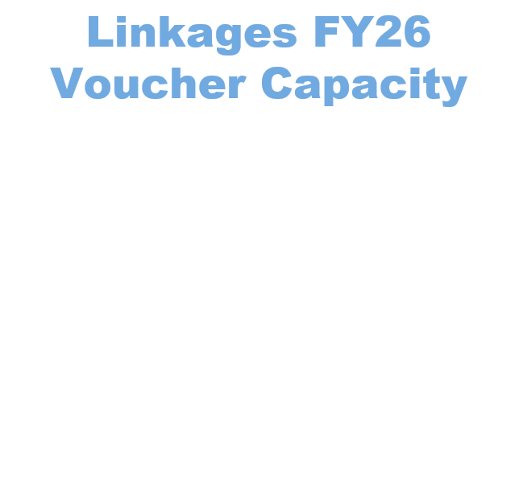
Notes:
Average utilization rate is 92% since FY18; FY24 91% - meaning in FY24, 91% of the 396 available vouchers were issued/filled

Slide 19




Linkages Funding and Medicaid
State General Funds - $10.2 million, separate from Medicaid
State general funds support the rental assistance voucher costs ($8.3M) and monthly home visits ($1.3M)
Medicaid does not support rent costs
Medicaid does support Linkages services beyond the monthly home visit to include landlord advocacy
Medicaid code H0044 Pre-Tenancy Supportive Housing Services is specific to Linkages and has had expansion.

Slide 20
Housing First model – house first and services voluntary
Voucher does not expire after application and housing secured
Housing Quality Standards (HQS) and recertification occur annually. (HA role)
Support Service Agencies assist Linkages clients with an application for Section 8 Housing Choice Vouchers to allow for movement of vouchers and availability
Linkages providers receive ongoing support from BHSD/MFA
BHSD and MFA meet regularly and update policy to reflect best practice.

Slide 21
Questions?
https://yes.nm.gov/nmhr/s/supportive-housing?language=en_US
BHSD HOUSING TEAM
Lisa Howley lisa.howley@hca.nm.gov
Cathy Trujillo cathy.trujillo@hca.nm.gov
Janice Shije Janice.Shije@hca.nm.gov
Mike Fuller Mike.Fuller@hca.nm.gov
Thank you!

