Slide 1









SOAR IN NATIVE COMMUNITIES
Stop, Observe, Act, Respond to Trafficking in Native Communities
By CSVANW
Follow CSVANW
Adapted from the Office on Trafficking in Persons (OTIP) SOAR online course
www.csvanw.org | info@csvanw.org | (505) 243 - 9199

Slide 2


Objectives
You will learn to:
  Utilize a trauma-informed, multidisciplinary approach
  Assess the unique needs of Native American survivors of trafficking
  Deliver the most effective social services to Native American survivors
Description: This presentation will describe the types of trafficking and their associating risk factors in Native communities, define trauma-informed and culturally sensitive methods to working with survivors, and comprehensively examine the SOAR methodology as it relates to Native communities.
#csvanw #BelieveSurvivors #CycleBreakers | Together, we do more. Together, we are the movement.

Slide 3

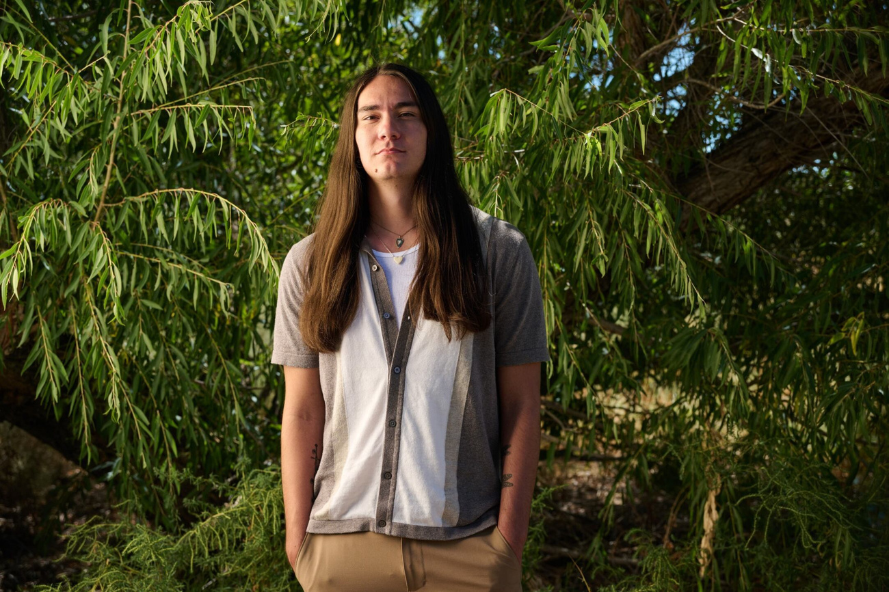
Patrick Gallegos
Senior Violence Response Training Coordinator
Patrick Gallegos has been working in the violence prevention and advocacy field for over four years, with a specialty in Missing and murdered Indigenous Persons (MMIP) and trafficking in tribal communities. They have a B.A. from the University of New Mexico in English and Native American Studies. They are passionate about deconstructing colonial systems of power through education, awareness, and direct action. Patrick believes white supremacy is upheld through neo-colonialism and capitalism, and building lateral structures of community power is essential to uprooting racist systems of oppression.
Patrick was born and raised in Albuquerque, New Mexico, and has strong ties to their community in the city. Patrick hopes they can build a better life for their relatives and community members in New Mexico as they work to undo centuries of exploitation in whatever small ways they can.
#csvanw #BelieveSurvivors #CycleBreakers | Together, we do more. Together, we are the movement.

Slide 4
The SOAR Framework
  The Stop, Observe, Act, Respond (SOAR) framework provides a quick mental reference for trauma-informed response to cases of trafficking within health and social service spaces
  Stop- Describe the types of trafficking and common risk factors
  Observe- Identify individual and environmental indicators of trafficking
  Act- Screen and identify through a trauma-informed, person centered approach
  Respond- Coordinate across multiple disciplines to meet indivdiual needs
#csvanw #BelieveSurvivors #CycleBreakers | Together, we do more. Together, we are the movement.

Slide 5
Guiding Principles of SOAR
  Inclusive of all types of trafficking
    Wide spectrum of abuse and exploitation in labor and sex trafficking
  Trauma-informed and person centered
    Recognizes trauma, and responds accordingly without re-victimization or re-traumatization
  Survivor Informed/Survivor-led
    Subject matter must be informed by lived experience, so that the needs of those who are impacted are directly met
#csvanw #BelieveSurvivors #CycleBreakers | Together, we do more. Together, we are the movement.

Slide 6
Guiding Principles of SOAR
  Culturally and linguistically appropriate
    Honor Native traditions, provide linguistic support, and utilize community healing methods
  Multidisciplinary
    Collaboration across medical, judicial, and social service fields; federal and Tribal communication
  Data-Driven
    Policies that are backed up by peer reviewed data
    Data Sovereignty and Free Prior and Informed consent from Tribes
#csvanw #BelieveSurvivors #CycleBreakers | Together, we do more. Together, we are the movement.

Slide 7
SOAR & Public Health
  SOAR is a public health approach to working with people who have experienced trafficking
    Public health is defined as the science of protecting the health, safety, and well being of people and their communities
  The public health approach contains a comprehensive response to human trafficking within communities and systems of power founded on the principles of mutual health, rather than a purely criminal justice approach
#csvanw #BelieveSurvivors #CycleBreakers | Together, we do more. Together, we are the movement.

Slide 8
The Public Health Approach is Holistic Prevention
  Primary Prevention- stopping violence before it happens
    Education on labor rights, poverty alleviation, peer outreach and support, healthy relationship programming, funding Tribal social services and building economic sovereignty
  Secondary prevention- Responding to violence when it happens
    Emergency medical care, emergency shelters, safety planning, and legal assistance
  Tertiary prevention- long term response following violence
    Stable housing, job training, mental health services, and community healing practices
#csvanw #BelieveSurvivors #CycleBreakers | Together, we do more. Together, we are the movement.

Slide 9
Opening Discussion
  Think what approaches to trafficking victim assistance you see in your community
    Is it more oriented towards a criminal justice framework?
    A public health framework?
    Both? Or neither?
    What is lacking and what is being done right?
#csvanw #BelieveSurvivors #CycleBreakers | Together, we do more. Together, we are the movement.

Slide 10
  STOP- Define & Understand
  Labor and Sex Trafficking: “Human Trafficking is a crime involving the exploitation of someone for the purpose of compelled labor or a commercial sex act through the use of force, fraud, or coercion.” (TVPA 2000)
    Knowingly used or “should have known”
    Minors automatically considered trafficked
  Limitations to definition
    Individuals selling sex criminalized instead of traffickers due to lack of evidence on force, fraud, and coercion
      Not all people experiencing trafficking consider themselves “victims”
#csvanw #BelieveSurvivors #CycleBreakers | Together, we do more. Together, we are the movement.

Slide 11
  STOP- Define & Understand
  Labor trafficking includes involuntary servitude and debt bondage, or peonage
  While labor traffickers are often employers, and sex traffickers are often partners, relatives, or friends, traffickers can be anyone
    They are not always strangers
  Anything of value can be traded
  Transportation is not required, but common
  Action, Means, Purpose
#csvanw #BelieveSurvivors #CycleBreakers | Together, we do more. Together, we are the movement.

Slide 12
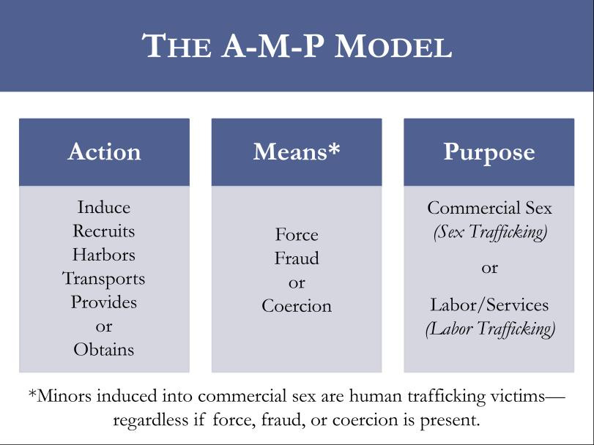
#csvanw #BelieveSurvivors #CycleBreakers | Together, we do more. Together, we are the movement.

Slide 13
  STOP- Define & Understand
  Fraud- False promises
    Someone may travel to a different country expecting fair wages, employment, and working conditions, but is actually forced to work on a farm with no promises kept
    Lying about modeling, nannying, or other positions and instead being forced into commercial sex
    Sex traffickers may also promise love & a relationship, gifts, housing, substances, and food
#csvanw #BelieveSurvivors #CycleBreakers | Together, we do more. Together, we are the movement.

Slide 14
  STOP- Define & Understand
  Coercion-psychological manipulation
    Threats of serious harm to others or themselves
    Degrading the individual, calling them names, treating them like they are worthless
    Using love, religion, or traditional values to guilt the person into staying with the trafficker
    Isolating someone from their family, friends, and loved ones
  Force- physical beatings, sexual assault, and forced markings
#csvanw #BelieveSurvivors #CycleBreakers | Together, we do more. Together, we are the movement.

Slide 15
  STOP- In Tribal Codes
  Unless Tribal codes are in place to prosecute cases of trafficking between Tribal members, federal law takes precedent over issues of trafficking on Tribal land
    VAWA’s special tribal criminal jurisdiction opt-in program allows for Tribes to prosecute non-Indians for trafficking on Tribal land
    VAWA defers to federal definition of trafficking
  Even if the funding and the resources aren’t there yet for comprehensive response, developing Tribal codes, policies, and procedures for human trafficking is essential for education and response
#csvanw #BelieveSurvivors #CycleBreakers | Together, we do more. Together, we are the movement.

Slide 16
STOP- Social Determinants of Health
  Systemic inequities are influenced by social determinants of health, or the circumstances in which someone was born, and what environment they are raised in
  History of abuse and neglect
  Social or cultural disconnection
  Social stigma and exclusion
  Racial and economic inequality
    Unequal access to housing, healthcare, and job opportunities
    Disproportionately affected by poverty
#csvanw #BelieveSurvivors #CycleBreakers | Together, we do more. Together, we are the movement.

Slide 17
STOP- People with Higher Risk
  People experiencing substance abuse
  People experiencing homelessness
  Undocumented people
  Migrant/seasonal workers
  LGBTQ2S+ people
  People with disabilities
  People who have experienced other forms of violence
  Native communities experiencing centuries long socioeconomic inequality/discrimination
#csvanw #BelieveSurvivors #CycleBreakers | Together, we do more. Together, we are the movement.

Slide 18
STOP- Encountering People
  67.6% of people who have experienced or are currently experiencing trafficking have seen a healthcare professional during their trafficking experience
  Places where one might encounter a person who is currently experiencing trafficking:
    Child welfare and family services
    Healhcare setttings
    Sexual assault services
    Domestic violence programs
    Many more
Tara N. Richards, Joseph A. Schwartz, Emily Wright, Examining adverse childhood experiences among Native American persons in a nationally representative sample: Differences among racial/ethnic groups and race/ethnicity-sex dyads, Child Abuse & Neglect, Volume 111, 2021.
#csvanw #BelieveSurvivors #CycleBreakers | Together, we do more. Together, we are the movement.

Slide 19
OBSERVE- Identify Indicators
  Identify the individual and environmental indicators for a person who may be experiencing trafficking
    Physical
    Behavioral
    Environmental
  Identification is just the first step before engagement, and it requires knowing and understanding the inherent complexities of trafficking
  It is not always accurate- your actions following identification are more important for talking and building a relationship with the individual
#csvanw #BelieveSurvivors #CycleBreakers | Together, we do more. Together, we are the movement.

Slide 20
OBSERVE- Physical Indicators
  These physical indicators are surface level and do not tell the full story- engaging with an individual by a utilizing person centered approach is far more important
    Untreated or under-treated workplace injuries
    Bruising or burns, evidence of branding
    Physical impacts of long term trauma
    Evidence of long term or recent physical/sexual abuse
    Exposure to toxic chemicals and respiratory issues from work
#csvanw #BelieveSurvivors #CycleBreakers | Together, we do more. Together, we are the movement.

Slide 21
OBSERVE- Behavioral Indicators
  Confusing or contradictory stories
  Inability to focus or concentrate
  Unaware of location, age, or time
  Protects person who harmed them, minimizes abuse
  Guilt/shame about experience
  Reserved, avoiding providing too much information
  Psychological trauma
  Knowledge or behavior outside of typical age range
  Fear of appointment running too long
  Reporting the need to frequently update spouse, friend, or significant other.
#csvanw #BelieveSurvivors #CycleBreakers | Together, we do more. Together, we are the movement.

Slide 22
OBSERVE- Environmental Indicators
  Accompanied by another individual who answers for them, unable to speak freely
    Person won’t leave them alone under any circumstances
  Living at work or living in overcrowded, unsafe conditions
  Not allowed to take adequate breaks, eat, or drink at work
  Recruited for work different than what currently doing (fraud)
  Experiencing homelessness, living in motel or place with older non relative
  Frequent sexual harassment at work
#csvanw #BelieveSurvivors #CycleBreakers | Together, we do more. Together, we are the movement.

Slide 23
OBSERVE- Additional Indicators
  Does not manage own money
  Carries large amounts of cash
  Does not possess legal documents
  Says they are not paid, underpaid, or pay is withheld
  Provides scripted or inconsistent story
  Difficulty regulating emotions
  Struggling with sense of self
#csvanw #BelieveSurvivors #CycleBreakers | Together, we do more. Together, we are the movement.

Slide 24
OBSERVE- Barriers to Identification
  Individual barriers
    Lacks understanding of their legal rights or what they are experiencing is trafficking
    Fears law enforcement or retaliation from trafficker
    Fears reporting could return them to another abusive situation
    Lacks identification documentation
    Language barrier
    Distrust of providers
    Non-Native providers without cultural sensitivity
    Resources are far away, lack of transportation
      Esp. Rural tribal communities
#csvanw #BelieveSurvivors #CycleBreakers | Together, we do more. Together, we are the movement.

Slide 25
OBSERVE- Barriers to Identification
  Provider-Related Barriers
    Lacks knowledge about human trafficking
    Has preconceived notions of people who have experienced trafficking
    "Checks off boxes" without seeing the full situation
    Inadequate understanding of federal, state, and Tribal human trafficking laws
    Lacks trauma-informed care training
    Lacks access to interpreters or cultural sensitivity training
    Lacks information on good referral options
    Attributes behaviors to harmful cultural stereotypes
    Misidentifies the case
    Presence of bias or victim-blaming attitudes
#csvanw #BelieveSurvivors #CycleBreakers | Together, we do more. Together, we are the movement.

Slide 26
OBSERVE- Cultural Sensitivity
  Allow for space to see Native providers if available, and provide language services for translation
  Understand that traditional healing practices (ceremonies, community gatherings, etc.) are incredibly important for health services
  Respond to the individual’s needs, they are the knowledge holders and will be open to having a conversation about what services feel most comfortable for them, especially in an IHS setting
  Utilize third party local organizations that specifically service Native communities and provide traditional services
#csvanw #BelieveSurvivors #CycleBreakers | Together, we do more. Together, we are the movement.

Slide 27
ASK- Screen and Identify
  The process of screening individuals and identifying them as people who may have experienced trafficking in a trauma informed and person centered way
  Your role as a provider
    You do not have to be an expert to identify trafficking, as long as you follow procedure and practice person centered care
    Stick to facts needed to identify needs and service allocation
    Do not ask in depth questions
    Refer to appropriate services
#csvanw #BelieveSurvivors #CycleBreakers | Together, we do more. Together, we are the movement.

Slide 28
ASK- Create a Safe Environment
  Ask for permission to speak to an individual before engaging
  Ensure that the meeting space is private, neutral, and comfortable
    Open the space in a good way, with prayers or smudging if appropriate and with consent
  Provide a brief tour to familiarize client with space
  Explain your role, the purpose of the conversation, and the role of other service providers
  Be aware of your verbal and non-verbal social cues
  If needed, secure the appropriate interpreter
  Review confidentiality and not sharing information unless given specific, written permission
  Have all documents explaining services, confidentiality, and victim’s rights printed out in plain, preferred language to provide
#csvanw #BelieveSurvivors #CycleBreakers | Together, we do more. Together, we are the movement.

Slide 29
ASK- Person Centered Interviewing
  Get informed consent from individual prior to asking questions related to potential violence or trafficking
  Inform client of purpose of questions and how they may be used
  Inform individual of confidentiality and any limitation associated with mandatory reporting
    Get to know your local state and Tribal laws on issues of mandatory reporting
  If your space allows and the client consents, try to get some one on one meeting time at every visit
    Have policy in place to try and separate client from potential trafficker if suspected
    If translation services are needed, make sure translator is professional and translates everything verbatim
      Professional native language translation may be less available
        Utilize whatever is available, and make sure staff is trained on how to engage with interpretation
#csvanw #BelieveSurvivors #CycleBreakers | Together, we do more. Together, we are the movement.

Slide 30
ASK- Trauma-Informed Interviewing
  The goal is NOT disclosure
    The goal is to identify support and resources for individual
    To know and understand circumstances
  Prioritize the individual’s sense of safety and well being
  Minimize need to retell traumatic stories
  Offer education on trauma/trafficking
  Affirm resilience and appreciation
  Provide services and resources
#csvanw #BelieveSurvivors #CycleBreakers | Together, we do more. Together, we are the movement.

Slide 31
ASK- Universal Education vs Screening
  Universal education- To determine the individuals needs while simultaneously educating the individual on the ways that interpersonal relationships, work environments, Tribal community health, or other sociological factors may inform and influence an individual’s situation and presenting issue
    Based on collaboration and partnership between the individual and provider
  Screening- To identify and secure understanding through a standardized set of questions about trafficking (valid and reliable)
    Hierarchical and determined by results of questioning
    How many folks have screening questions for trafficking at their work?
#csvanw #BelieveSurvivors #CycleBreakers | Together, we do more. Together, we are the movement.

Slide 32
ASK- Screening Tools
  Adult Human Trafficking Screening Tool and Guide
    National Human Trafficking Training and Technical Assistance Center
  Screening for Human Trafficking
    Guidelines for Administering the Trafficking Victim Identification Tool (TVIT), VERA Institute of Justice
  Rapid Appraisal for Trafficking
    Journal of the American College of Emergency Physicians Open
  No trafficking screening tools specifically for Native communities have been developed or validated, but it is still possible to adapt what is available to fit unique needs
#csvanw #BelieveSurvivors #CycleBreakers | Together, we do more. Together, we are the movement.

Slide 33
ASK- Screening Tools
  Adult Human Trafficking Screening Tool and Guide EXAMPLE
    National Human Trafficking Training and Technical Assistance Center
#csvanw #BelieveSurvivors #CycleBreakers | Together, we do more. Together, we are the movement.

Slide 34
ASK- Responding to Disclosures
  Your Reaction
    Do not react with shock or strong emotions
    Do not feel the need to get all the details
    Orient around the individual’s emotional state
    Validate and normalize their emotions
    Express that you are there to help
    Express prior knowledge and experience with other cases if appropriate
#csvanw #BelieveSurvivors #CycleBreakers | Together, we do more. Together, we are the movement.

Slide 35
ASK- Responding to Disclosures
  Support
    Invite the individual to ask questions or convey any concerns or fears they may have.
    Explain relevant laws and protections that may be available depending on their specific situation.
    Provide reassurance that they are not to blame and convey that they have a right to live free from abuse and exploitation.
    Make sure to engage with a larger treatment network to address potential safety concerns
    Ensure multiple meetings and encourage individual to direct pace of conversation
#csvanw #BelieveSurvivors #CycleBreakers | Together, we do more. Together, we are the movement.

Slide 36
ASK- Responding to Disclosures
  Support
    Be aware of status as mandated reporter
    Develop a safety plan with the individual.
    This safety plan may contain a strategy for how to leave their trafficking situation, or it may be about how to maximize safety if they are not ready to leave.
    Inform the individual of the resources available to them and, when known, inform them of resources that may be available later
    If the person is not ready to leave the trafficking situation, work to maintain continued engagement
#csvanw #BelieveSurvivors #CycleBreakers | Together, we do more. Together, we are the movement.

Slide 37
Respond- Address Needs Appropiately
  Coordinate across multidisciplinary partners to deliver services appropriately
  Protective factors that address needs
    Substance use treatment
    Positive role models and peers in community
    Engagement with Tribe and community
    Stable housing, and stable income
    Skills development
    Increased awareness
#csvanw #BelieveSurvivors #CycleBreakers | Together, we do more. Together, we are the movement.

Slide 38
Respond- Multidisciplinary Response
  Every person who is experiencing trafficking or has experienced trafficking is unique and requires a different mix of services
  Cross sector collaboration is universal and necessary in supporting survivors
  Be informed of what your Tribe nearby Tribes have to offer- and when to refer to services outside of community or in diverse urban settings
  Know what services specific to Native Americans exist outside of your area, for referral and relationship building
#csvanw #BelieveSurvivors #CycleBreakers | Together, we do more. Together, we are the movement.

Slide 39
Respond- Health Centers
  Health Centers can be an invaluable partner in identifying and responding to human trafficking. Individual healthcare needs will vary, but may include:
    Primary care
    Emergency department for acute health concerns (e.g., broken bones, malnutrition, dehydration)
    Tribal health clinics
    Sexual assault forensic examination
    Substance use treatment
    Short- and long-term medical treatment
    Referrals to other specialists (e.., gynecologist, dermatologist, orthopedist)
#csvanw #BelieveSurvivors #CycleBreakers | Together, we do more. Together, we are the movement.

Slide 40
Respond- Social Services
  Social service providers can offer a wide range of immediate and long term assistance to survivors of trafficking
    Emergency housing/shelters
      Transitional housing for survivors of sexual violence or trafficking
      Long term, sustainable housing in community
    Domestic violence and sexual assault services
      Battered Families Services, SASNWNM, Childhaven, 505-GET-FREE
    Cash, food, and energy benefits for low income individuals
    Head Start and child support services
    Vocational assistance
#csvanw #BelieveSurvivors #CycleBreakers | Together, we do more. Together, we are the movement.

Slide 41
Respond- Behavioral Health
  Behavioral health providers can help survivors address their trauma through:
    Counseling services
    Treatment for mental health or substance use
    Sexual assault trauma services
    Short- and long-term therapy
    Referrals for more specialized care
    School-based counselors
    Medication management
    Traditional healing practices, community healing initiatives through traditional medicine
#csvanw #BelieveSurvivors #CycleBreakers | Together, we do more. Together, we are the movement.

Slide 42
Respond- Community Based Organizations
  These organizations bring well-developed networks, strong community trust, long-standing expertise serving marginalized communities, and individuals who have experienced violence. They also have the capacity to tailor services in their own community based on localized research and experience.
  Community-based organizations can support the development of a protocol and serve as a primary referral for individuals for a variety of services, such as:
    Housing
    Cultural healing
    Peer support and community engagement
    Food assistance
    Language revitalization as a tool for healing
#csvanw #BelieveSurvivors #CycleBreakers | Together, we do more. Together, we are the movement.

Slide 43
Respond- Legal Aid
  As with healthcare, behavioral health, and social service needs, an individual's legal needs will vary. Legal aid professionals can provide services such as:
    Information about legal options and legal advocates
    Including Tribal advocates to navigate federal/tribal law & prosecution
    Applying for "T" or "U" visas
    Orders of protection
    Representing individuals who testify against their traffickers
    Assisting with documentation needed for eviction and housing issues
    Obtaining proper legal documentation
    Expungement relief for individuals with a criminal history
    Family court
#csvanw #BelieveSurvivors #CycleBreakers | Together, we do more. Together, we are the movement.

Slide 44
Respond- Responsible Case Management
  Identify appropriate services. Familiarize yourself with local and Tribal service providers and know what is available before you begin asking about potential trafficking. Few service providers offer comprehensive services in-house, so it's important to coordinate with other service providers to address individual needs.
  Understand the limitations of each service provider's capacity and the funding restrictions under which they operate.
  Remember, needs assessment is not static, but rather an ongoing process of engagement. As one need is met, another may be identified.
#csvanw #BelieveSurvivors #CycleBreakers | Together, we do more. Together, we are the movement.

Slide 45
Respond- Address Full Range of Needs
Short Term
  Emergency medical care
  Emergency housing/shelter
  Food
  Legal assistance
  Safety planning
  Treatment for substance usage
Medium Term
  Ongoing medical care- behavioral, substance usage
  Ongoing emotional support
  Community reintegration
  Transportation
  Access to systemic services
Long Term
  Long term, sustainable housing
  Long term therapy
  Legal aid
  Ongoing medical care
  Restorative healing, community and peer support
#csvanw #BelieveSurvivors #CycleBreakers | Together, we do more. Together, we are the movement.

Slide 46
Respond- Working with Law Enforcement
  Be aware of negative experiences with law enforcement, understand the harm law enforcement has done
    Many people who have experienced trafficking are criminalized rather than their traffickers
  If there is a unit or division of law enforcement with a specialization in human trafficking, contact them before other agencies
  Limit disclosures to law enforcement
    Only if client consents or agrees to meet
    Or if there is imminent danger
  Reach out and push for trauma-informed training for Tribal law enforcement
#csvanw #BelieveSurvivors #CycleBreakers | Together, we do more. Together, we are the movement.

Slide 47
Respond- Follow up and Follow through
  Establish trust and build relationship with individual
  Enagage at every step of the process, support and communicate through difficulties
  Maintain professional level of confidentiality
  Warm handoff to next providers
    Always explain what will happen next
  Include individual in decision making regarding safety planning, resource referral, and after-care plan
#csvanw #BelieveSurvivors #CycleBreakers | Together, we do more. Together, we are the movement.

Slide 48
Respond- Workshop
  Jane Doe has made contact with Navajo Division of Children and Family Services and disclosed her experience with trafficking. She was first trafficked when she was 17, and is now 19 years old. She has returned to Churchrock, NM to reunite with her siblings and care from them away from her abusive family home. She believes her trafficker is still tracking/stalking her, and Jane expressed to her local victim advocate her desire to leave the trafficker for good, find a new home for her and her siblings, and pursue a protection order against her trafficker within her local court.
#csvanw #BelieveSurvivors #CycleBreakers | Together, we do more. Together, we are the movement.

Slide 49
Respond- Workshop
Final Discussion- 15 minutes
  What culturally relevant support from judicial, social, and medical services does Jane Doe need to properly exit her situation safely? What is/isn’t available to her?
#csvanw #BelieveSurvivors #CycleBreakers | Together, we do more. Together, we are the movement.
Notes:
Think of all aspects of support and care; from legal support in court, housing support outside of her abusive situation, community healing and reintegration, behavioral health support, substance use support, and victim advocacy.

Slide 50
Reflections/Final Thoughts
What is one thing you are going to take away from this training today?
How do you envision support for survivors of trafficking improving within your field?
#csvanw #BelieveSurvivors #CycleBreakers | Together, we do more. Together, we are the movement.
Notes:
Think of all aspects of support and care; from legal support in court, housing support outside of her abusive situation, community healing and reintegration, behavioral health support, substance use support, and victim advocacy.

Slide 51







CONTACT INFORMATION
pgallegos@csvanw.org
505-236-3154
4600 Montgomery Blvd Albuqurque, NM 87019
www.csvanw.org
Become a Member Today! Learn more at CSVANW.org
Healthy Families, Healthy Communities.

