Slide 1

NMDOJ MMIP
Task Force & State Response Plan
Deiandra Reid
Delores Juanico
Stephanie Padilla

Slide 2
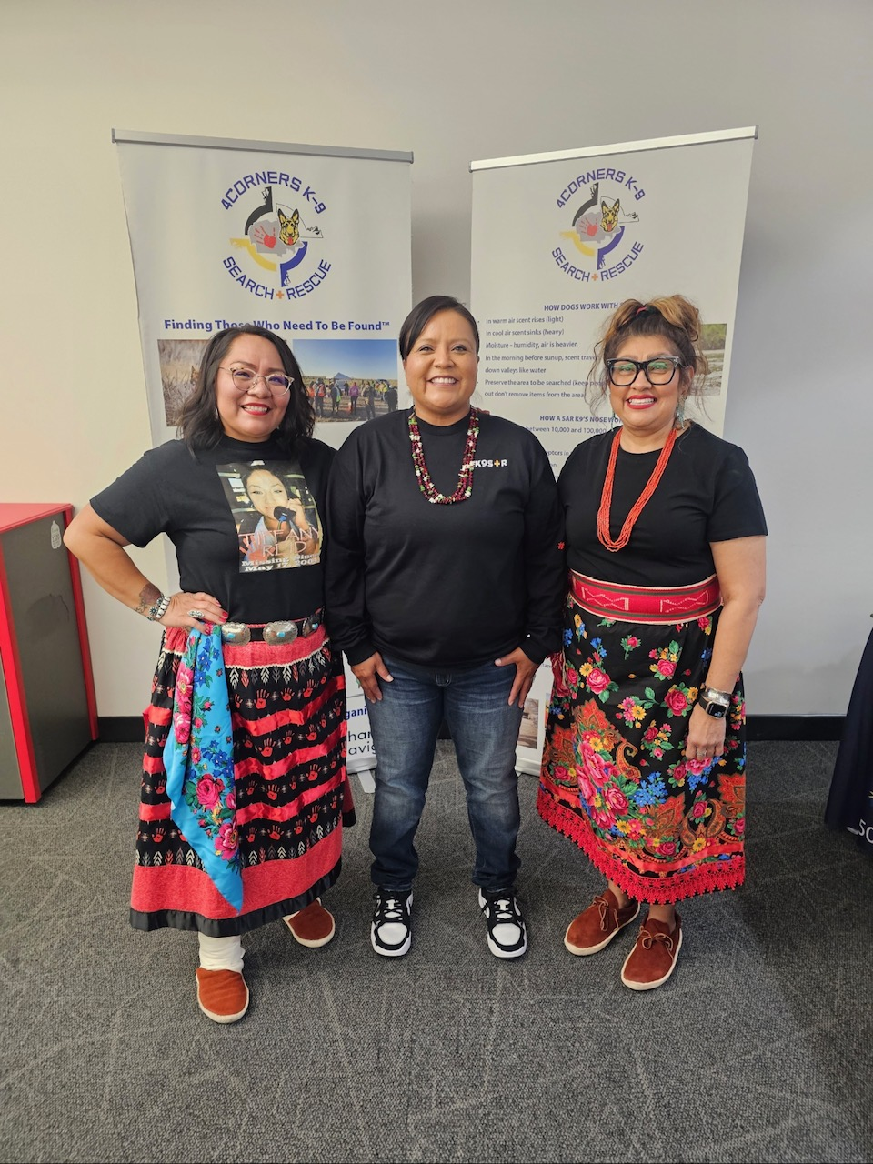
Discussion Rules
Be respectful of various perspectives
Be open to listening and learning
Be mindful of those present in room
Remember: We are all on the same team!

Slide 3

How is this Task Force Different?
Previous Task Force was created in 2019
  Drafted State Response Plan in 2022 in response to MMIP Crisis
  Disbanded in 2023
This Task Force was created by Senate Joint Memorial 2
  Members are unpaid volunteers
  SJM 2 specifically outlines categories of who should be on the Task Force
  Task Force voted for fully open meetings with the ability to close meetings to discuss sensitive or confidential subject matter.

Slide 4
What is this Task Force assigned to do?
SJM 2 identified two objectives for the NMDOJ Task Force:
Review and update the 2022 State Response Plan
    MMIWR_ResponsePlan2022_FINAL.pdf
Provide ongoing legislative recommendations on how to address the MMIP crisis in NM

Slide 5
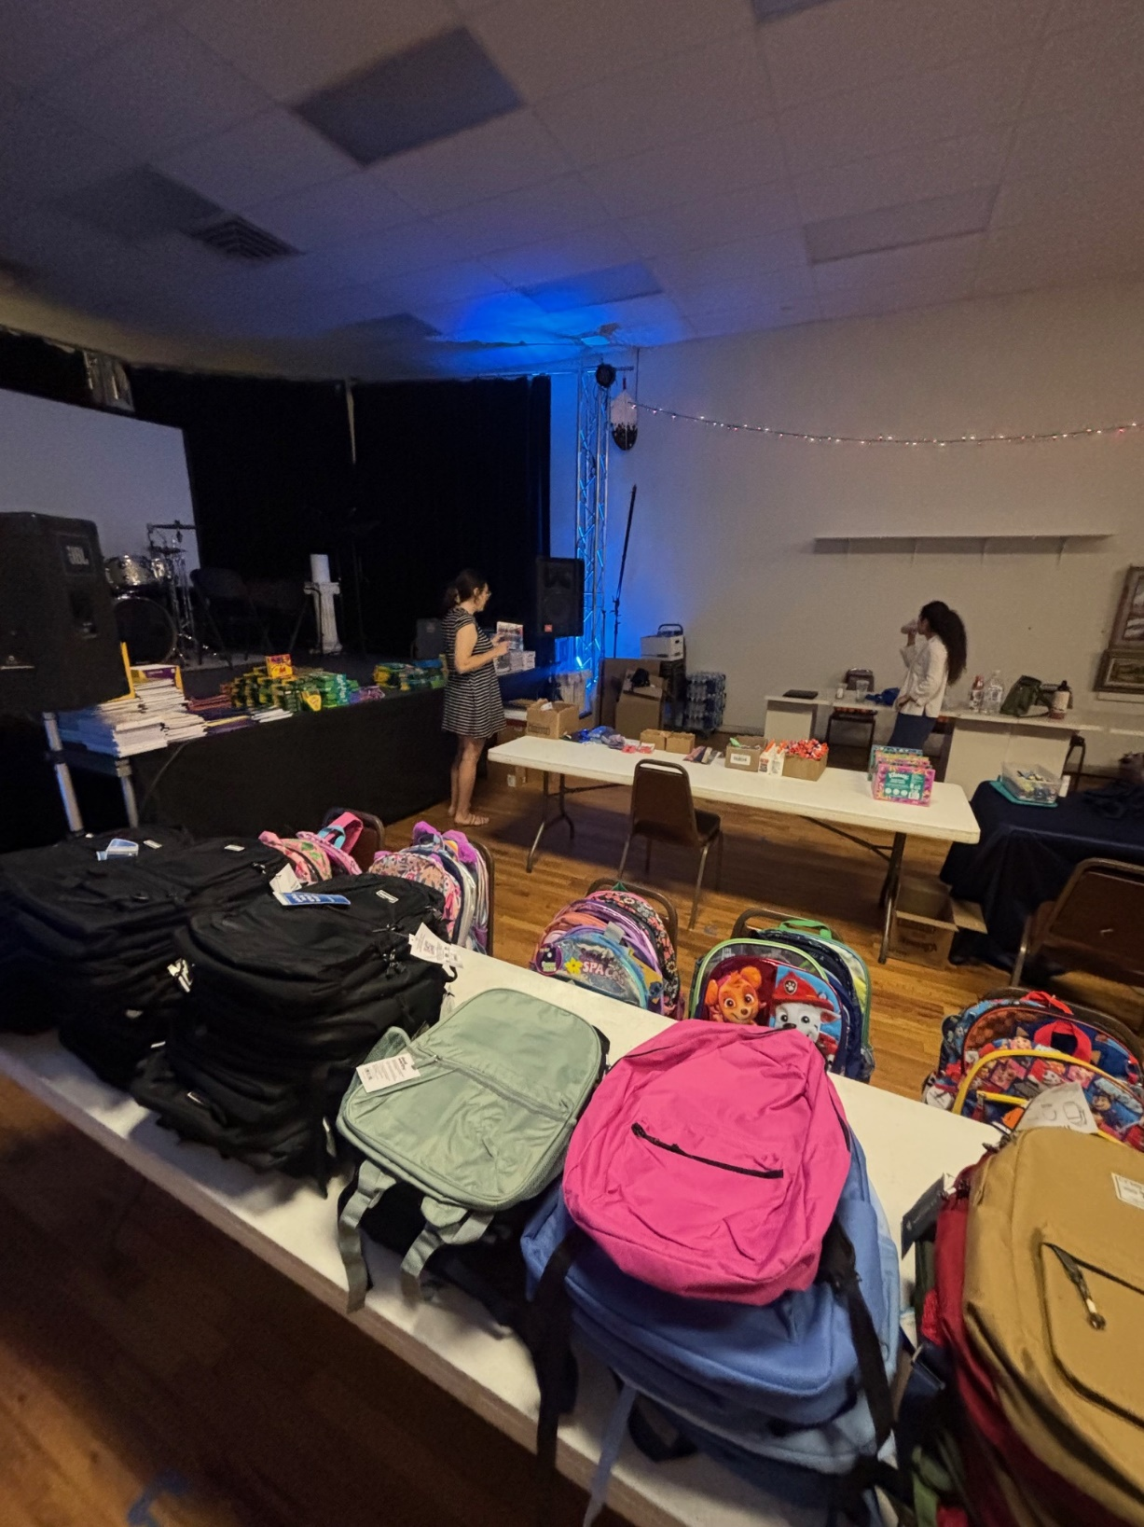
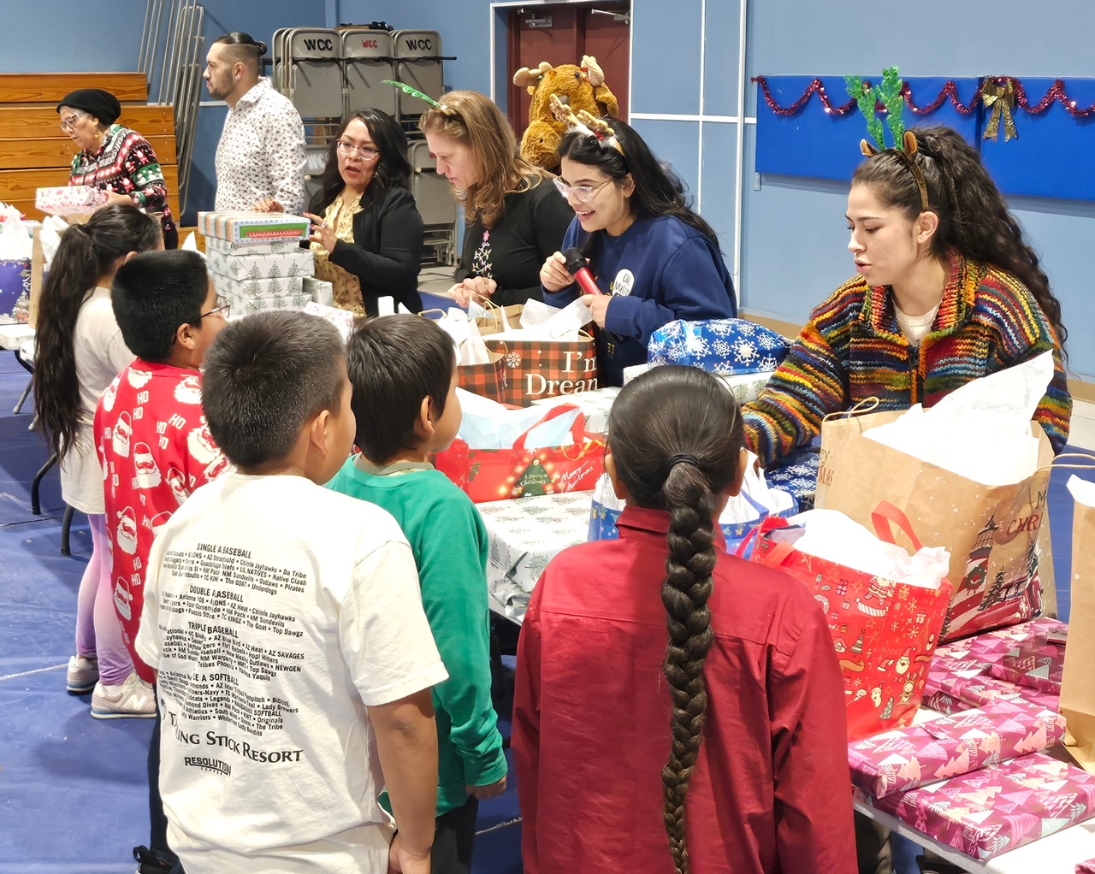
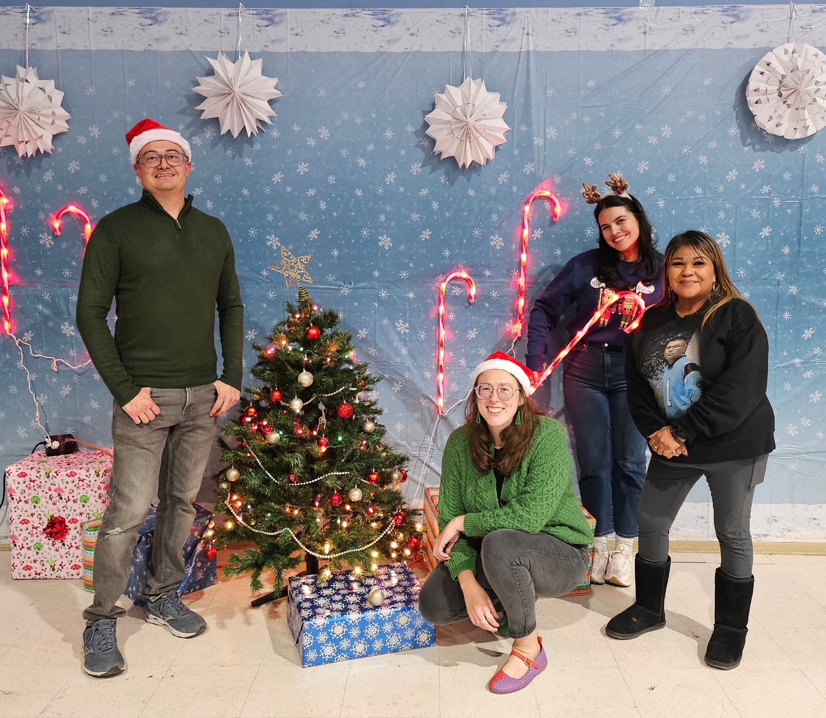
Holiday and Back-to-School Outreach Events

Slide 6
How will the goals be accomplished?
The majority of the work of the Task Force will be done through subcommittees:
  Legislative Subcommittee
  Information Technology Subcommittee
  Law Enforcement Training Subcommittee
  Resources for Tribal Judicial Systems Subcommittee
  Resource Data Subcommittee
  Community Impact Subcommittee

Slide 7

Community Impact Subcommittee
  Objective 1: Strengthen supports to communities, families, and survivors of MMIP – Support Services for Survivors
  Objective 2: Expand youth programs and community education to raise awareness and prevention and sexual violence
  Objective 3: Strengthen supports to communities, families, and survivors of MMIP and develop community resources for strong responses

Slide 8

Resources for Tribal Judicial Systems Subcommittee
Objective 4: Leverage resources for tribal judicial systems
Law Enforcement Subcommittee
Objective 5: Increase law enforcement capacity to prevent, investigate, prosecute, and report MMIP cases

Slide 9

Data Subcommittee
Objective 6: Develop standards and capacity for data to be reported and documented accurately and used to support prevention and response
IT Subcommittee
Responsible for working with the NMDOJ on Portal and making any other relevant technological recommendations

Slide 10
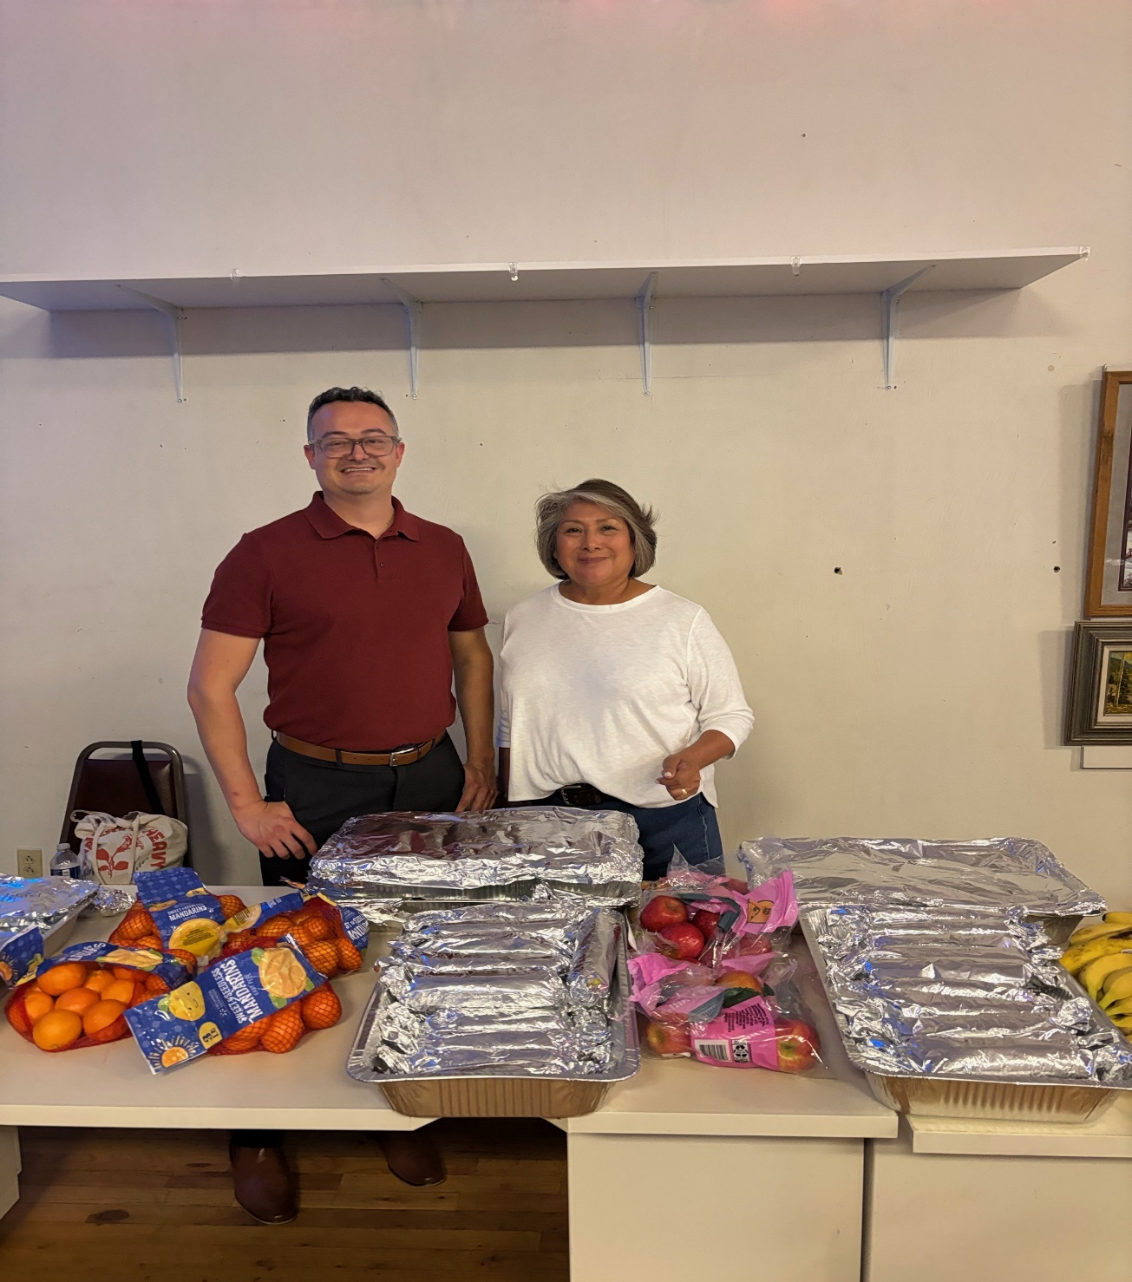
Legislative Subcommittee
Responsible for meeting with other subcommittees and presenting legislative recommendations on behalf of the Task Force.
Community Impact legislative recommendation: More funding for the NM Crime Victim Reparation Commission (CVRC) to assist in their financial support to Coalition to Stop Violence Against Native Women.

Slide 11

Family Subcommittee
New Subcommittee as of March 2026
Outreach subcommittee for families impacted by the crisis- focus is on speaking with and following up with families on needs and resources as well as taking lead on potential listening sessions.

Slide 12
NMDOJ MMIP Webpage and Portal
  Seeking Justice for Missing and Murdered Indigenous Peoples - New Mexico Department of Justice
  Welcome to the NMDOJ MMIP Portal for New Mexico and the Surrounding Areas

Slide 13
NMDOJ Indian Affairs Division
  Act as legal counsel to MMIP Task Force
  Liaisons for all 23 Nations, Pueblos, and Tribes in New Mexico
    Contact us with any questions or concerns, whether it’s related to MMIP or not
    May also contact Chair, Stephanie Padilla, with questions or concerns.

Slide 14
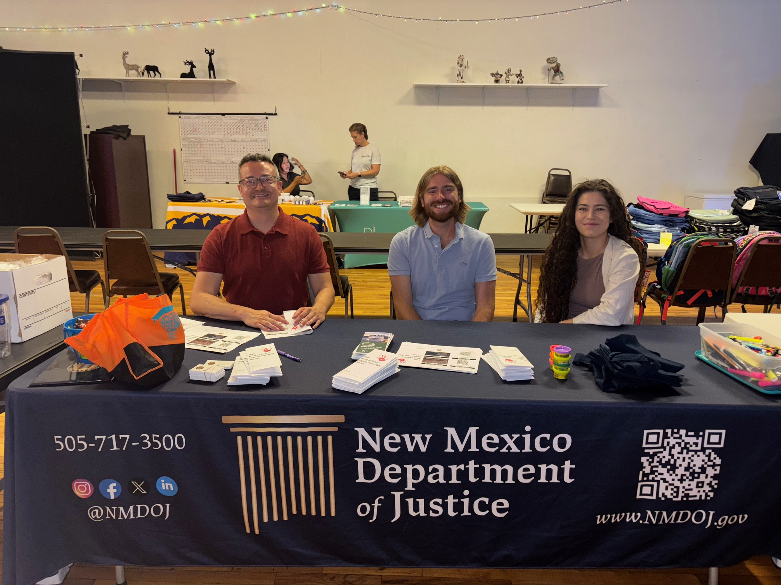
NMDOJ Indian Affairs Division

Slide 15
Request for Tribal Input
What resources do your communities currently have for survivors and family members facing the crisis that work for them? Is there something specific you wish your community had but lacks at this time?
What state resources (if any) do your community members trust or utilize which you would like to see better supported or strengthened? *This could be any agency or state system
What gaps do you wish could be filled between tribal and state resources/agencies?
Does your community currently partner with any state agencies for funding related to the crisis?
What are your or your community’s concerns regarding the MMIP crisis?
What are your concerns regarding data sovereignty?
What other recommendations do you have for the Task Force?

Slide 16

Questions?
Contact Info
Stephanie Padilla
Chair
Deiandra Reid
CSVANW
Michael Kiehne
NMDOJ
505-869-5574
505-574-7448
505-627-3487
Stephanie.padilla@isletapueblo.gov
dreid@csvanw.org
MKiehne@nmdoj.gov

Slide 17

MMIP Task Force Survey

