Slide 1
Centering Survivor Autonomy in Legal Advocacy: Balancing Safety, Strategy, and Choice
Hailey Zock, staff attorney
Southwest Women’s Law Center

Slide 2
Disclaimers
Legal Disclaimer: This presentation is for informational and educational purposes only and does not create or establish an attorney-client relationship
Personal Disclaimer:
I believe we all have room to grow, and that learning is ongoing.
As I strive to do better, I know there may be times when I misunderstand, accidentally say something harmful, or simply get something wrong.
If I ever say or do something that does not sit right with you, I welcome that feedback. My intention is never to cause harm, but I know that my intent does not matter more than how my words or actions are received.
While I recognize it is not others’ responsibility to carry my growth, I want to be clear that I deeply appreciate feedback and accountability.
Please do not feel shy about calling me in or calling me out.
Notes:
Note my use of general terms such as “client,” “survivor,” “mom,” “dad,” “partner,” “abuser,” etc. These terms are used for clarity and anonymity. Survivors’ identities, relationships, and experiences are diverse and complex and my use of these terms is not intended to diminish this.

Slide 3
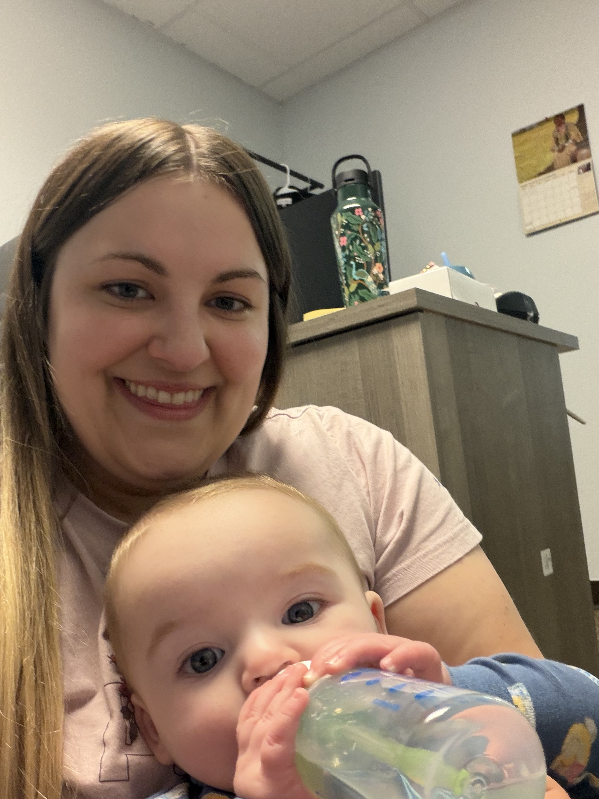
About Me
UNM Law graduate
Bachelors in Psychology and Political Science
I provide free legal representation, advice, and brief services to Native individuals experiencing DV/IPV
Focus on helping survivors navigate family law matters in Tribal Courts in NM
Protection Orders, Custody, Child Support, Safety Planning, and related legal issues

Slide 4

Learning Objectives
By the end of the presentation, you will be able to:
Identify common ways legal advocacy can unintentionally undermine survivor autonomy
Apply practical strategies for supporting survivor choice while still meeting legal and safety obligations
Navigate advocacy when survivors are hesitant, resistant, or distrustful of legal systems
Reflect on your own advocacy defaults and how to move beyond one-size-fits-all approaches

Slide 5
Power Imbalances in Advocacy & Legal Systems
Recognizing power imbalances in domestic violence relationships
Power within broader historical and cultural contexts
Examining advocacy-related power dynamics: advocates’ knowledge of systems vs survivors’ lived realities
“Best practices” can unintentionally override survivor autonomy and can become paternalistic
Understanding informed consent

Slide 6
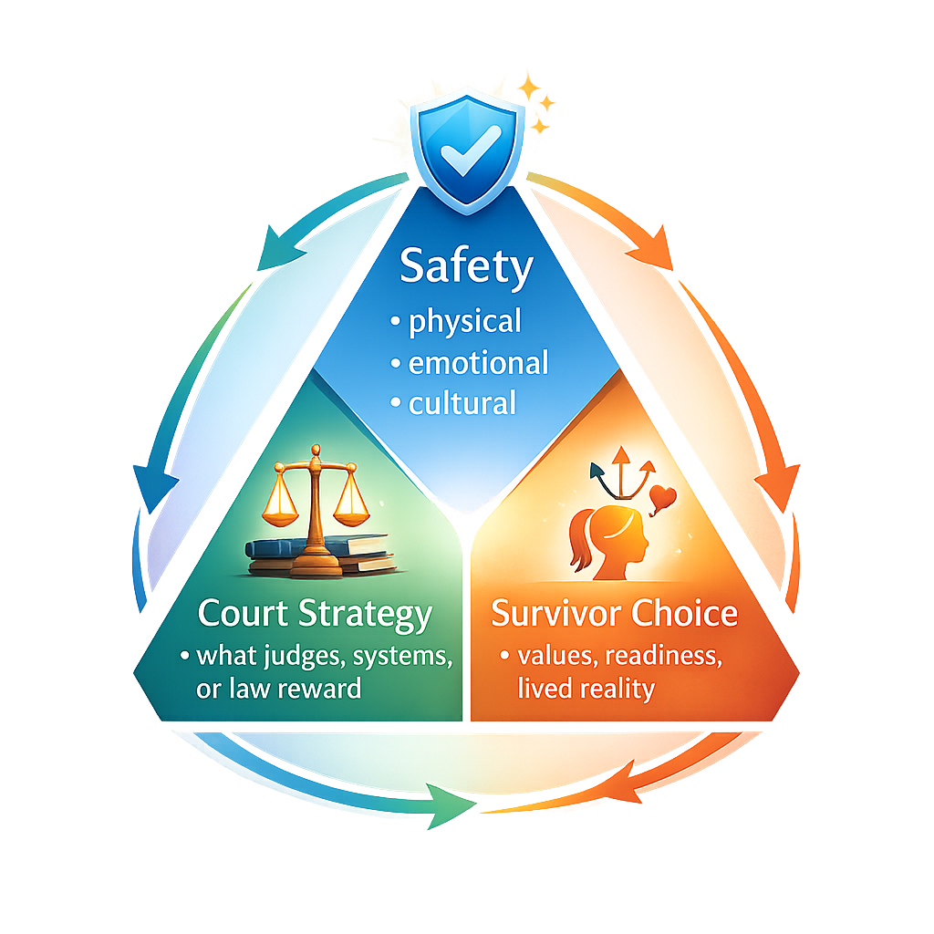
The Tension Triangle: Safety, Strategy, and Choice
Tension triangle framework:
Safety: physical, emotional, cultural
Court strategy: what judges, systems, or law reward
Survivor choice values, readiness, lived reality

Slide 7

Safety & Advocate Experience
Our own experiences can impact our advocacy
Secondary Trauma
Compassion fatigue
Experiences of other clients
Internalizing outcomes

Slide 8
Court Strategy
Court expectations versus reality
Client behavior and abuser behavior
Petitions
Evidence
Protection Orders
Severe Emotional Distress evidence
Physical harm evidence
Impactful evidence
Custody
Courts view of social services versus clients
Upholding status quo for children

Slide 9
Supporting Survivor Choice
Clearly define your role
Foster trust
Listening time vs Strategizing time
Understand their goals
Offer options, not directives
Explain risks, benefits, tradeoffs
Ensure understanding (parrot back or ask “why?”)
Use consent-forward language and center survivor expertise
Distinguish legal requirements vs recommendations
Document informed consent

Slide 10

Informed Consent
The client understands their options
They understand risks and tradeoffs
They are not being pressured
They are choosing based on their values and realities

Slide 11
What does this look like in practice?
Define your role: “I am your advocate, I am here to help guide and support you through this process. I will let you know what is legally required and I will give you my advice, but just know I act on your behalf and you make the decisions. I can’t do anything illegal or unethical. But, if there is something I don’t think is a good idea I will advise you as to why, but you can tell me to kick rocks.”
Trust: “To do the best I can, I need you to trust me and know that I would never judge you.”
Examples: Text messages, lying to providers/police, violating a protection order

Slide 12
What does this look like in practice?
Understand their goals: “If you could get everything you wanted out of these cases, what would that look like for you?”
Offer options, not directives: “Here are your options, what feels right for you?” “You don’t have to make this decision today. You can think it over and reach out with any questions that might pop up.”
Make note of the risks, benefits, tradeoffs of each option
Use consent-forward language and center survivor expertise: “You should file for a protection order” vs “Would you like me to talk you through the benefits and limits of protection orders?”
“You know your situation best.”

Slide 13
Case Examples
A survivor who qualifies for a protection order but does not want one
A survivor whose parenting plan conflicts with expectations
A survivor who wants outcomes advocates believe are risky
A survivor with prior negative experiences with courts, law enforcement, or social services
Questions:
What is your instinctive response as an advocate?
Where might autonomy be unintentionally limited?
How can you support choice while still offering informed guidance?
What language reinforces survivor control rather than compliance?

Slide 14

Lessons Learned: When Survivors Don’t Want What the System Wants
What survivors have taught me about trust and readiness
Trust is built over time
Readiness is not linear
Hesitation is often protective, not resistant
Readiness can shift based on safety, resources, and timing
Survivors can change their mind, and that’s okay
Flexibility is a strength, not inconsistency

Slide 15

Lessons Learned: When Survivors Don’t Want What the System Wants
Why “success” looks different for different survivors
Success is not one-size-fits-all
Legal outcomes ≠ survivor well-being
Stability, safety, and autonomy matter
Survivors define their own goals
Pushing your own goals can cause issues

Slide 16
Lessons Learned: When Survivors Don’t Want What the System Wants
How to communicate and advocate for survivor choices within legal systems
Translate survivor choices into system-recognized language
Highlight survivor insight and lived experience
Document decisions as informed and intentional
Strategies for pushing back, professionally, against paternalism in courts and agencies
Reframe autonomy as safety strategy and emphasize thoughtful decision making
Validate court concerns, then redirect
Use neutral, system-aligned language
Avoid direct confrontation, focus on framing

Slide 17

Lessons Learned: When Survivors Don’t Want What the System Wants
What to do when clients are ordered by the Court to do things they don’t want to (ex: social services)
Acknowledge limits of court authority vs survivor autonomy
Help survivors understand what is required vs flexible
Explore ways to comply while minimizing harm
Maintain transparency about consequences
Continue to center survivor voice and dignity

Slide 18

The Autonomy Checklist
Whose goal am I prioritizing? The survivor’s or the systems?
Am I offering options or instructions?
Have I explained risks and tradeoffs without pressure?
Did I make sure the survivor understood all options?
Am I respecting the survivor’s timing and readiness?
If they choose differently than I would, will I still support them the same?

Slide 19

Questions?

Slide 20

Contact Us
EMAIL ADDRESS
hzock@swwomenslaw.org
PHONE NUMBER
(505) 244-0502
MAILING ADDRESS
7510 Montgomery Blvd NE, Suite 106
Albuquerque, NM 87109

