Slide 1
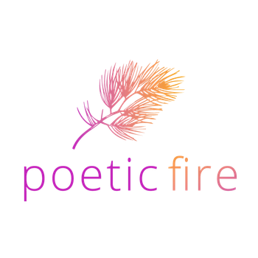

Igniting Healing
through Storytelling
April 7, 2026

Slide 2
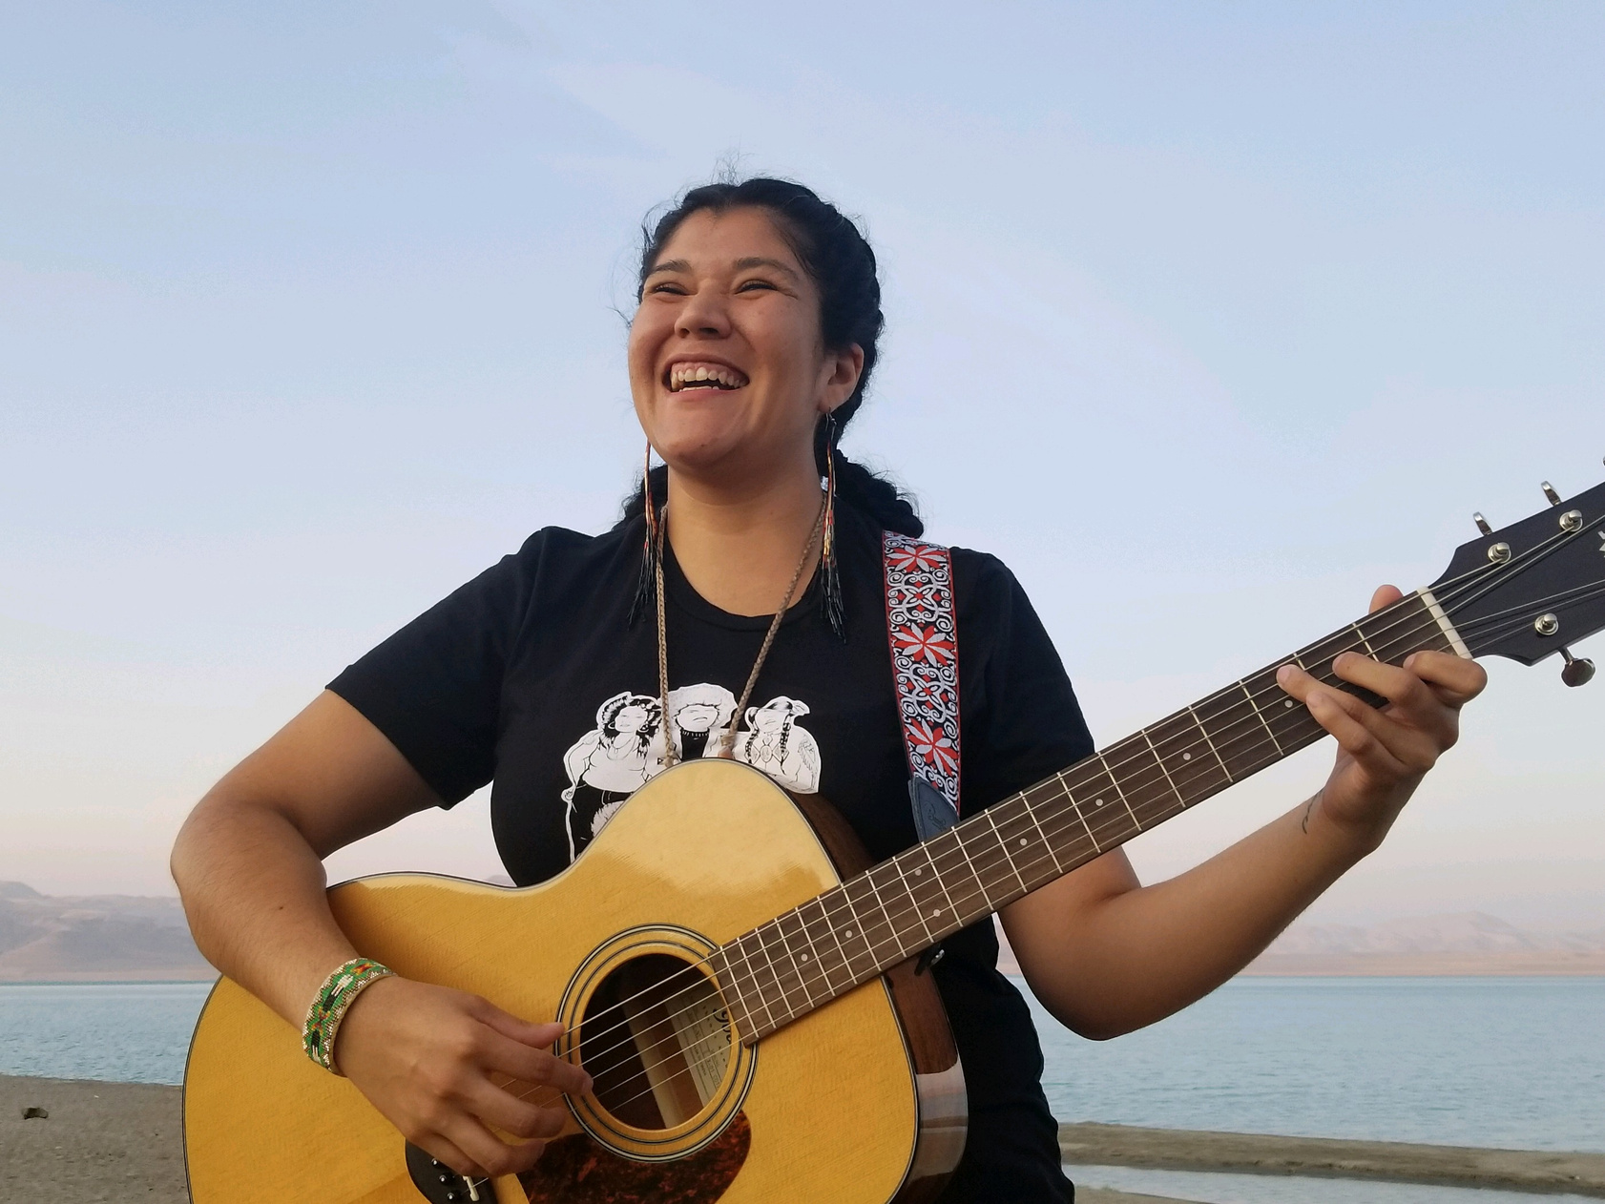
About Me
Tanaya Winder is an accomplished author, singer-songwriter, poet, and motivational speaker from the Duckwater Shoshone Nation. Her intertribal heritage includes Southern Ute and Pyramid Lake Paiute lineages. She holds a Bachelor of Arts from Stanford University and a Master of Fine Arts from the University of New Mexico. Winder's poetry collections include "Words Like Love" and "Why Storms Are Named After People and Bullets Remain Nameless." She combines storytelling, singing, and poetry to delve into themes of healing, love, and discovering one's purpose—what she calls "heartwork." Tanaya emphasizes the importance of storytelling as a form of medicine and encourages individuals to harness their voices as a source of power. To learn more about her work, you can visit: www.tanayawinder.com
Tanaya Winder
Author & Motivational Speaker

Slide 3
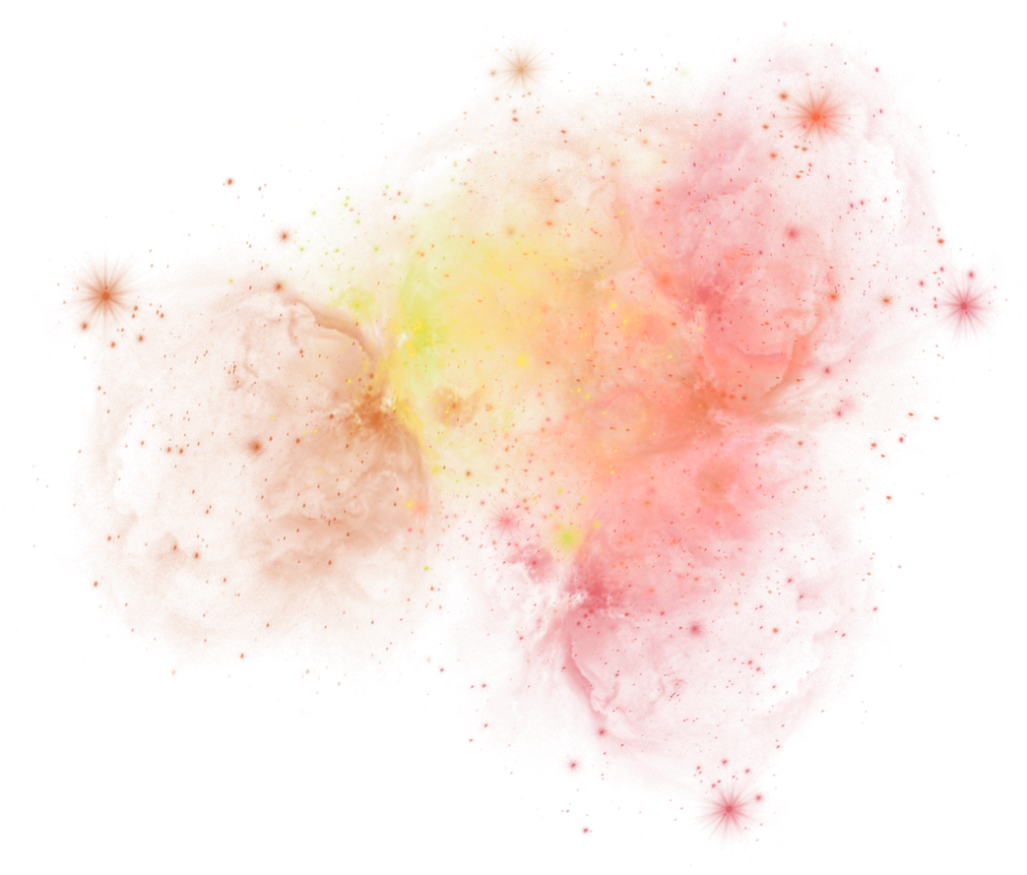
Welcome!
As individuals dedicated to serving our community, we engage in heartwork. “Heartwork” is the work each human being is born to steward during their time on Mother Earth. Serving others is a sacred practice that requires us to embody our values; it is about continuously learning what it means to be a healing being -- someone who lives, breathes, and advocates for justice, abundance, and healing for all.
Many of our family, kin, ancestors, and those we work with have experienced historical, ancestral, and personal traumas. Navigating these traumas so that soul wounds can heal is both challenging and essential. One way to ignite healing is by honoring the radical act of survival through speaking our stories and healing into existence.
This interactive breakout session offers an invitation to step into presence with like-hearted people, leaning into self-care as a form of communal care. Participants will engage in journaling prompts, breathwork, meditation, and other grounding activities. These practices will help you explore aspects of your journey that you wish to reexamine with compassion and kindness, while also allowing you to understand the medicine of the stories you carry. Attendees will leave the workshop equipped with prompts and activities that can aid them in supporting their clients, colleagues, and others they serve in sharing their own stories.
Through this breakout session, participants will
(1) Learn mindfulness techniques that can be applied in workshops and interactions with clients, families, and more;
(2) Understand storytelling as a form of medicine and recognize the power of presence as a tool for connecting with and understanding the human condition, particularly regarding self-love and compassion for others; and
(3) Explore and deepen your skill set to plant seeds of resilience that will blossom into ancestral strength and liberation.

Slide 4

Find Your Superhero Pose
Notes:
For me, I like to do this superhero pose. And I invite you all to stand up if you’re able (but you can also totally do it sitting down).
Let's get our bodies moving, let's get in our bodies. Some of us live our life in our heads always in doing mode, but this morning I invite you to get into being mode.
Be with me.
Put your hands on your hips. Imagine you are a superhero. Think about your fabulous cape that flows behind you. It’s wind powered by your ancestors.

Slide 5
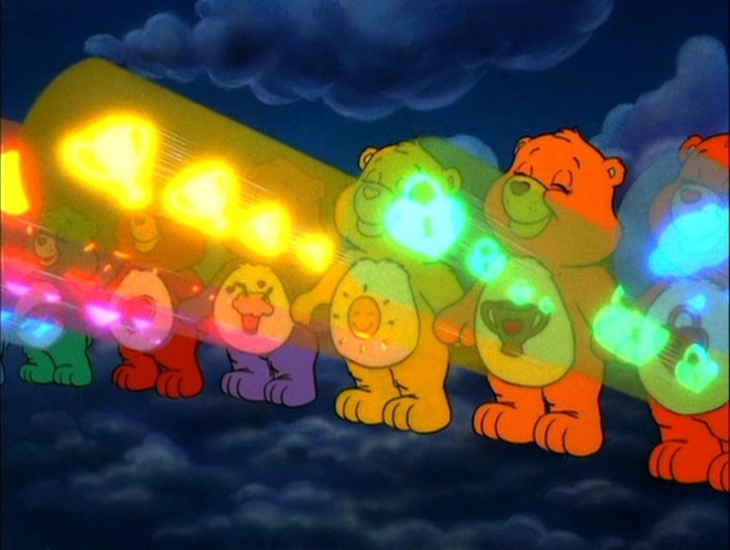
Find Your Carebear Stare
Notes:
And if you’re not feeling the superhero pose, you can also think of it as a Care Bear Stare!
What are you light are you letting emanate from you?
What gifts of yours are you wanting to project and share with this world to help build it in a better more loving, more inclusive, more equitable way?

Slide 6
Trust your power,
lean into your light.
Notes:
On our journeys to help uplift others, we learn how to further uplift (and heal) ourselves.
But, trusting the powers we have and trusting our light and our magic can be challenging especially in a world and society that has done everything it can to remove us from our power and our intuition.
Sometimes trusting our power or leaning into our light is difficult. Or, it can be difficult to access our light because we feel unworthy, not good enough, not smart enough, ill-equipped.
We might feel this way because we feel in the deepest, most private, intimate part of us that we are not whole. In fact, we may feel like we have an actual hole in our hearts.
So how can we get to the place where we can trust our power and lean into our gifts, lean into the light each of us carries within us.

Slide 7
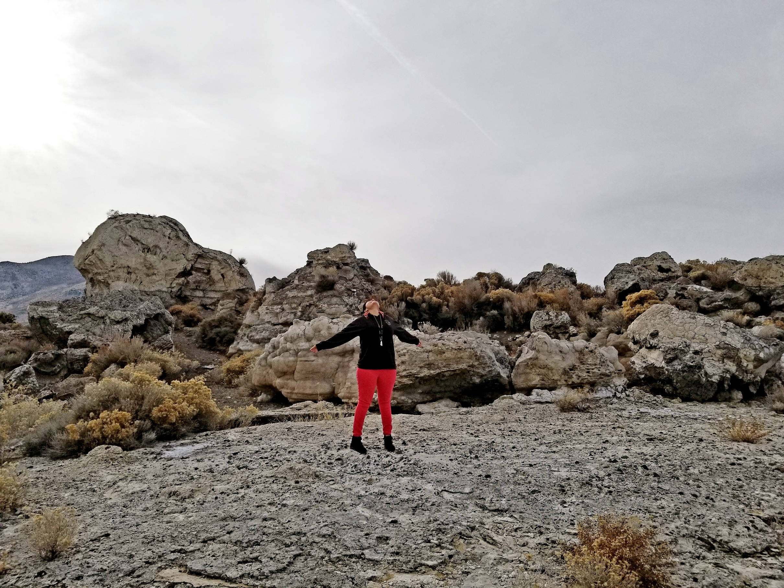

"I have to tell you something, I said. I'm not going to lie. I have to tell you. I have this God-shaped hole in my heart, and I think you do too."
- Richard Van Camp, The Lesser Blessed
Notes:
If this quote/sentiment resonates with you, you might be wondering "How can I let my heartwork lead me if I feel like my heart isn't whole?"
"How can I let my heartwork lead me if my heart has a hole in it that's so big that it's God-shaped? Creator-shaped? Universe-shaped?"
In my time with you today, I'll take you on a journey through what it means to live with purpose and how to honor your heartwork.
I'll share with you the guide posts that have been helpful to me in letting my heartwork lead me. On this journey we'll take together in the next 45 minutes, it may get heavy, it may get "real" but I ask for your trust that I'll bring us through the other side.

Slide 8
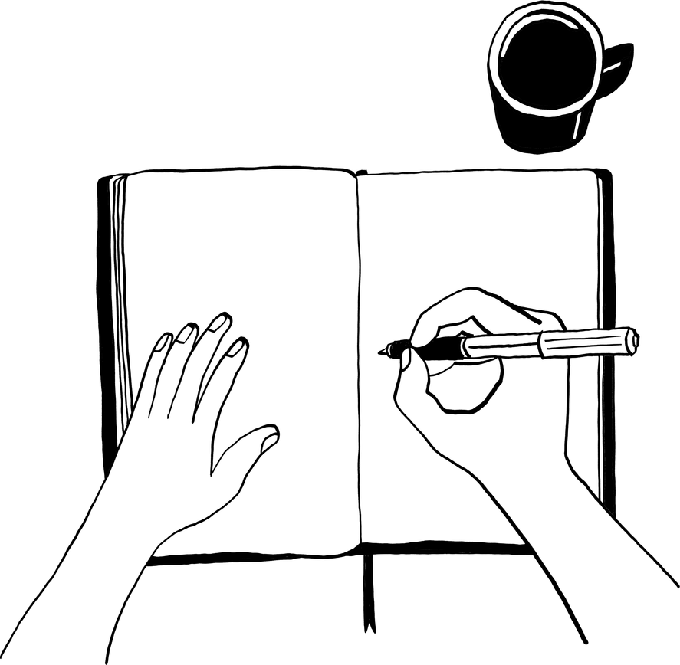
Expressive Writing -
What It Is & Who It’s For
Expressive writing is a type of therapeutic or personal writing that focuses on exploring and processing one’s emotions, feelings, and thoughts instead of focusing on grammar, spelling, or structure. This simple but powerful approach to writing can help you gain insight into your emotional, mental, and spiritual states, allowing you to better understand and support your growth and healing. Expressive writing is a powerful tool to process and release what you might be carrying inside. You can freely write about your experiences, thoughts, and emotions to reflect on and make sense of your experiences on your growth in a healing-oriented way.

Slide 9

Expressive Writing Lets You:
  Complete fragmented memories
  Create context for memories and emotions
  Identify triggers
  Address anxiety and persistent stress
  Uncover new insights about yourself and your experiences

Slide 10

How and Where to Start:
  One good tip is to use a pen and paper, not a keyboard
  Writing longhand uses many more areas of the brain than typing
  200+ research studies show enhanced learning capability with longhand writing
  Writing longhand allows for more creativity
  Writing longhand makes your brain slow down

Slide 11

Things to Remember
  Expressive writing is for you and you alone. So, it doesn’t matter whether the page is messy or the grammar is correct.
  Focus on telling your story and expressing whatever is in your heart or surfaces to the top of your mind.
  It’s okay to be nervous, anxious, or even scared about putting your thoughts and feelings in writing.
  It’s okay to trust the writing where it leads you even if you don’t know where it will take you or lead you.
  It’s okay to get emotional while you’re writing. Remember: feeling is healing. Give yourself permission to feel whatever emotions come up in your writing.

Slide 12

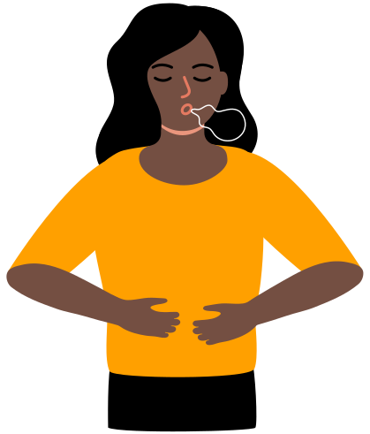
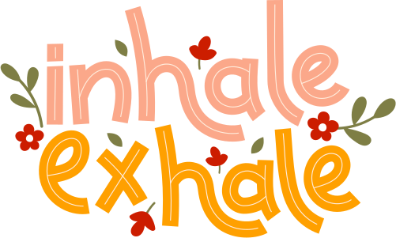
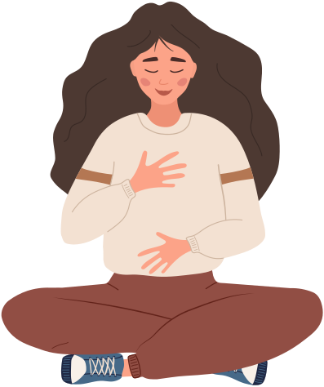
Getting Grounded: The Power of a Pause
Notes:
one foot in the doing and one foot in the being for balance
slowing down and having a powerful pause helps us move from misalignment to alignment
Soft belly breathing (M/B)
Our breath is always with us and one of the most powerful ways to tap into and influence our nervous system. Just as short-shallow breathing can quickly put the body into a fight/flight response, so can deep belly breathing with long exhales shift the nervous system into the parasympathetic or “rest and digest” state. Sleep, digestion, and healing can only happen when our parasympathetic nervous system is activated.
Soft-belly breathing stimulates the vagal or “wandering” nerve, which connects to all major organs in the torso including the heart and stomach. When we can take a long, deep breath, it means we are not in immediate danger and do not need to run from or fight; the fact we can take a slow deep belly breath is a way for the body to message to the brain that it can shut off the alarm, we are physically safe.
If closing your eyes feels good you can close them, otherwise soften your gaze as you look at whatever is in front of you. Begin bringing your awareness inward, to your breath.
As you continue breathing, breathe in through your nose, and out through your mouth at a slow, deep pace.
As you breathe in through your nose, bring your breath down into your belly, imagining your belly is like a balloon that is filling up with air on the inhale.
As you exhale, breathe out slowly through your mouth, extending the exhale as long as you comfortably can.
Continue breathing slowly and intentionally in this way; in through your nose, and out through your mouth. If it’s helpful for you, you can say in your mind, “soft” as you breathe in, and “belly” as you breathe out, reminding yourself to keep your belly nice and soft as inhale deeply.
To close the practice, we will close with one mindful breath together. Taking a nice big inhale through the nose, and a slow exhale out through the mouth.

Slide 13
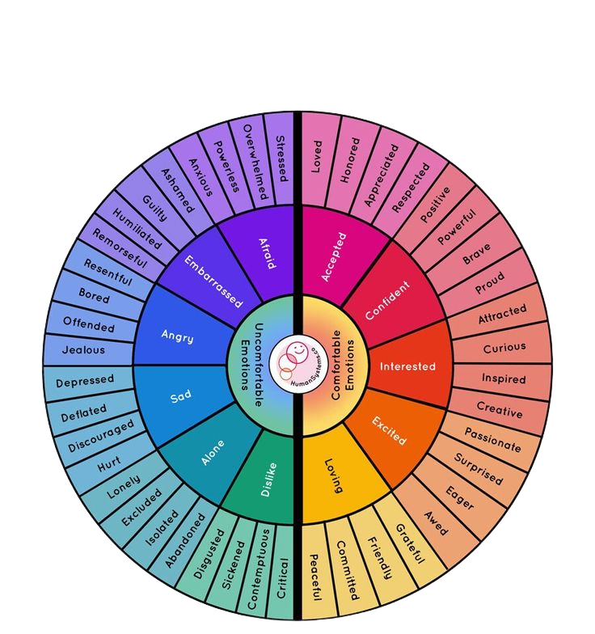
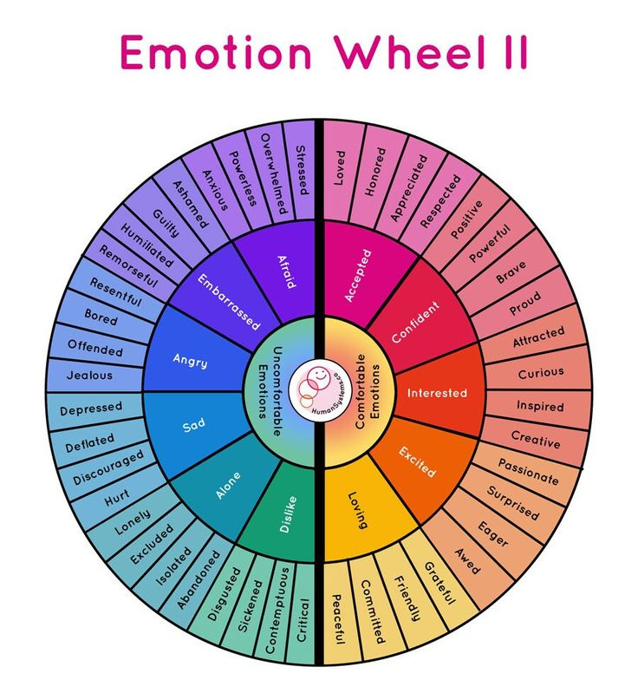
Notes:
Another good form of checking in is to check in with yourself on what your needs are.
Take a look at this Needs Wheel to see if you can identify a need that you have today, this week, in this moment. Once you've identified your need, remember the word or need you chose and think about it as we do a grounding breathing exercise.

Slide 14
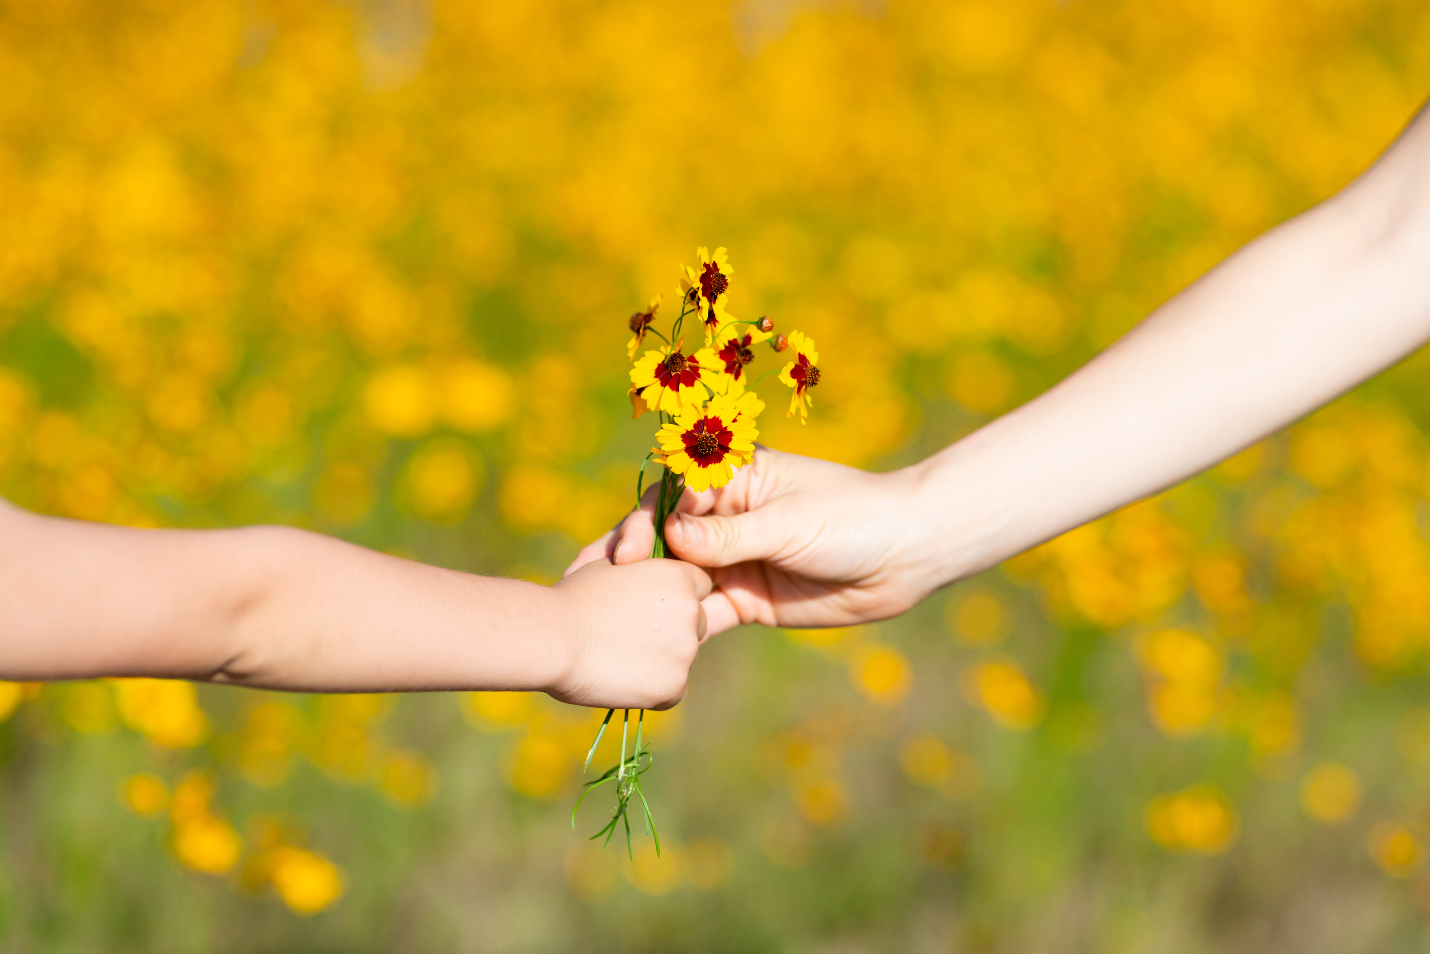
“There’s something revolutionary about creating a space for people to lay down what burdens them. We can carry our pain like a secret. We learn somewhere along the way that we are to blame for our own hurt, our shame, the feeling that we don’t belong. We bottle these secrets up, push them down, because we don’t have the time or space to look them in the eye or to fall apart. We find ways to cope, drowning our histories in substances or overwork, but we forget how, over time, the past and our efforts to stifle it erode our focus, our ability to be present, and our sense of power and agency in the world. Concealing this pain wears down our capacity for vulnerability and connection, and eventually our bodies, too. Our stories need airing out and places to land.”
― Prentis Hemphill, What It takes To Heal
Notes:
this is why healing from the inside out is so important to supporting the world we wish to build, to create the transformations we are dreaming of

Slide 15
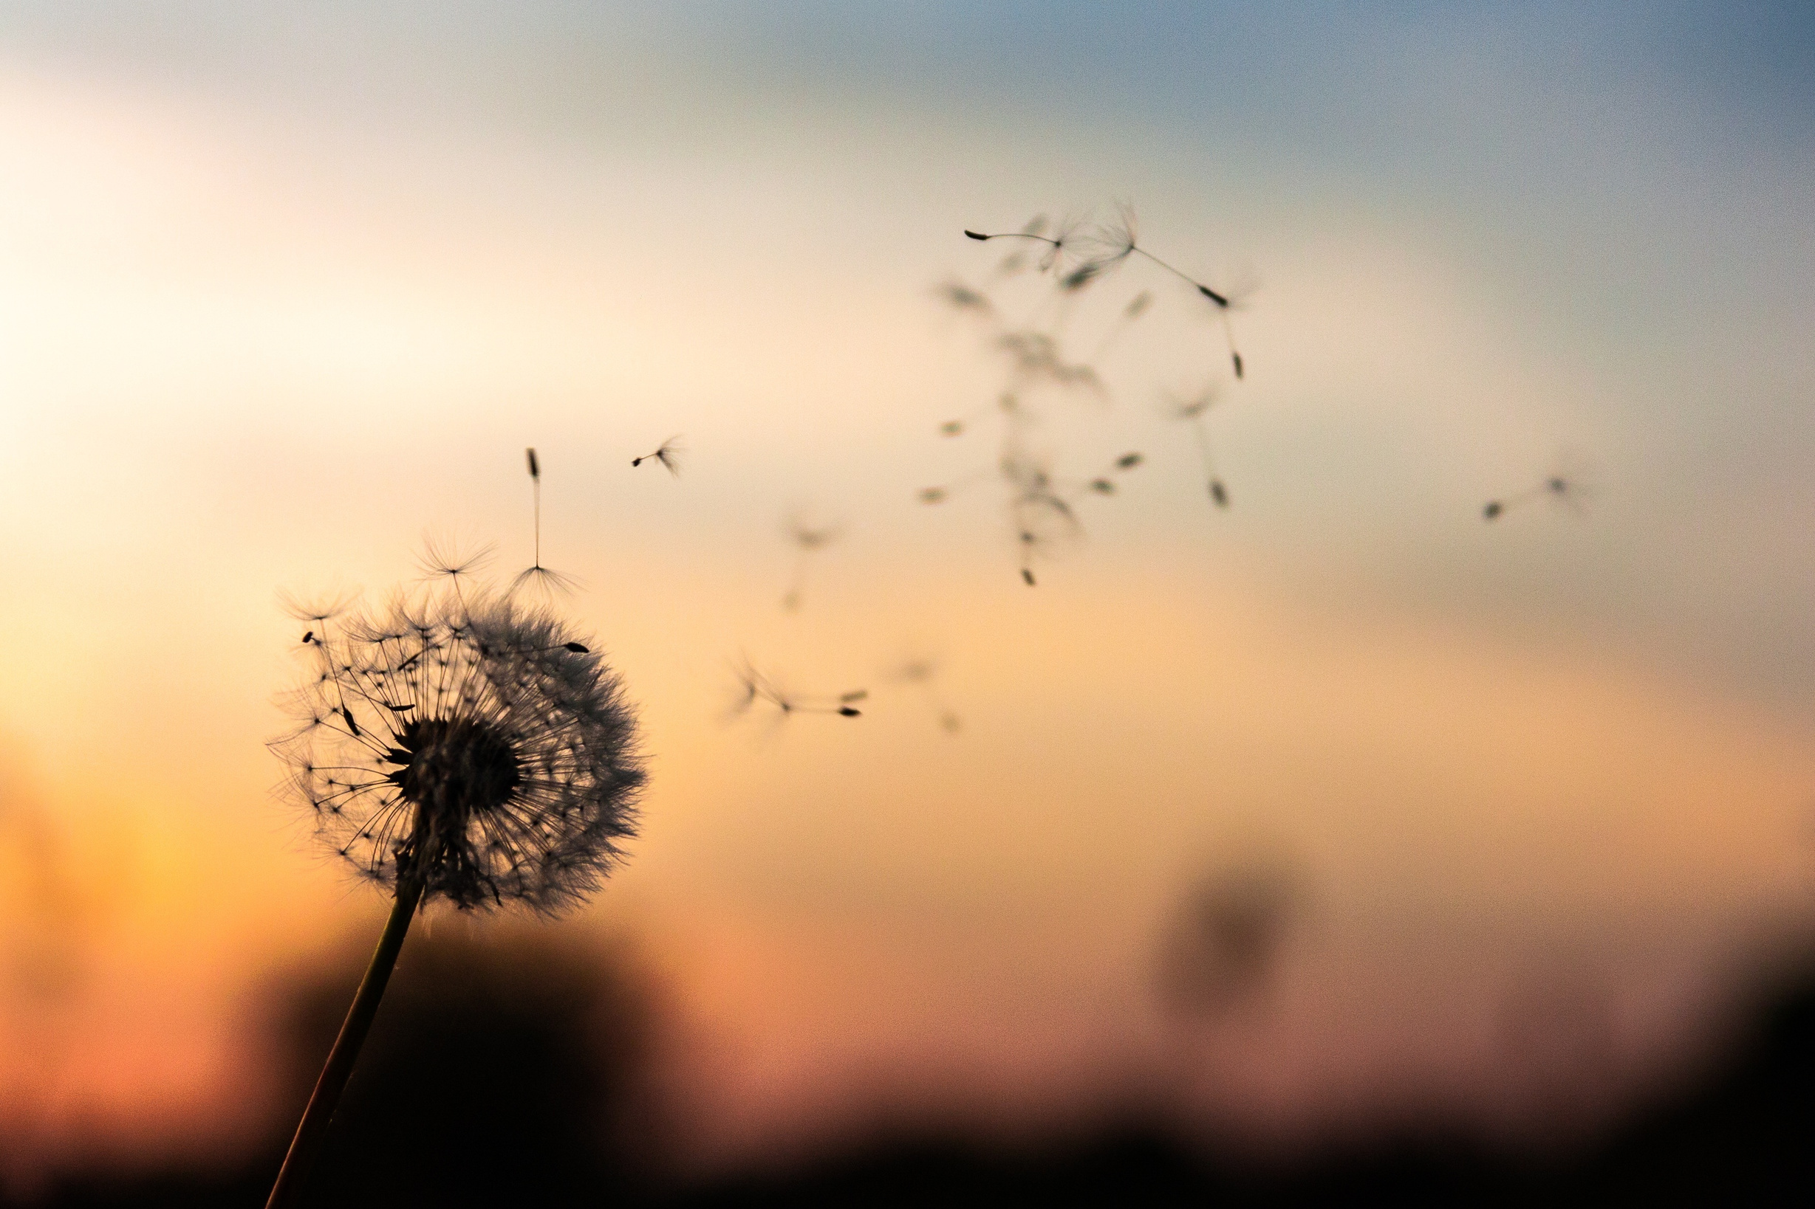
Words as Seeds
Notes:
briefly review what mom said about words being seeds, share some examples of Words as Seeds.
Because of my mom ingraining into me the power of words, that that our words can grow into something beautiful or harmful, something uplifting or empowering. it's why as a writer I believe in the power of words, that the stories we tell ourselves and each other can be healing, that words can be medicine.
and when we think of words in this way, we can use them as building blocks, seeds of empowerment, connection, belonging (and even healing) in our programming, the services we provide, and even our policies.
So as we spend this time together this morning, let's think about how we can infuse our values, beliefs, and stories into every aspect of our work.

Slide 16

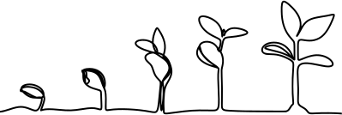
The Seeds We Carry
Journaling Prompt
Reflect and journal to the following questions:
  What words were spoken over you as a young person or child?
  What words do you carry with you today?
  What words do you wish were spoken over you?
  If you could speak to your younger self, what are some seeds you would plant?
Notes:
Each of us has experienced words spoken about us at different points in our lives. For example, when you were younger, someone might have told you that you were good at a particular task or activity. Perhaps you were told you were a good listener. When people speak these words into existence, they can plant seeds that take root in our hearts and minds.
Sometimes, the seeds planted in us are positive, full of hope, love, and good intentions. When those positive seeds are planted, it can feel like we have people cheering us on and wishing us good things. In a way, it could feel like an anchor, as if those positive seeds ground you no matter how hard life’s wind blows at you. At other times, the seeds planted in us (the words spoken to us) can be negative and feel hurtful or mean. Perhaps, out of frustration, someone may have told us we were unworthy, stupid, ugly, or bad. These negative seeds can have a greater impact on us than we realize. Instead of creating a healthy anchor for us to hold onto when we’re tested, upset, or unsure (like the positive seeds do for us), the negative seeds might try to tell us that the people who said bad things about us are right. We might even start to believe that we are unworthy or bad. We might begin to look for signs to prove it true.
Essentially, words can be about how someone sees you, and what can make it frustrating is that you don’t have any control over the words they use and say about you. Not having control doesn’t always feel good, and depending on what’s said and how you think about it, it can have either a positive or a negative effect on your life. When you’re a child or young, you have even less control over what is said about you and limited power in how you might express yourself. In this way, the positive and the negative seeds planted in our lives can have an impact on how we think of, believe in, and even love ourselves.
It’s important to note that positive and negative seeds can be planted in us using more than just words. Other people’s actions or inaction can also plant seeds in us. In this exercise, focusing on the words (seeds we carry) or perceptions of who you are versus how people see you can be beneficial to developing our healthy sense of self.
For this prompt, participants should free-write and journal for 5-7 minutes, reflecting on some of the words that were planted in their hearts, minds, or spirits.

Slide 17


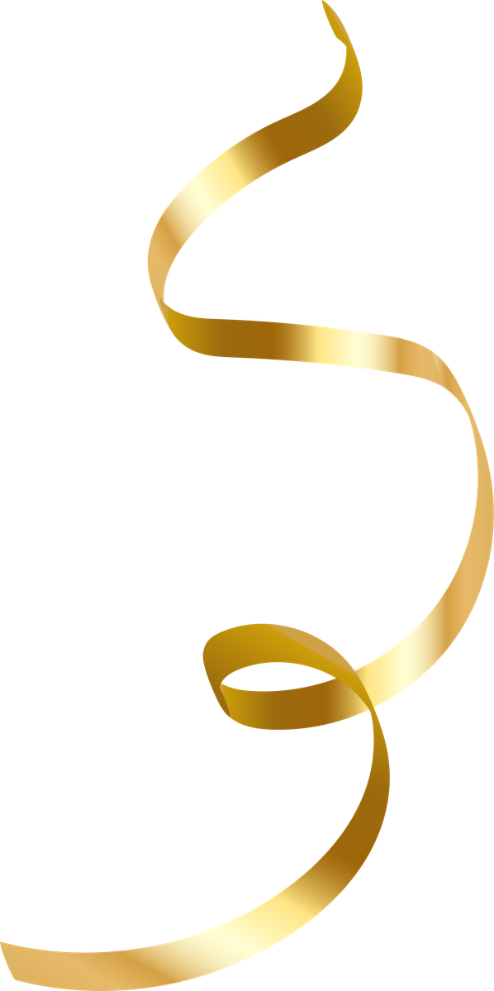


Sharing and Holding Space
Notes:
10-15 minutes
Group or share in pairs to prompts (Also can be used as time to reflect on what’s rising to the surface in this workshop)

Slide 18
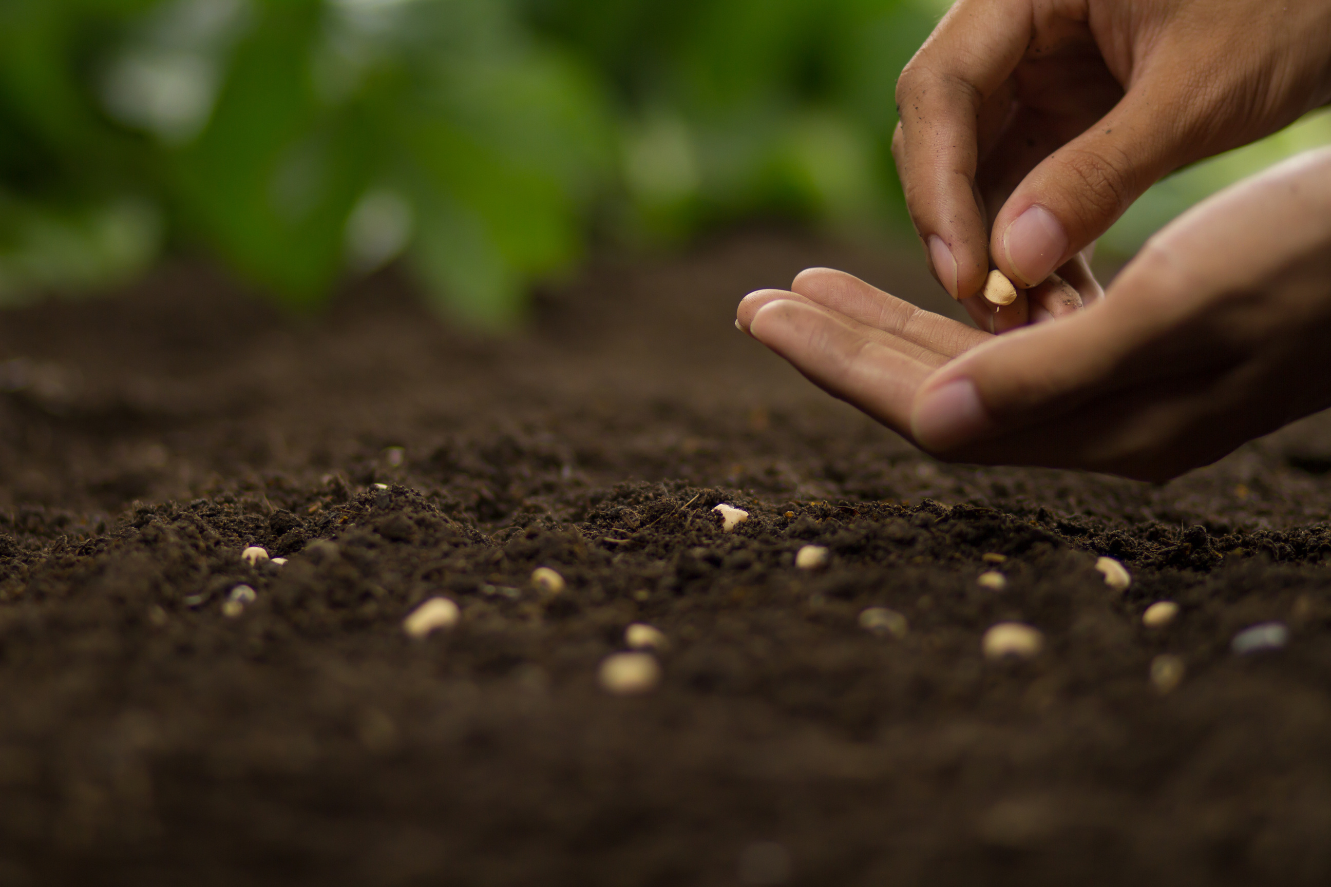
Guided Visualization
Notes:
Everyone, get comfortable in your seat or if you’re standing, find a relaxed stance. You can also lay down on the floor if you want to. Once you’re comfortable, I invite you to close your eyes or look somewhere not too far from you in a soft gaze. Take some deep breaths in through your nose and out through your mouth. Do this for four deep breaths.
Now imagine your ancestors, mentors, elders, or loved ones surrounding you. Each of them is using their breath of life to breathe good energy into you. Each of them are speaking love and good thoughts, wishes, and hopes for you directly over you, behind you, in front of you, and all around you. They are planting as many positive seeds as they can into your mind, body, heart, and spirit. Imagine what each of them is saying to you. Imagine receiving each of those seeds they’re planting in you, with open arms, welcoming in all the positive hopes and prayers they are gifting to you. Take a few deep breaths to breathe in that positivity and love.
Now, take a few deep breaths to express gratitude to your ancestors, mentors, elders, or loved ones who showed up to support you. Now, let’s all do one final deep breath together. When you’re ready, open your eyes. Think or journal later this evening, about how you will nurture and tend to the seeds that were planted in you today.

Slide 19
The Seeds We Carry
Journaling Prompt
Reflect and journal to the following questions:
  What positive words or wishes did you imagine your Ancestors planting in your life?
  What blessings did you imagine your Ancestors gifting you?
  What prayers did you imagine your Ancestors praying over you and for you?

Slide 20
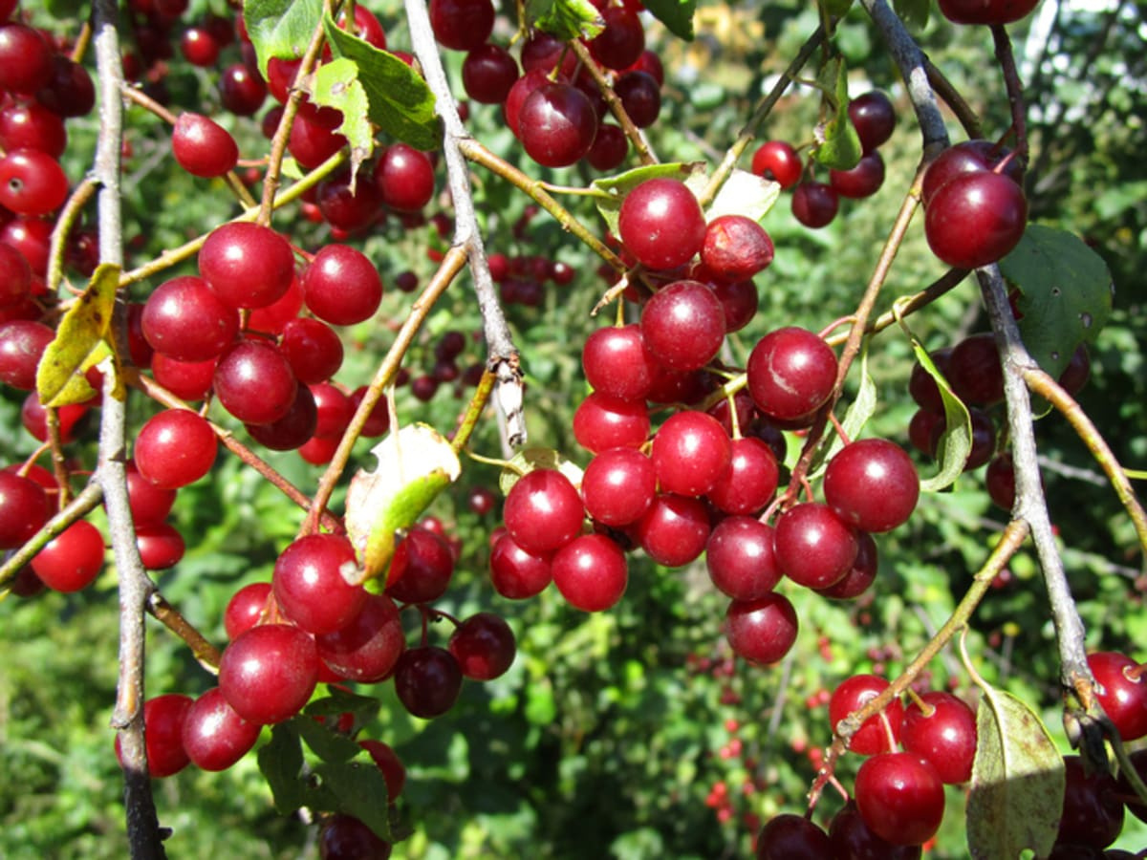

The medicine
is in the seed.
Notes:
Tell the story of the student in Owyhee who did a study on Chokecherry pudding with the seed that inhibits certain types of cancer cells from growing.
The medicine is in the seed. So what are the seeds of your programs? What core cultural values drive the work you do? And when we examine those seeds, ask yourself: what medicine is there? How are you activating that medicine in your work? In my Upward Bound example, I truly believe we activated that FIRE in our students to empower them to burn brightly in this world.
Again for me it is FIRE as a metaphor, it's also about circles.
https://ictnews.org/archive/bringing-science-culture-together-chokecherry-pudding#:~:text=Traditionally%2C%20the%20Shoshone%20and%20Paiute,School%20in%20Nevada%2C%20told%20ICMN.

Slide 21
Words as Seeds
Notes:
briefly review what mom said about words being seeds, share some examples of Words as Seeds.
Because of my mom ingraining into me the power of words, that that our words can grow into something beautiful or harmful, something uplifting or empowering. it's why as a writer I believe in the power of words, that the stories we tell ourselves and each other can be healing, that words can be medicine.
and when we think of words in this way, we can use them as building blocks, seeds of empowerment, connection, belonging (and even healing) in our programming, the services we provide, and even our policies.
So as we spend this time together this morning, let's think about how we can infuse our values, beliefs, and stories into every aspect of our work.

Slide 22
Sacred Liberation
Our healing journeys often require us to pause and reflect. Pausing and reflecting can take various forms, including asking ourselves powerful questions to help us dig deeper into what needs to be unearthed, replanted, or tended with more compassion and care.
If we think of our healing journeys through the framework of liberation, it can help us recognize that healing isn’t just about pain management or learning to cope, rather it is about freeing our hearts, minds, bodies, and spirits from what previously held us —trauma, fear, self-doubt, regret, or harmful patterns. When we think of healing as liberation, we can reframe it as freedom —the power, agency, and choice to grow into who we are meant to be.
Notes:
Let's reflect on what resonates from the poem or what it brings up.

Slide 23
Sacred Liberation
Journaling Prompt
Reflect and journal to the following questions:
  What is holding you back?
  What prevents us from healing past wounds so that we can move forward in a healthy way where old pains, hurts, and traumas are just experiences from our past and not something that controls our present?
  What do you want to release with tenderness, compassion, and maybe even understanding?
  Who or what could support you moving forward in your healing?

Slide 24
Sharing and Holding Space
Notes:
10-15 minutes
Group or share in pairs to prompts (Also can be used as time to reflect on what’s rising to the surface in this workshop)

Slide 25
Looking back is an act of bravery and it invites us to step into our courage
Notes:
any questions or clarifications?

Slide 26
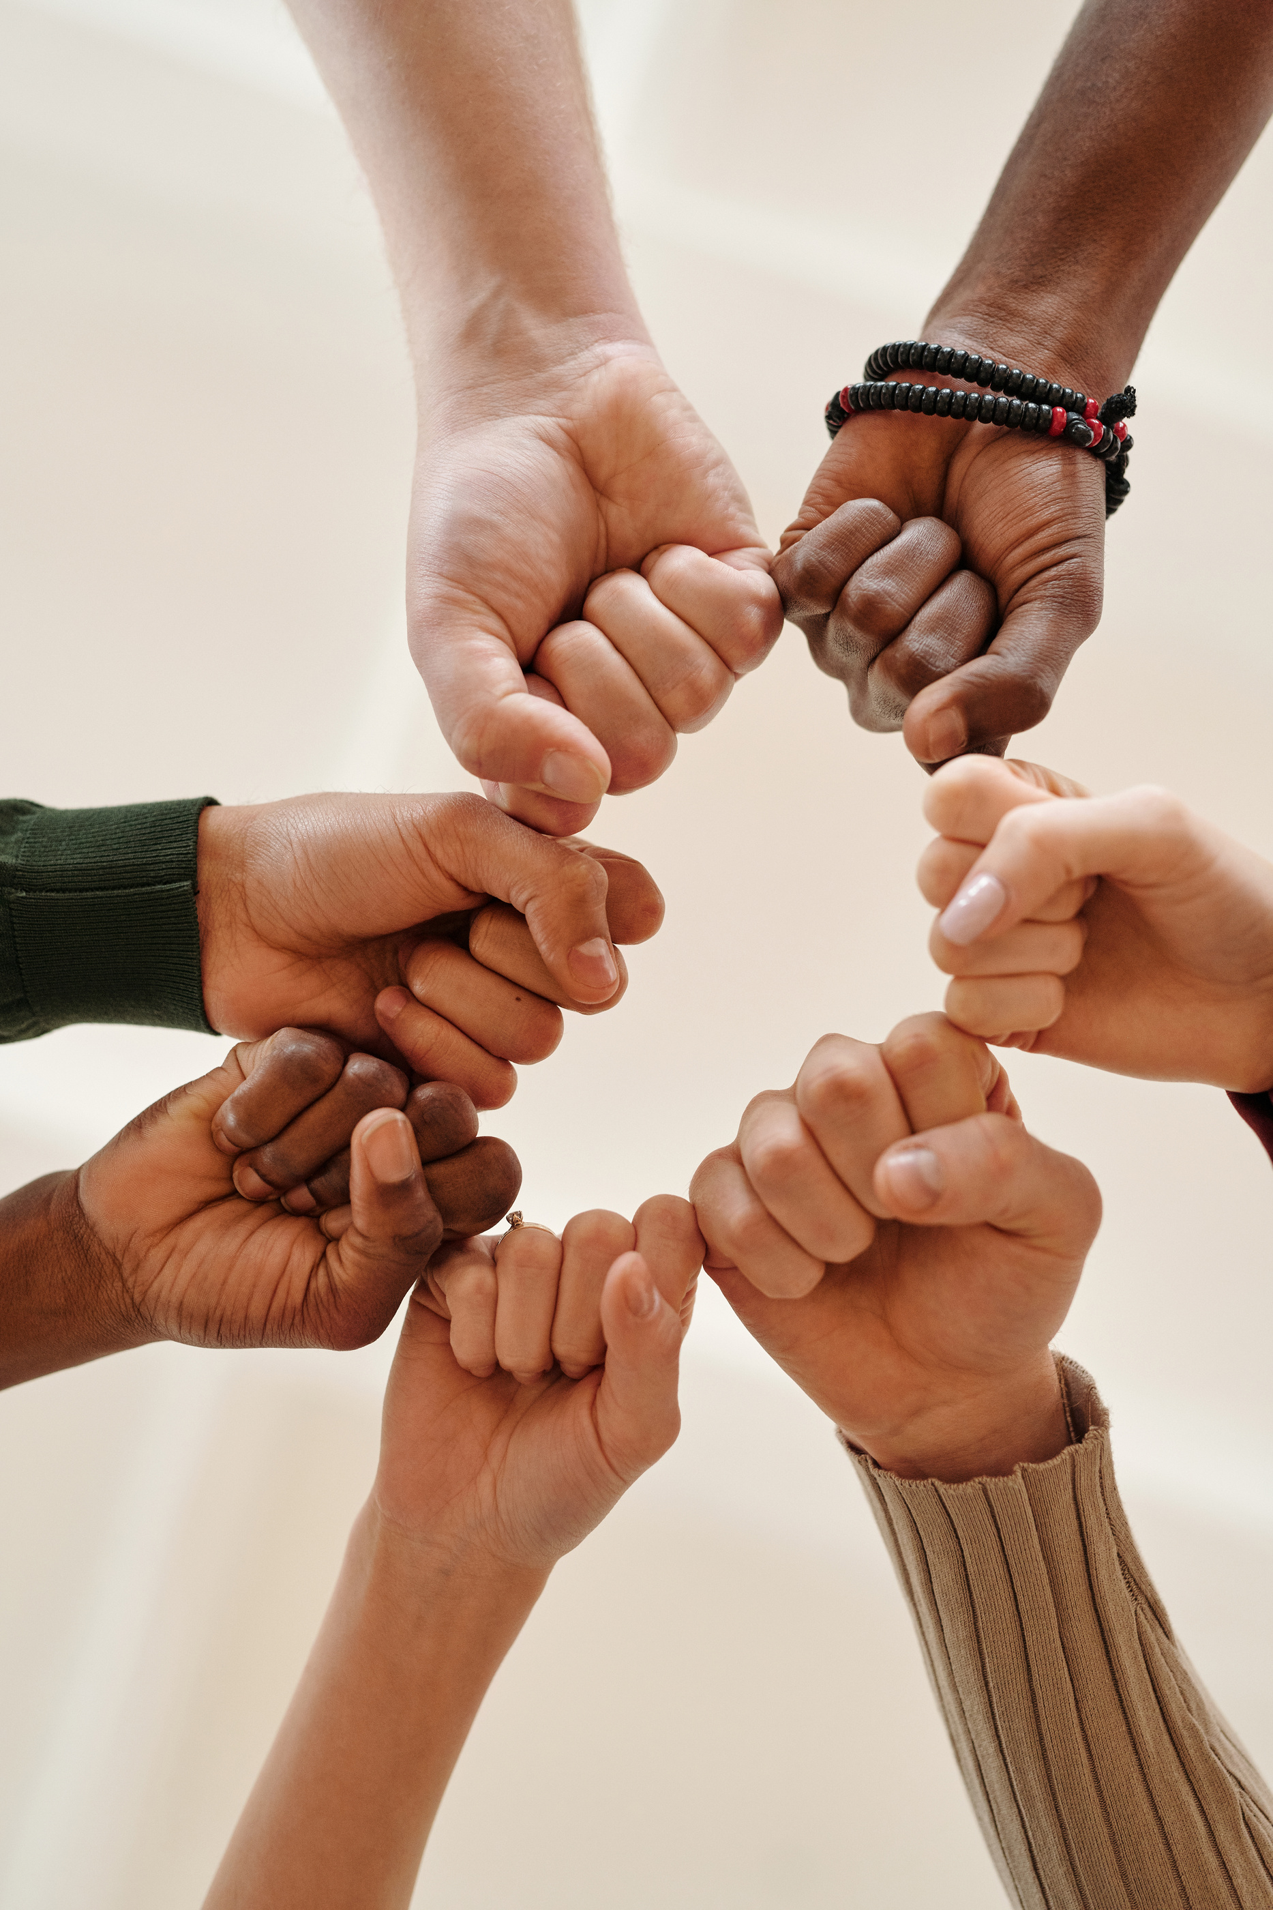
Notes:
Lead somatic exercise about Closed Fist
make a fist, clench it tight.
now put your other hand around that clenched fist to support it.
what if anything do you notice about the clenched fist?
did anything change with your clenched fist?

Slide 27
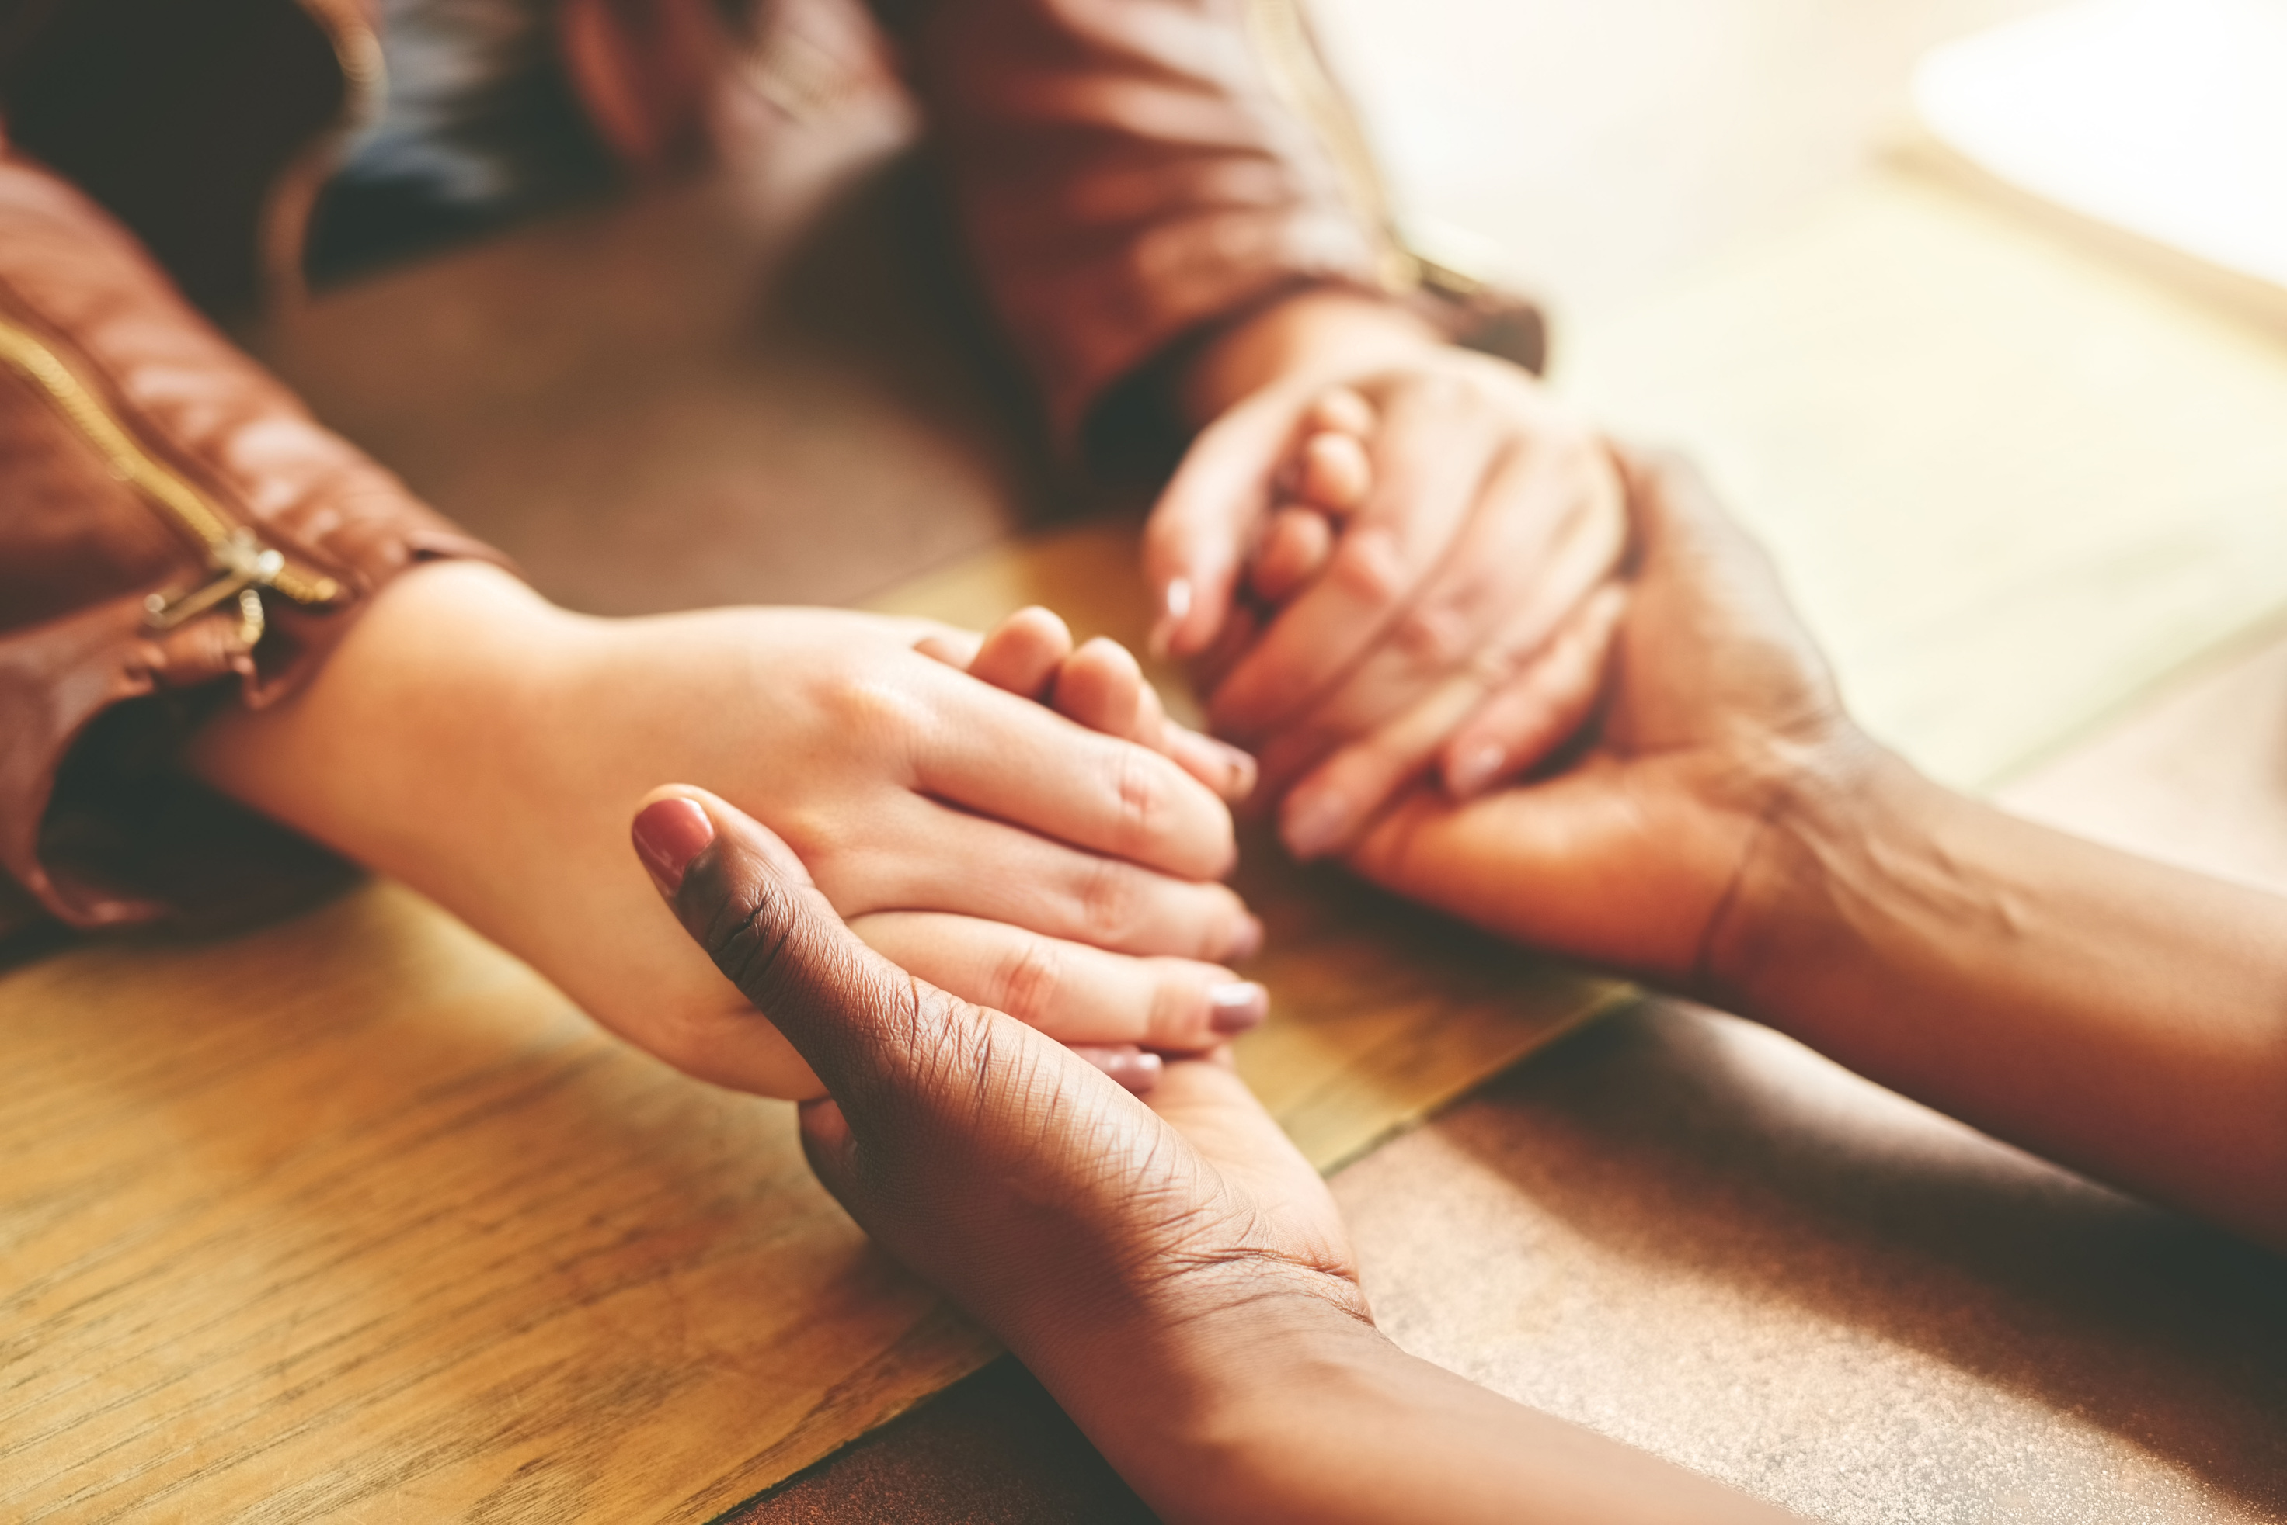
Notes:
what becomes possible for the clenched fists in our lives when they are offered support? or grounding?

Slide 28
Mantra Meditations
  I am enough
  All I need is within me
  In alignment, I am powerful
  May my heart’s wisdom shine through all I do
  All of me is welcome here. My feelings and emotions can take up space right now.
  I am here. I belong. I carry blessings.
Notes:
Mantra Meditations (choose one sentence and repeat it over and over in your mind while you breathe easily)
I am enough
All that I need is within me
In alignment, I am powerful
May my heart’s wisdom shine through all I do

Slide 29
Conversation Starter (orJournaling Prompt)
Manifesting Blessings
Write your own mantra that you want to carry and hold for yourself. Is it a phrase that you need to hear today? Is it a phrase that you want to use as an intention for this current season of your life? What would the ancestor version of yourself want you to know at this time in your life?
Notes:
Let's reflect on what resonates from the poem or what it brings up.

Slide 30
Partner Up!
Conversation Starter
Tell your partner about a time where you used or accessed your wisdom?
Notes:
Let's reflect on what resonates from the poem or what it brings up.

Slide 31
Partner Up!
Conversation Starter
Tell your partner about a time you were connected to love (or purpose) in a really big way.
Notes:
Let's reflect on what resonates from the poem or what it brings up.

Slide 32
When Giving is All We Have
a poem by Alberto Rios
One river gives
Its journey to the next.
We give because someone gave to us.
We give because nobody gave to us.
We give because giving has changed us.
We give because giving could have changed us.
We have been better for it,
We have been wounded by it—
Giving has many faces: It is loud and quiet,
Big, though small, diamond in wood-nails.
Its story is old, the plot worn and the pages too,
But we read this book, anyway, over and again:
Giving is, first and every time, hand to hand,
Mine to yours, yours to mine.
You gave me blue and I gave you yellow.
Together we are simple green. You gave me
What you did not have, and I gave you
What I had to give—together, we made
Something greater from the difference.

Slide 33
Getting Grounded Through PAUSE
Notes:
Guided Visualization: Now that participants have reflected on their trauma, lead them through a guided visualization, adapted from Leslie Avant-Brown's book, "Blooming Willow's Pause as a Practice."
Take a moment to ground yourself in your chair, feeling your feet planted on the ground, connected to Mother Earth’s healing energy. Breathe deeply and think of a behavior, thought pattern, or false belief that you no longer wish to carry—a burden you don’t want to pass on to future generations.
Imagine holding this burden in your hands. Visualize releasing it back to the person who raised you, who then passes it back to their parents, and so forth through your ancestral line. Each ancestor who loves you does so without judgment, passing it back gently and without shame or blame.
When it has been released as far back as you can imagine, envision your final ancestor letting it go into the universe—into the water, air, or back to Mother Earth. Take a moment to breathe and notice how you feel after letting go of this pain.
Now, visualize this ancestral figure deciding to offer you a beautiful gift. This gift could be words, an image, a feeling, or anything else you need most. See this gift being passed down through your ancestors until it reaches you. Imagine it entering your body as a beam of light, radiating throughout you. Spend a moment connecting to this experience.

Slide 34
Sharing Your Medicine
Journaling Prompt
Spend a few minutes reflecting on the poem and meditation. Did anything resonate with you? Let’s take some time to journal to the following questions:
  What gifts have I received from my ancestors?
  What gifts have I been given in this lifetime? What medicine do I bring?
  How do I share the gifts I’ve received?
  In what ways will I ensure that my magic, my medicine, and my power extend beyond myself?
  Why does your community, family, or network need the gifts or medicine you bring?

Slide 35
Earth Teach Me
Chief John Yellow Lark, Trans.
Earth teach me limitation
as the ant which crawls on the ground.
Earth teach me freedom
as the eagle which soars in the sky.
Earth teach me resignation
as the leaves which die in the fall.
Earth teach me regeneration
as the seed which rises in the spring.
Earth teach me to forget myself
as melted snow forgets its life.
Earth teach me to remember kindness
as dry fields weep with rain.
Earth teach me stillness
as the grasses are stilled with light.
Earth teach me suffering
as old stones suffer with memory.
Earth teach me humility
as blossoms are humble with beginning.
Earth teach me caring
as the mother who secures her young.
Earth teach me courage
as the tree which stands all alone.

Slide 36
The Path Before You
Journaling Prompt
Let’s take some time to journal to the following questions:
  How has Mother Earth (or your journey on her) taught you courage?
  Describe a time you—or someone you cared for—rose up again after hardship. What enabled that reawakening?
  How can Mother Earth remind us to be kind? Recall an act of kindness you gave or received during a tough time. How did it heal or nurture you?
  How can you show Mother Earth thanks for all of the lessons she offers us?

Slide 37
The Sacredness of Release
Writing Prompt
Reflect and journal to the following questions:
  What season am I in that I need to move on from?
  What do I need to let go of?
  Where am I holding myself back?
  What is a limiting belief you want to let go of? What would your new belief be?
  How might my not letting go impact my family? My work? My health? My spirit?
  What negative stories or limiting beliefs about yourself are holding onto tight-fistedly? What would it look like to release those beliefs in a loving way that honors the sacredness of how you were trying to protect yourself?
Notes:
"when we live in the past, we can no longer learn from it." Prentis Hemphill

Slide 38
Sharing and Holding Space
Notes:
10-15 minutes
Group or share in pairs to prompts (Also can be used as time to reflect on what’s rising to the surface in this workshop)

Slide 39
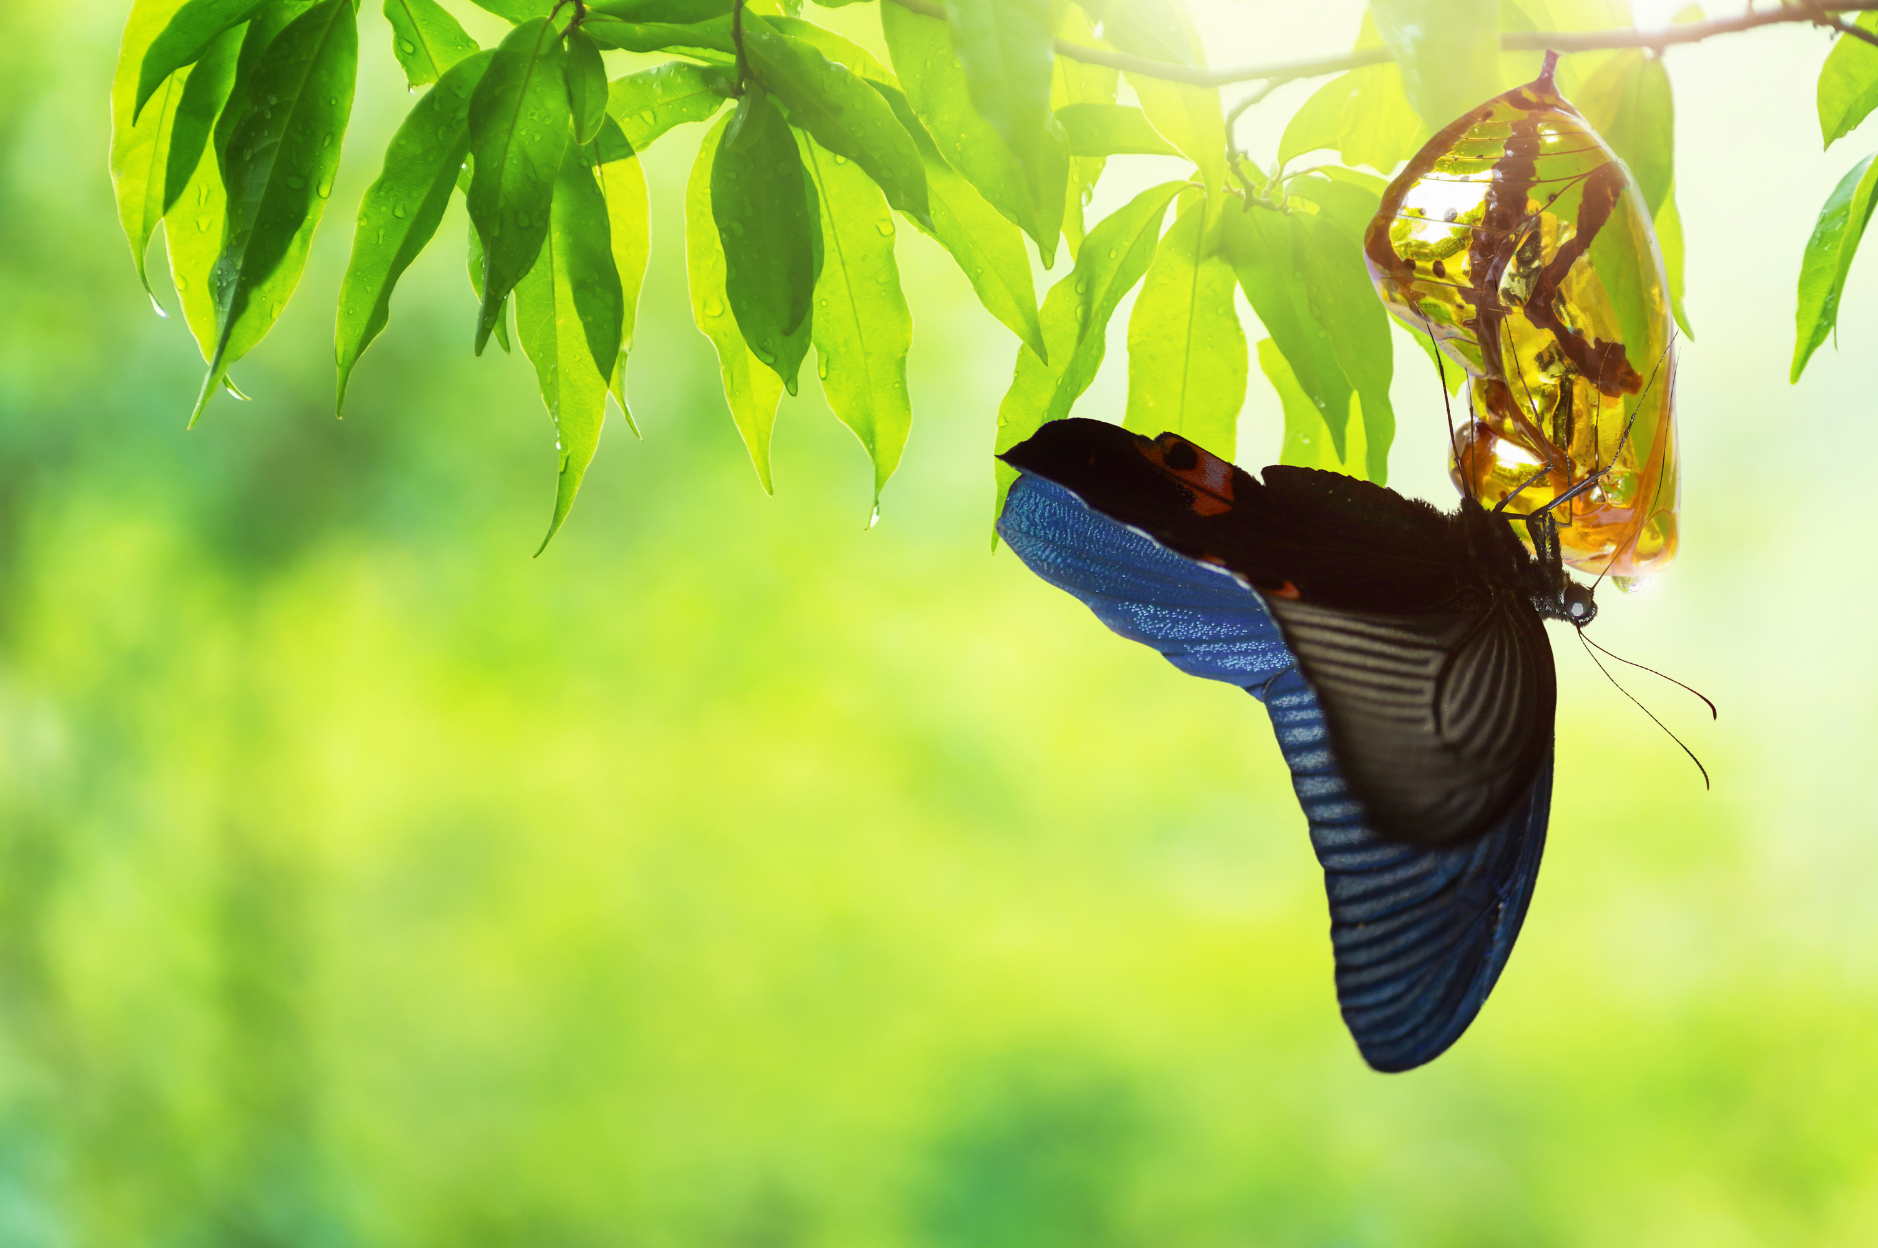
“Over time, I have come to understand that social transformation
(the push for more just systems and policies) and personal transformation (healing our own trauma and reshaping our relationships) have to happen together. Not one or the other, but both. We neglect ourselves or our growth in our rush to change what is external. When we do, we fracture, and succumb to what we are unwilling to face.”
― Prentis Hemphill,
What It takes To Heal
Notes:
this is why healing from the inside out is so important to supporting the world we wish to build, to create the transformations we are dreaming of

Slide 40
Journaling Prompt
Transformation
Reflect and journal to the following questions:
What social transformation are you hoping, dreaming, or visioning to bring into this world?
What personal transformation are you seeking?
How are social and personal transformations you’re seeking interconnected?

Slide 41
Sharing and Holding Space
Notes:
10-15 minutes
Group or share in pairs to prompts (Also can be used as time to reflect on what’s rising to the surface in this workshop)

Slide 42
Sacred Connections
“I am living a life I don’t regret. A life that will resonate with my ancestors and with as many generations forward as I can imagine.”
- Adrienne Maree Brown
Notes:
any time we make or create space for connection, we are doing something sacred. Connection is sacred, making spaces to connect is a sacred act.

Slide 43
spell for reclaiming the moment
Journaling Prompt
For this prompt, take some time to journal and reflect on the following questions:
  How do you know when you are aligned with the prayers of your ancestors?
  How can you tap into your sacred connection to your ancestors, the divine self, the source, or a higher power?
  When a sacred connection is guiding your path, what becomes possible?
Unit 6: Committing to Yourself

Slide 44
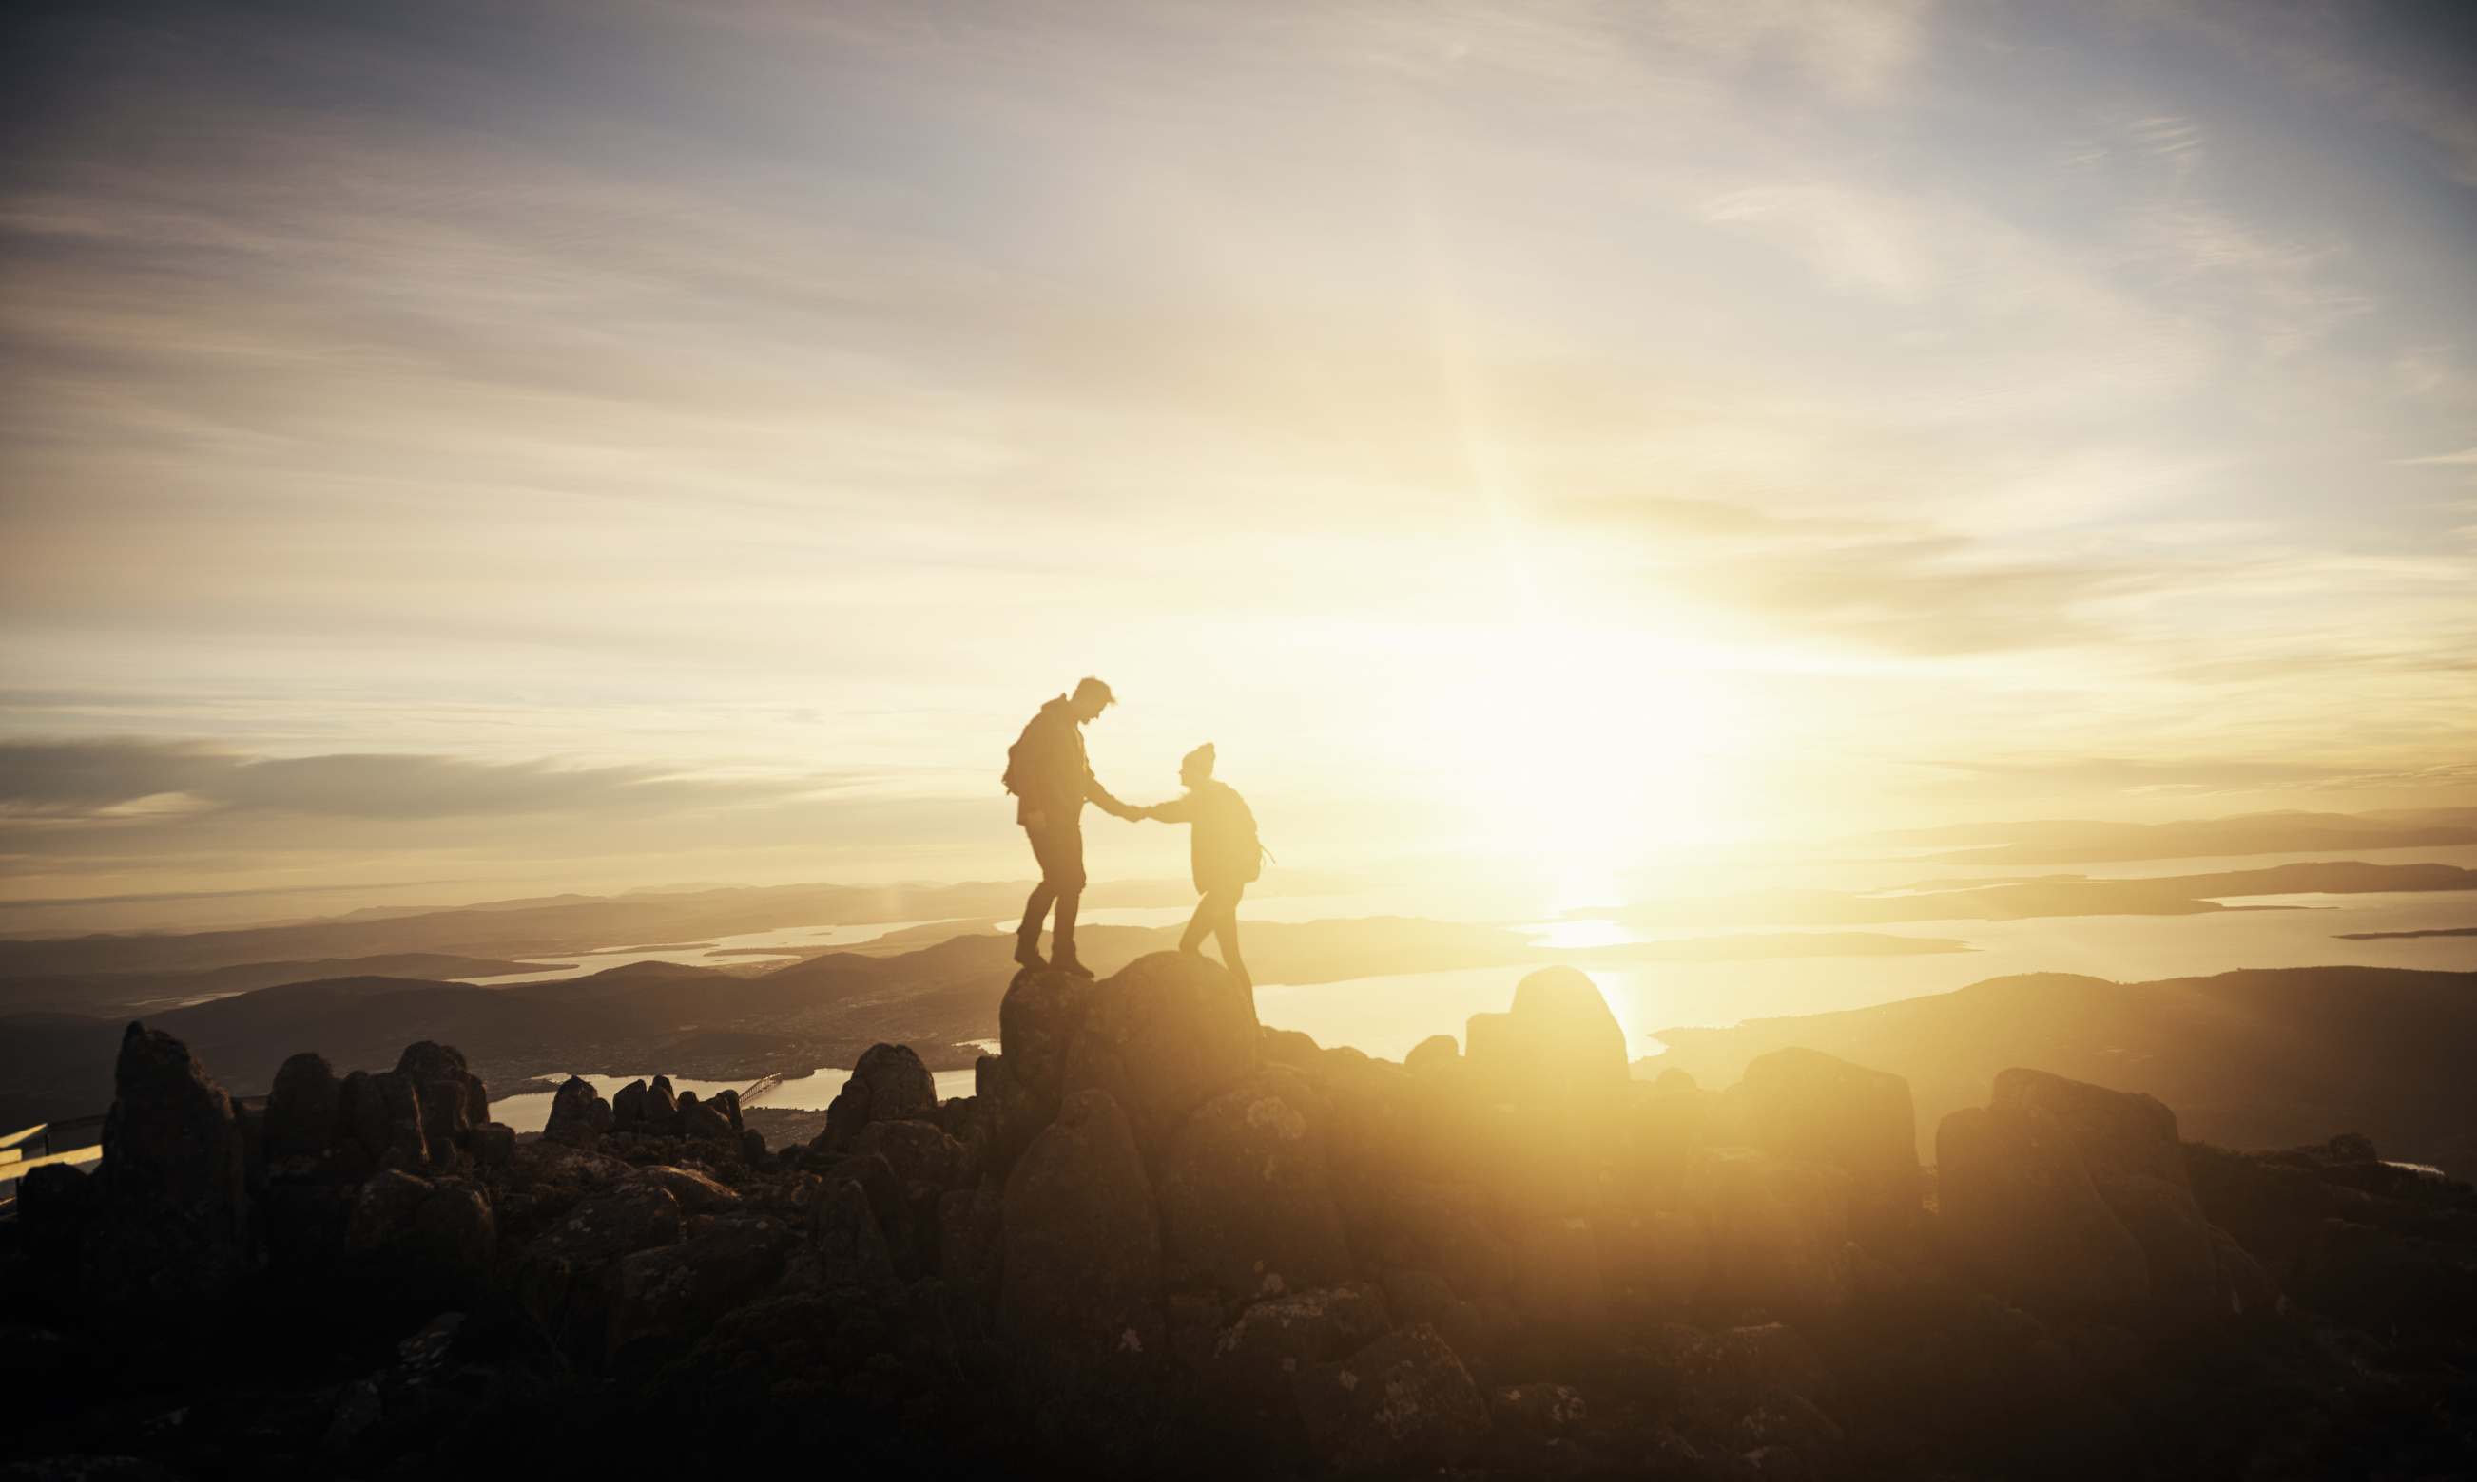

You cannot take anyone anywhere you have not been

Slide 45
“as you are.’ says the universe. ‘after…’ you answer. ‘as you are.’ says the universe. ‘before…’ you answer. ‘as you are.’ says the universe. ‘when…’ you answer. ‘as you are.’ says the universe. ‘how…’ you answer. ‘as you are.’ says the universe. ‘why…’ you answer. ‘because you are happening now. right now. right at this moment and your happening is beautiful. the thing that both keeps me alive and brings me to my knees. you don’t even know how breathtaking you are. as you are.’ says the universe through tears.
― Nayyirah Waheed, nejma
Notes:
Read aloud the Nayyirah Waheed excerpt. Have participants close their eyes and focus on breathing while you read the quote.
Then ask the participants to share what comes to mind from the quote. What resonates?
You can also have everyone write their own versions of “As You Are” in response to the quote.
For instance, what questions do you continually ask the universe? Are there questions you ask daily? What are those questions? Imagine the universe responding to you with love, with the grounding that you are breathtaking, beautiful, and powerful just as you are. What comes up for you when you think of the concept “as you are” ?

Slide 46

Journaling Prompt
As You Are
Imagine the universe responding to you with love, with the grounding that you are breathtaking, beautiful, and powerful just as you are. What questions do you continually ask the universe? Journal to any of the following questions that resonate with you:
  What do you need to be “as you are?”
  Who are you “as you are?”
  What do others not see in you that you want seen?
  What old ideas of yourself are you ready to release?
  What parts of you do you want to bring into this space?

Slide 47
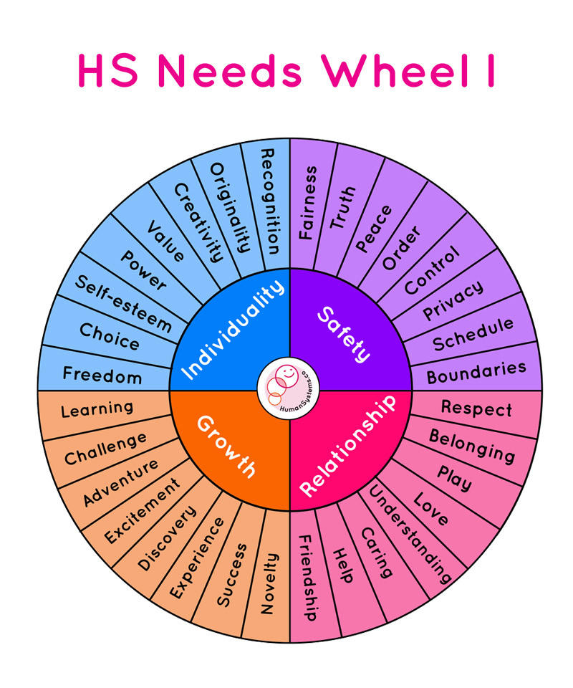
Unit 1: Getting Grounded
Notes:
Another good form of checking in is to check in with yourself on what your needs are.
Take a look at this Needs Wheel to see if you can identify a need that you have today, this week, in this moment. Once you've identified your need, remember the word or need you chose and think about it as we do a grounding breathing exercise.

Slide 48
Writing Prompt
Honoring Your Needs
Reflect and journal to the following questions:
  What was the need you named in the grounding exercise? Was this need a surprise to you?
  How will you address or honor the need you identified?
  What advice or wisdom is your body offering around your named need?
  How can you respond to your needs later today? this week?
  Who or what can support you in meeting your need(s)?
Notes:
Now that you've grounded in your body, let's journal and reflect on the need or needs you identified.

Slide 49

Journaling Prompt
Igniting Your Heartwork
Reflect and journal to the following questions:
What do you need to remember?
What makes you feel whole?
What parts of yourself are you still looking for?
What is your heartwork?
How do you ignite your healing?

Slide 50
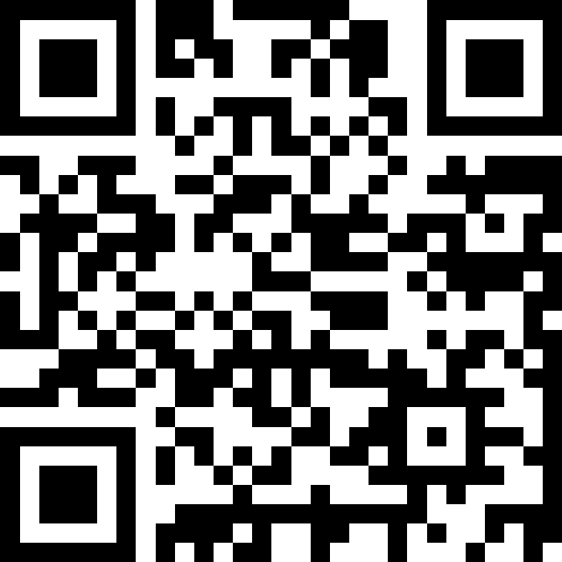
Integration Time
Reflection Prompts
Let’s take this final time to share with the person next to us what you want to remember from the workshop, any insights you learned.
What were any a-ha moments or key takeaways you had today?
What’s alive for you or standing out from this session?

Slide 51

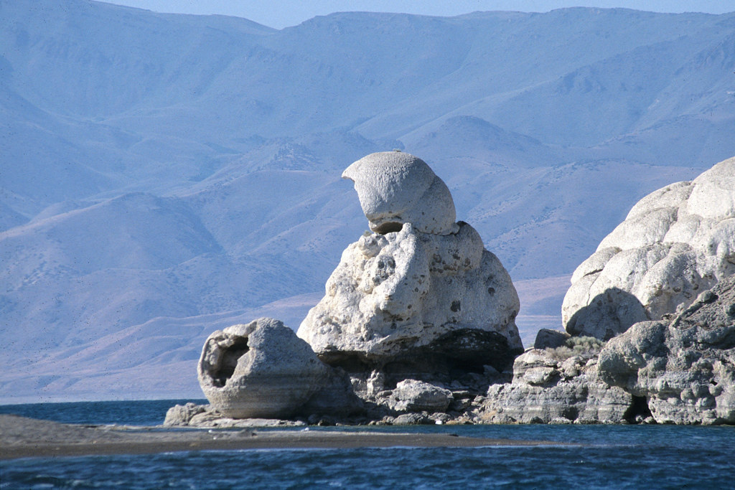

Slide 52
The power of heartspeak &
heartwork
Call your spirit back. Use that Creator-shaped hole in your heart to bring light into this world that desperately needs love. Ignite your fire so that your ancestors know that you are here -- alive, breathing, dancing, singing, and being all they prayed for you.
- Tanaya Winder

Slide 53
www.tanayawinder.com
Closing the Circle

Slide 54


THANK YOU &
CONTACT INFORMATION
www.tanayawinder.com
tanaya.winder@gmail.com
@tanayawinder
https://www.facebook.com/tanayajwinder/

