Slide 1



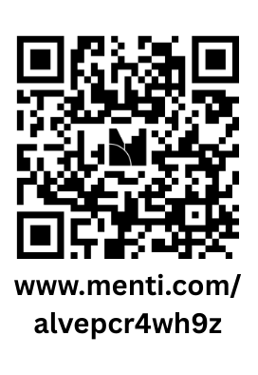
Missing and Murdered Indigenous
Women and Relatives:
Resources for Judges and Tribal Court Staff
NATIONAL AMERICAN INDIAN COURT JUDGES ASSOCIATION

Slide 2
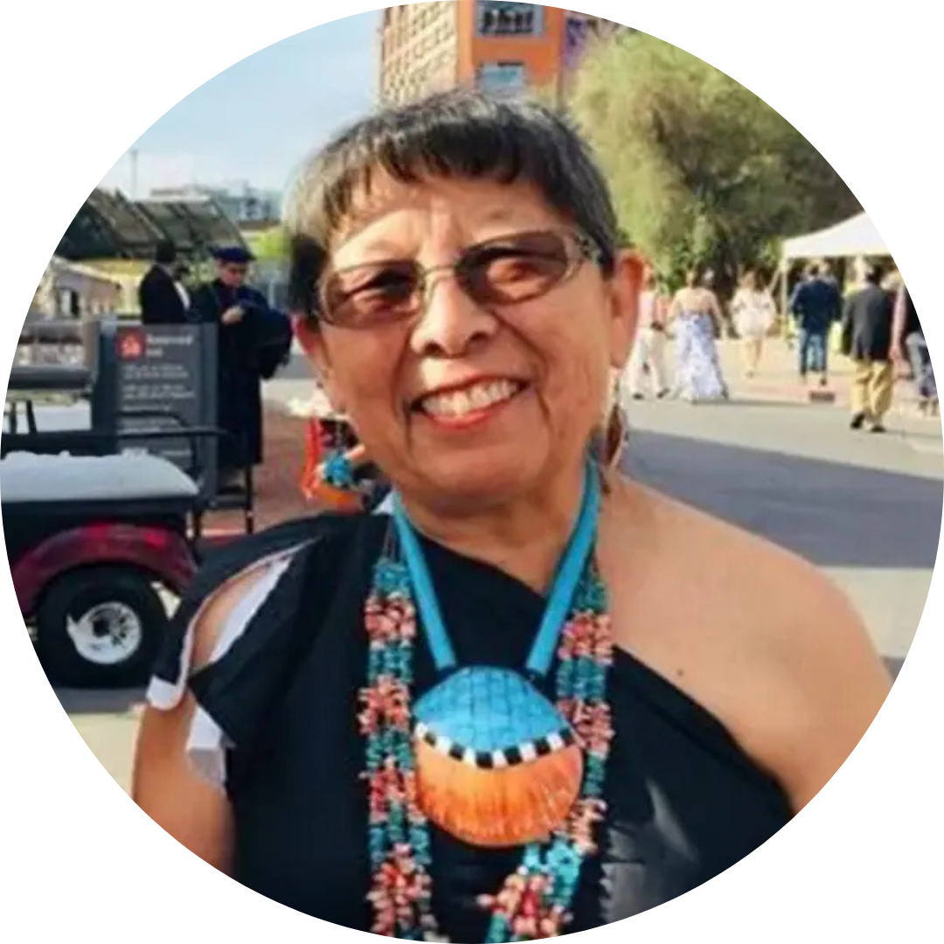

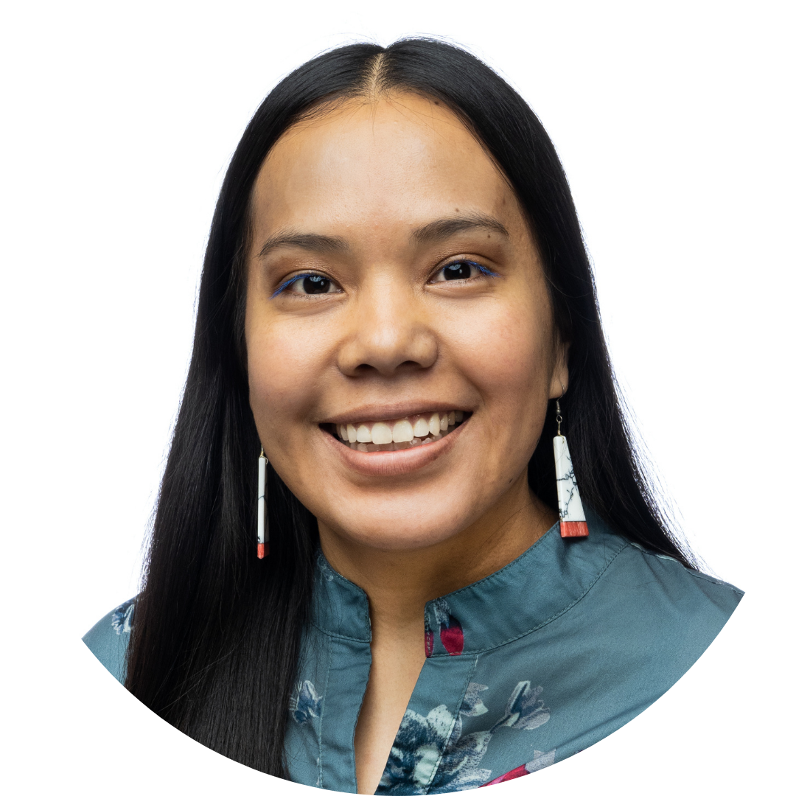
Presenters
NATIONAL AMERICAN INDIAN COURT JUDGES ASSOCIATION
Honorable Peggy Bird
Coalition to Stop Violence Against Native Women, Co-Founder
Mary Rodriguez
NAICJA Program Attorney
Johnny McCraigie
NAICJA Program Coordinator

Slide 3
Disclaimer
NATIONAL AMERICAN INDIAN COURT JUDGES ASSOCIATION
This project was supported by Grant Nos. 15PBJA-23-GG-05498-TRIB and 15PBJA-23-GG-05500-TRIB awarded by the Bureau of Justice Assistance (BJA). The BJA is a component of the Department of Justice's Office of Justice Programs, which also includes the Bureau of Justice Statistics, the National Institute of Justice, the Office of Juvenile Justice and Delinquency Prevention, the Office for Victims of Crime, and the SMART Office. Points of view or opinions in this document are those of the author and do not necessarily represent the official position or policies of the U.S. Department of Justice.

Slide 4
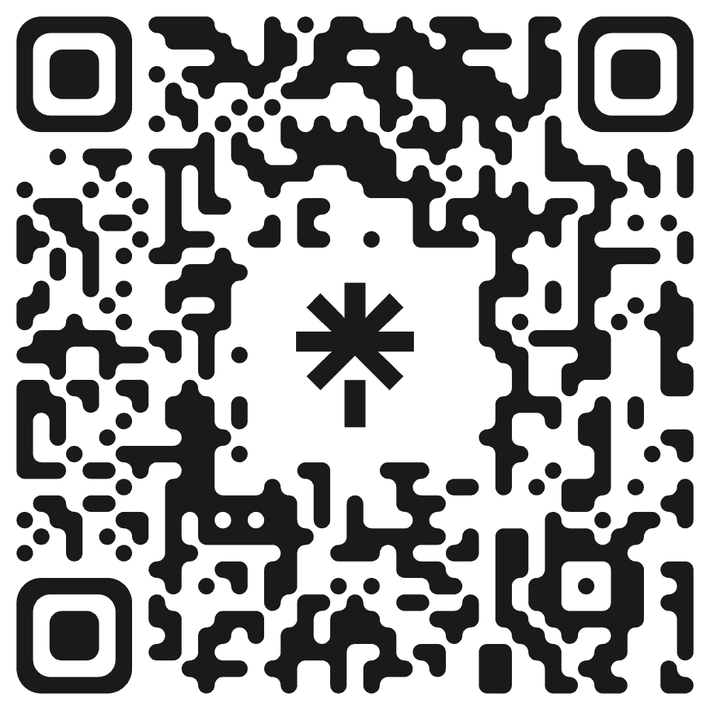
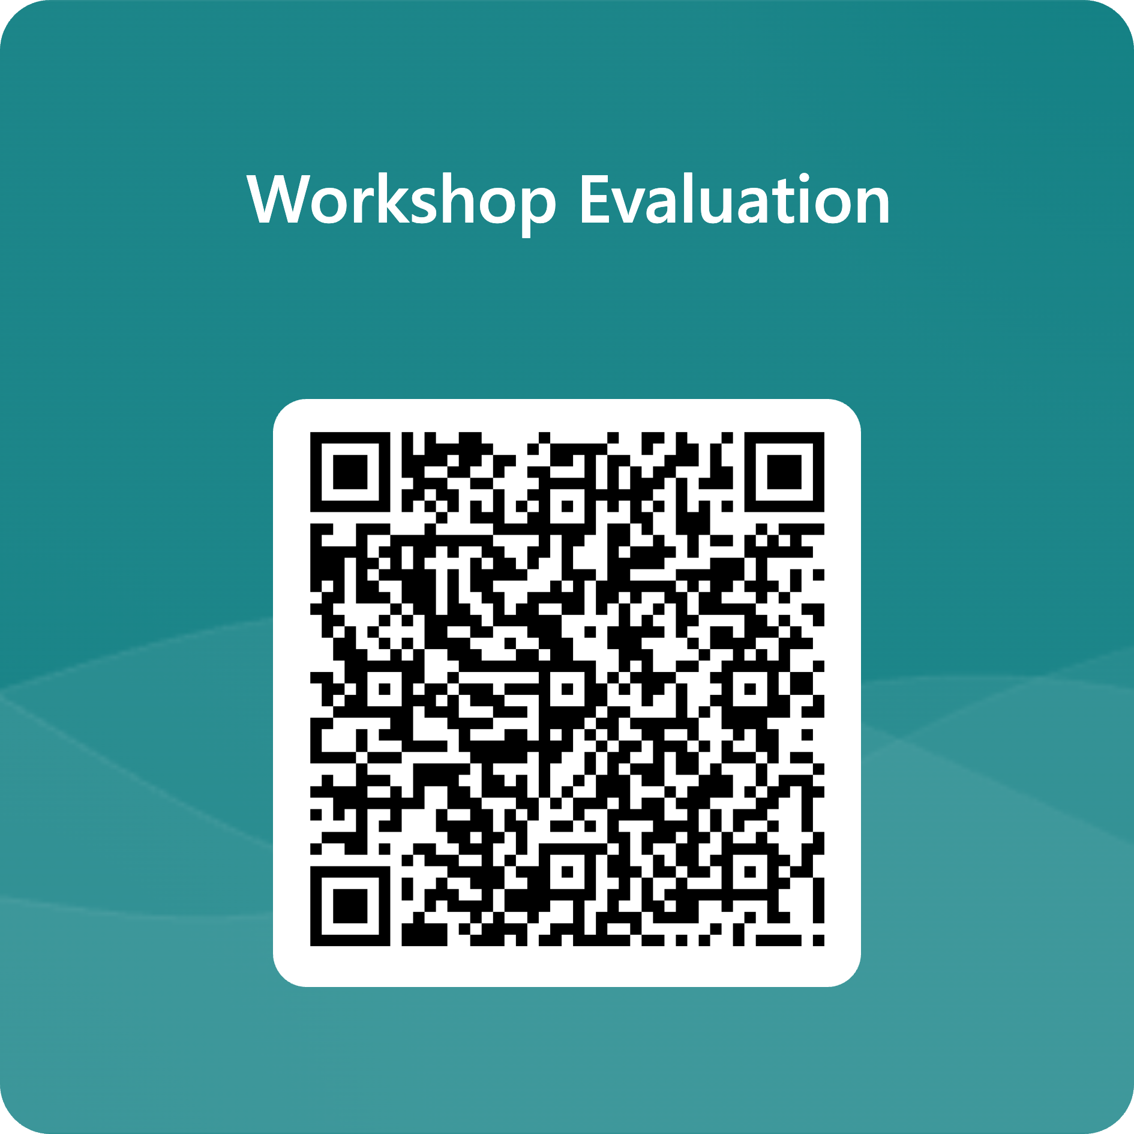
THANK YOU!
NATIONAL AMERICAN INDIAN COURT JUDGES ASSOCIATION
Stay In Touch!
www.linktr.ee/naicja
Mary Rodriguez maryr@naicja.org
Johnny McCraigie johnny@naicja.org

