Slide 1
Healing Together: Holistic Approaches to Domestic Violence and Child Maltreatment
Misty Flowers, MA
Isanti Dakota/Tlingit
Senior Child Welfare Fellow
Notes:
Tanyan yahipi (Welcome)
Misty introduction in Dakota
Thank you to the Pueblo of Isleta for hosting us and welcoming us onto their land. Thank you for their hospitality and express gratitude to their land and ancestors
Thank them all for being there and the work that they do to help families heal

Slide 2
Welcome and Introduction
Workshop Objectives
Treating the Symptoms of Historical and Intergenerational Trauma
Scope of the Problem
Mandated Reporting
Effects of Child Witness to Domestic Violence (DV)
Healing from Family Violence
Challenges in DV/Child Welfare (CW) Collaboration
Effective Practices and Staff Considerations
Additional Resources
Notes:
Our focus for the day is the Intersectionality of DV and CW. How do these 2 social issues intersect and how can we be more effective in helping families to heal in Indian Country
Terminology – I may use acronyms throughout the presentation for simplicity. Family violence in the home is often referred to as Domestic Violence, Inter-Personal Violence, Family Violence and I may utilize DV to include all of those terms.
I will also use Native or Indigenous when referring to the AI/AN and First Nations peoples.
If I say any acronyms that you may not understand, please let me know.
This is the agenda for this workshop. We only have 1 hour, so I may go through somethings quickly.

Slide 3
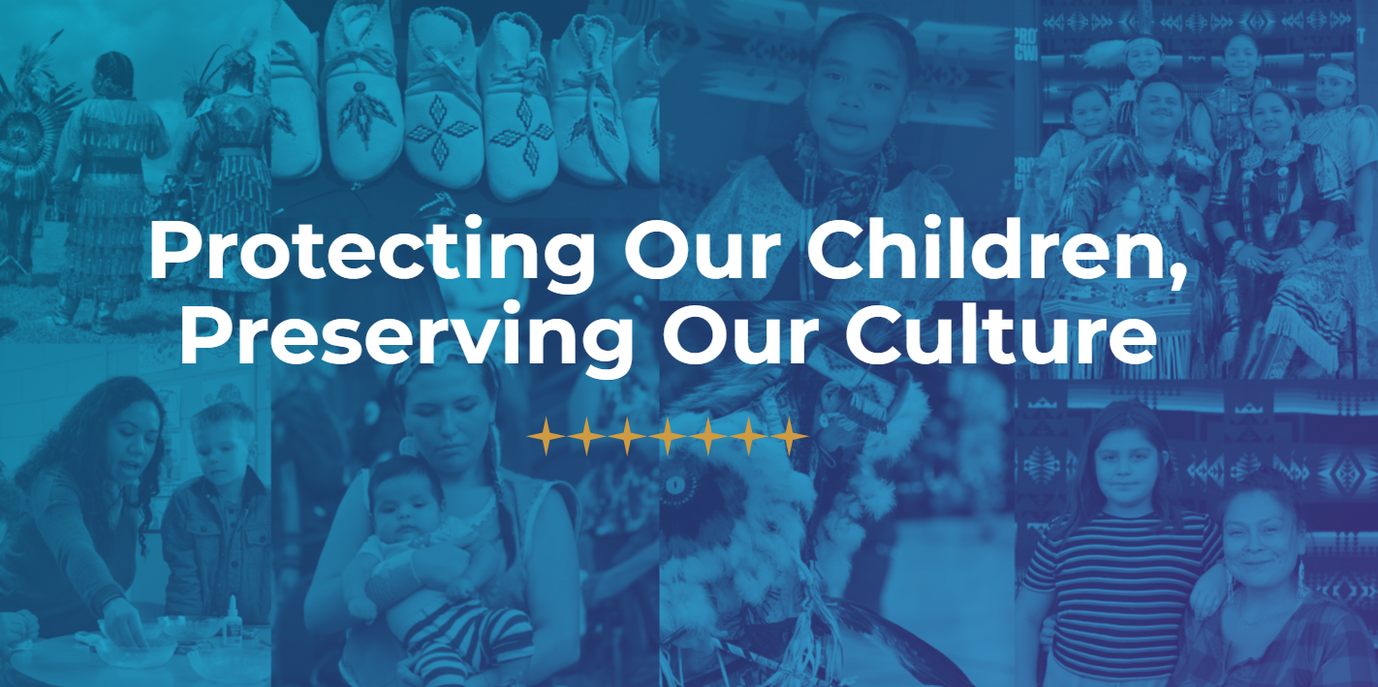
NICWA
Notes:
Before we get into it. I want to make mention of NICWA.
Our Mission
NICWA protects the safety, health, and cultural identity of all Native children and families—today and for future generations—by upholding culturally based services, community strength, and Tribal sovereignty.
Our Vision
All Native children and their families are safe, healthy, and belong to strong communities that are culturally and spiritually abundant.
We have several resources available on our website that may be helpful for helpers and families to help navigate the child welfare system

Slide 4
Treating the Symptoms
Historical and Intergenerational Trauma
Notes:
Before we go in depth, I just want to recognize that we are treating the symptoms of Historical and Intergenerational Trauma.
For simplicity - I will refer to only Historical Trauma (HT)

Slide 5
Impacts of Historical Trauma
Avoidance of cultural symbols
Emotional numbness
Difficulty forming healthy relationships
Overwhelming sadness
Fear of authority figures
Low self-esteem linked to ancestry
Struggles with identity and belonging
Notes:
Historical trauma is “a constellation of characteristics associated with massive cumulative group trauma across generations” (Brave Heart, 1999). These are some of the ways HT manifests in Indian Country - How historical and inter-generational trauma shows up. In Indian Country we are all experts of historical and intergenerational trauma because we live it.
It impacts us all differently
These are some symptoms of historical trauma.

Slide 6
What Historical Trauma looks like
Lack of cultural identity
Low educational achievement
Lower socio-economic status
Domestic violence
Sexual abuse
Unhealthy relationships
Substance abuse
Chronic grief
Incarceration
Mental health Issues
Suicide
Missing and Murdered Indigenous Relatives (MMIR)
TRAUMA THAT CREATES
MORE TRAUMA
(Wellbriety Movement, 2011)
Notes:
“Dr. Maria Yellow Horse Brave Heart (2003) describes historical trauma as the “cumulative emotional and psychological wounding over the lifespan and across generations, emanating from massive group trauma experience.
What does historical/intergenerational trauma look like?
Our people have been victims of the Indian Adoption Project, Boarding Schools, and other forms of assimilation that have had long lasting impacts. One of those is the impact on cultural identity. The lack of cultural identity can be directly related to mental health and substance use disorders. (Journey of Forgiveness, 2011), (ACF, nd)
How many of these things do you think affect a parent's ability to be a good parent?
All these things and then of course we know that Adverse Childhood Experiences (ACEs) has long lasting effects on us and even if we heal or think we have healed from our childhood trauma, it can still abruptly hit us when we get older by a sudden heart attack or stroke. (Dr. Nadine Burke Harris, 2018)
Our people have lower life expectancy than the general population
As professionals in the field, we are trying to heal from it, so we don’t pass it on to our children, while working in it, and still living in it.

Slide 7
PTSD in Child Witness to DV
Lower self-worth
Lower self esteem
Aggression
Self-destruction
Recurring nightmares
Hypervigilance in safe places
Disconnection from family traditions
Persistent feelings of guilt or shame
Increased rates of substance use
Unhealthy relationships
Depression
Anxiety
(Vickerman, 2011)
Notes:
National Library of Medicine
Post-traumatic Stressin Children and Adolescents Exposed to Family Violence
Gayla Margolin, Katrina A Vickerman
Hypervigilance – constant worry about safety

Slide 8
Scope of the Issues
The Intersectionality of Domestic Violence and Child Welfare
Notes:
In the past 20 years there has been a shift in addressing Domestic Violence and child welfare (Meyer, Silke 2025). Separation was seen as the necessary step in preventing children's ongoing Childhood Experiences Domestic Violence (CEDV)

Slide 9
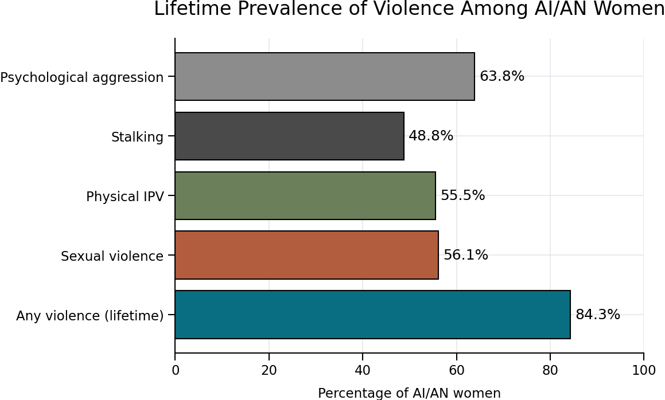
What the Data Says
Notes:
I already know that you all know that Native women are the most victimized group in the US.
According to the Center for Disease Control and Prevention (CDC) –
84% of American Indian/Alaska Native (AI/AN) women have experience violence in their lifetime, making them over 2.5 times as lieklye to experience violent crimes than any other race
Homicide is the 4th leading cause of death
84.3% of AI/AN women have experienced violence in their lifetime, making them over 2.5 times as likely to experience violent crimes than any other race.
56.1% of AI/AN women have experienced sexual violence in their lifetime.
55.5% of AI/AN women have experienced physical violence by an intimate partner in their lifetime.
48.8% of AI/AN women have been stalked in their lifetime.
63.8% of AI/AN women experience psychological aggression in their lifetime.

Slide 10
Domestic Violence in Indian Country
About 58% of American Indian and Alaska Native (AI/AN) women and 51% of AI/AN men experienced intimate partner violence during their lifetimes (NISVS 2016-2017)
Intimate partner violence was a factor in 38% of homicides of AI/AN women and 7% of homicides of AI/AN men (NVDRS 2022)
In their lifetime, about 44% of AI/AN women were raped. In their lifetime, about 14% of AI/AN men were made to penetrate someone else through physical force, threats of violence, or alcohol or drug facilitation (NISVS 2016-2017)
About 32% of AI/AN women reported experiencing sexual coercion, which is unwanted sexual activity that happens when someone is pressured, tricked, threatened, or forced in a nonphysical way (NISVS 2016-2017)
Notes:
National Vital Statistics System (NVSS) 2023 data, among non-Hispanic American Indian/Alaska Natives
National Violent Death Reporting System (NVDRS) 2022 data, among non-Hispanic American Indians/Alaska Natives
National Intimate Partner and Sexual Violence Survey (NISVS) 2016-2017 data, among non-Hispanic American Indian/Alaska Natives
Where are the children while all of this occurs?

Slide 11
National Child Abuse and Neglect Data System
Not every state reports on all possible risk factors. Of the ones that do, Domestic Violence and Substance Abuse the are the 2 highest risk factors for child abuse/neglect (US DHHS, 2025)
36 states reporting in 2021 – 410,268 (28.2%) have the domestic violence caregiver factor(US DHHS, 2023)
38 states reporting in 2023 - 108,112 (25%) have the domestic violence caregiver factor (US DHHS, 2025)
Notes:
Child Maltreatment Report of 2023 – National Child Abuse and Neglect Data System (NCANDS)
Of the states that reported data on domestic violence – Domestic Violence and Substance Abuse are the 2 highest factors for child abuse and neglect
Often times families have both
Of the 38 states reporting in 2023 that included Domestic Violence factors – 108,112 or 25% of the families had domestic violence as a factor
NCANDS data – National Child Welfare data –. States report this data, however this often does not include Tribal data
So, even when we talk about disproportionality of Native children in the child welfare system, the numbers are not accurate. These numbers usually reflect the number of Native children in the state systems and not tribal child welfare systems.
Other reports say 1 in 4 children - Pediatrics

Slide 12
Overlap
The overlap between Inter-Personal Violence (IPV) and child physical abuse in published studies range from 45% - 70% (Thackeray et al., 2023)
National Survey of Children’s Exposure to Violence (Thackeray et al., 2023) :
1 in 3 youth with a history of IPV has been maltreated within the past year
56.8% of children exposed to IPV reported a history of maltreatmen t in their lifetime.

Slide 13
Disproportionality in Child Welfare
Disproportionality By State
State | Disproportionality Rate | % of children who are Native alone (Puzzanchera et al., 2023) | % of children in foster care who are Native alone (HHS, 2025)
Minnesota | 13.5 | 1.4 | 19
Wisconsin | 6.0 | 1.0 | 6
North Dakota | 5.7 | 7.6 | 44
Oregon | 4.5 | 1.1 | 5
South Dakota | 4.4 | 12.4 | 55
Utah | 4.4 | 0.9 | 4
Montana | 4.3 | 9.3 | 40
Iowa | 3.3 | 0.3 | 1
Alaska | 2.7 | 18.6 | 52
Nebraska | 2.7 | 1.1 | 3
California | 2.5 | 0.4 | 1
Idaho | 2.0 | 1.0 | 2
North Carolina | 1.8 | 1.1 | 2
Kansas | 1.4 | 0.7 | 1
Arizona | 1.3 | 4.6 | 6
Notes:
From NICWA Disproportionality Fact Sheet (2026)

Slide 14
Mandated Reporting

Slide 15
Child Abuse Laws in Indian Country
Indian Child Protection & Family Violence Prevention Act​
Victims of Abuse Act​
Tribal Laws and Ordinances​
Various state laws
ICWA
Notes:
States and Tribes have varying Mandated Reporting laws. Laws usually require professionals such as school personnel, childcare providers, medical professionals, social workers, mental health providers, law enforcement, and service providers. You may be a mandatory reporter. We all have a responsibility to make sure children are safe
Mandatory Reporting is a training all by itself so I will touch very briefly on it
Just like Domestic Violence, Child Abuse and Neglect gets complicated by Jurisdiction
Tribes may have their own Tribal Child Welfare system – LE, Court, and Child Protection Agency
Some Tribes may be served by the BIA
Some may be under state/county jurisdiction
For those families that live off reservation (80% of Native families) – ICWA may apply

Slide 16
Components of Mandatory Reporting
Mandated Reporting
Definitions of child abuse/neglect
Protections for mandated reporters
How to spot evidence of child abuse
How to report child abuse
What happens after a report is filed
Notes:
These are the components of mandatory reporting.
Mandatory reporting training goes more in-depth about child abuse and neglect definitions, protections for mandated reporters, how to spot child abuse and neglect, how to property report child abuse and neglect (telling a supervisor is not enough). The person witnessing the CA/N need to make the proper report to the child abuse hotline or contact the proper law enforcement agency. States have child abuse/neglect hotlines for proper reporting. Some Tribes may also utilize the state’s hotline. Hotline workers are trained to ask questions and get all of the proper information such as address, contact info, are they a Native American child or not, and details about observed child abuse/neglect. Once the information is received, they will put a priority on it that determines how quickly CW workers need to get out to make contact with the child/family. For example, priority 1 is within 24 hours
The reports can go a myriad of ways depending on where the abuse took place (jurisdiction) –Are they covered through the state/county? BIA? Tribal?
Mandated reporters aren't investigating the allegation of abuse (unless that is their role as a CPS/CA investigator), so they need to recognize signs of abuse, but not make the determination

Slide 17
Intersection of Domestic Violence and Child Welfare

Slide 18
Intersection of DV, Child Welfare, MH and Substance Use Disorders
DV may lead to substance use and mental health challenges
Substance use may exacerbate the DV
Mental health challenges arising from trauma
May increase exposure to Adverse Childhood Experiences (ACEs)
(NCSACW, 2025)
Notes:
As seen with the NCANDS data, often times DV and child maltreatment is exacerbated by Mental Health and Substance Abuse disorders. (NCSACW, 2025)

Slide 19
Intersection of DV/CW
Something to keep in mind:
Utilize the child welfare system to re-victimize
The “saint”
Over‑reporting and its effects on families
Racial disproportionality and mitigating strain on the CW system
Exploring alternatives to child welfare involvement that maintain child safety
Notes:
We know that DV perpetrators will utilize the child welfare system to further victimize. I just want to recognize that. When I worked in the field we would get multiple reports. At one point the perpetrator was even calling from jail and so I would go out and just check on the family. The report was saying that the house was dirty, the kids didn’t have clean clothes, and that mom was intoxicated all the time. Everytime I went to the house, the house was clean, kids were at school, and it actually smelled really fresh in the house. On that day I would have my child welfare hat on so I would explain that we have a responsibility to look into every call and then I would check in on her to see how she was doing. He was in jail and had his relatives driving by and threatening her.
Perpetrators also know how to talk and utilize the system, often making themselves out to be the “saint”
Every single call was frustrating to
Families that may be starting their healing journey have a lot going on and mom may be struggling with mental health, substance abuse, financial, court/legal issues. Children are going through a lot and may start to act out. We will discuss Child witness to domestic violence here in a bit
We don’t want people to not report, but we want to encourage professionals to maybe do an assessment of the situation and to really determine if a call to the hotline is necessary.
As you may be aware, American Indian/Alaska Native children continue to be disproportionately represented in the child welfare system.
Are there ways to ensure safety without initiating the child welfare system? – safety plans

Slide 20
Other Considerations
Safe Housing needs
Native specific child abuse forensic interviewer
Challenging geography
Jurisdictional confusion and restrictions
Fear of the system
Notes:
Women may stay because they have no place to go
A DV shelter may be available
Insufficient housing on the reservation is a huge issue if they live on the reservation

Slide 21
Effects on Children

Slide 22
Inter-Personal Violence (IPV) in the Home
Consequences vary by severity and chronicity of the violence
Developmental stage of the child
Child resiliency
Social supports
6 times more likely to be emotionally abused
4.8 times more likely to be physically abused
2.6 times more likely to be sexually abused
(Thackeray et al., 2023)
Notes:
Family violence creates a home environment where children live in constant fear.
Children who witness family violence are affected in ways similar to children who are physically abused.. They are often unable to establish nurturing bonds with either parent.
Children are at greater risk for abuse and neglect if they live in a violent home.
Statistics show that over 3 million children witness violence in their home each year. Those who see and hear violence in the home suffer physically and emotionally. "Families under stress produce children under stress. If a spouse is being abused and there are children in the home, the children are affected by the abuse." (Ackerman and Pickering, 1989)
Intimate Partner Violence: Role of the Pediatrician | Pediatrics | American Academy of Pediatrics
Domestic violence affects every member of the family
Home Environment
Similar effects as if they are physically abused
Difficulty bonding
Affected by the abuse even when we think we are protecting them

Slide 23
Physical Impact
Bruises
Knife wounds
Pelvic pain
Headaches
Back pain
Broken bones
Gynecological disorders
Pregnancy difficulties like low birth-weight babies and prenatal deaths
Sexually transmitted diseases
HIV/AIDS
Central nervous system disorders.
Gastrointestinal disorders
Symptoms of post-traumatic stress disorder (e.g., emotional detachment, sleep disturbances, flashbacks, replaying assault in mind, heart or circulatory conditions)
(Thackeray et al., 2023)
Notes:
These are the physical symptoms for parental caregivers – the physical impact on caregivers has an impact on the children. Especially if they are witnessing the violence, or even if they are in the next room, can hear it, may be trying to protect themselves and siblings

Slide 24
Psychological and Social Impact
Depression
Antisocial behavior
Suicidal behavior in females
Anxiety
Low self-esteem
Inability to trust men
Fear of intimacy
Restricted routinely in the way they can gain access to information and services
Strained relationships with health providers and employers
Isolation from social networks
(Thackeray et al., 2023)
Notes:
Again these are the impacts on caregivers. How might these things impact the children in the home?
How do these things impact a caregivers ability to parent?

Slide 25
Effects of IPV on Children
Social, emotional, psychological and behavioral issues
Anxiety
Low self-esteem
Depression
Anger and temperament
Affect development
Can continue into adulthood (ACEs research)
Notes:
National Child Traumatic Stress Network (NCTSN)
Children exposed to family violence are more likely to develop social, emotional, psychological and or behavioral problems than those who are not.
Recent research indicates that children who witness domestic violence show more anxiety, low self esteem, depression, anger and temperament problems than children who do not witness violence in the home.
The trauma they experience can show up in emotional, behavioral, social and physical disturbances that effect their development and can continue into adulthood.
Children exposed to IPV are at increased risk of being abused and neglected and likely to develop adverse health, behavioral, psychological, and social disorders later in life.
(Dr. Nadine Harris Burk, 2018)
I didn’t see these things until after my abuser left. That was when my son really started acting out. He is now 25 and he says those are days we don’t talk about. He calls it his angry period. Every child is different and it will come out in different ways. His came out in anger. I had holes in my walls, he was scratching at himself and trying to hurt himself. There was a time when I didn’t want to leave him home alone even though he was of age to stay home alone, because I was worried about coming home to him successfully committing suicide.
DV in a home has a different affect on children based on their age, gender, re-occurrence of violence, severity of violence, and response of the caregivers. (National Child Traumatic Stress Network)

Slide 26
Effects on Younger Children
Withdrawn
Non-verbal
Regressed behaviors (clinging, whining, thumb sucking)
Eating difficulty
Sleeping difficulty
Concentration problems
Generalized Anxiety
Physical complaints (stomach aches, head aches)
Self-blame
Guilt
Worry
Anxiety
Manifests to
these behaviors
(OVC, 2012)
Notes:
(OVC, 2012)

Slide 27
Pre-Adolescent Child
Greater ability to externalize emotions
Loss of interest in social activities
Low self-concept
Withdrawal/Avoidance of peer relations
Rebellious
Oppositional defiant behavior
Girls are more likely to exhibit withdrawal (may be missed as child who needs support)
(OVC, 2012)
Notes:
(OVC, 2012)

Slide 28
Adolescent Youth
Risk of academic failure
School drop-out
Delinquency
Substance abuse
May start to experience “dating violence”
(OVC, 2012)
Notes:
(OVC, 2012)

Slide 29
Long-Term Effects
Risky behaviors
Alcohol and drug abuse
Smoking
Early initiation of sexual activity
Depression
Suicidality
Heart disease
Chronic obstructive pulmonary disease
Liver disease
Heightened risk for experiencing IPV in adulthood (OVC, 2012)
Notes:
(Office for Victims of Crime Training and Technical Assistance Center, 2012)

Slide 30
Healing from Family Violence

Slide 31
Parents: Give Children Love and Care
Provide safety Trust and Respect
Provide emotional security
Physical security
Provide discipline
Give time
Encourage and Support
Lots of Affection
Care for caregivers
Rebuild Self-Esteem and Confidence
Strengthen family bonds
Family-Centered
Healing
(ChildPsy Today, 2024)
Notes:
Healing and Recovery is possible
Trust and Respect: Acknowledge children's right to have their own feelings, friends, activities and opinions. Promote independence, allow for privacy and respect their feelings for the other parent. Believe in them.
Provide Emotional Security​ Talk and act so children feel safe and comfortable expressing themselves. Be gentle. Be dependable.
Provide Physical Security​ Provide healthy food, safe shelter and appropriate clothing. Teach personal hygiene and nutrition. Monitor safety. Maintain a family routine. Attend to wounds.
Provide Discipline​ Be consistent; ensure that rules are appropriate to age and development of the child. Be clear about limits and expectations. Use discipline to give instruction, not to punish
Give Time​ Participate in your children's lives, in their activities, school, sports, special events, celebrations and friends. Include your children in your activities. Reveal who you are to your children.
Encourage and Support​ Be affirming. Encourage children to follow their interests. Let children disagree with you. Recognize improvement. Teach new skills. Let them make mistakes.
Give Affection​ Express verbal and physical affection. Be affectionate when your children are physically or emotionally hurt.
Care for Yourself​ Give yourself personal time. Keep yourself healthy. Maintain friendships. Accept love.

Slide 32
Healing
Cultural healing (Wellbriety Movement, 2011)
Show grace
Safe spaces to feel and heal
What you put out is what you are going to get back (Whiteman, 2011)
When parents heal, they naturally heal their children (Flowers, 2026)
Notes:
Cultural healing – language, traditions culture immerse in cultural activities (This was the strongest form of healing that I did with me and my children)
Find spiritual healing – whatever that looks like for the family
Show grace to self and to the children
What we put out into the world is what we are going to get back. – when we put out good, we get back good. Eventually things will line out and things start happening for the family
When parents heal, it naturally heals the entire family – healing radiates outward.
When we make the safe space for children, they will heal

Slide 33
Challenges in DV/CW Collaboration

Slide 34
Challenges in Collaboration
Common barriers to effective cross ‑system work
Conflicting Interests
Lack of Coordination
Legal and policy issues
Resource limitations
Resistance to change
Lack of understanding of roles and responsibilities
Confidentiality and privacy laws
NCSACW, 2025)
Notes:
May have conflicting safety plans and treatment plans
Financial and logistical barriers for families
Conflicting Interests - The key value of “best interests of the child” conflicted with the key interest of DV advocates of “keeping the victim safe and empowering victims.” Most DV programs don’t look at the children as victims and provide services. Most child protection agencies don’t see a domestic violence victim, as a victim, but somehow see the person as being in control of the situation. Issues of confidentiality become problematic with attempts to collaborate.
Parents sometimes have difficult time getting their children back b/c they lack basics such as cell phones, transportation, adequate housing.
Lack of Coordination – there is no one agency that can fully meet the needs of the individual or family
Collaboration – MDT team members may lack sufficient cross-training
Resource Limitations - Opportunities – align case plans and safety plans
Braided funding for integrated services
Shared referral pathways
Build networks of support for the entire family – MH, substance abuse, court, community groups, support groups, culturally appropriate services (MIS/FIS, PIP)
Legal and Policy opportunities – confidentiality on both sides can get tricky.
review policies for trauma-informed, family centered alignment
Lack of sufficient training for law enforcement and court personnel on both issues
Resistance to Change: often times is not the priority of leadership. Resistance from both sides or one side regarding changing approaches. National push for prevention. Bias towards one side or the other.

Slide 35
Systemic issues of oppression
Mandatory Reporting
Substantiated Decisions
Central Registries
Socioeconomic
Lack of legal representation
Notes:
Laws that require mandatory reporting or the perpetrator utilizing the system to continue to victimize
Substantiated decisions can have lifelong consequences for families
Central Registries – families stay on registries
Socioeconomic – Native families often face socioeconomic oppression as well and it is further compounded by Domestic Violence
Unequal access to employment, housing, education
Lack of Adequate legal representation that may not fully understand the impact of Domestic Violence, ICWA, and other family laws. Lack of understanding of Indigenous cultures

Slide 36
Approaches to strengthen coordinated case planning
Ensure basic needs are met
Provide resources and support for the whole family
Hold perpetrator accountable and avoid victim blaming
Align case plans and safety plans
Be prepared for substance abuse support for families
Encourage culturally based services when available
All systems screening for DV
NCSACW, 2025)
Notes:
Basic needs may include – access to a phone, transportation, basic shelter, food, clothing, birth certificates, social security cards
Screening for DV in support programs including mental health, substance abuse treatment
Depending on how tribal programs are set up – collaboration can be easier or harder.
Some DV programs and CW programs are all under Social Services
Some are completely separate departments
Some Tribes have victim services under the Tribal court
Batterer/Perpetrator accountability – some perpetrators are allowed to participate in sacred ceremonies and have high positions within the Tribe and in Native communities – what about cultural reparation.

Slide 37
Effective Practices and Staff Considerations

Slide 38
“I’m always struggling when the victim
views the system not as their friend, but as
a monster that creates more havoc in their
lives. Their kids are going to be removed
and their life is turned upside down, if they
don’t leave their home and they don’t have
resources of their own. What they learn is
to not call the police. It’s better to live in the
environment [of violence]. “ - Judge

Slide 39
3 Guiding Principles
Create Safety
Enhance well-being
Stability for children and families
TLPI, 2011)

Slide 40
If they have a Child Welfare case
ICWA
Determining eligibility
Active Efforts
Placement Preferences
Qualified Expert Witness
Notes:
ICWA requires that the child must be enrolled or eligible for enrollment and at least one biological parent must be an enrolled tribal member (see ICWA Family Guide)
If ICWA applies - ensuring placement preferences and active efforts are met
ICWA requires a showing that the continued custody of the child by the parent or Indian custodian is likely to result in serious emotional or physical damage to the child before removing the child from his
or her family. The determination must be supported by clear and convincing evidence, including the testimony of qualified expert witnesses.
Placement preferences require the state to place in the least restrictive setting.
Active efforts must be provided to provide remedial services and rehabilitative programs designed to prevent the breakup of the Indian family. DV staff can help ensure active efforts are met by providing resources and supportive services, especially services that are culturally appropriate
Some DV Programs are able to help families living off the reservation.
ICWA requires QEW testimony for reasons such as: when a child enters foster care and prior to Termination of Parental Rights (TPR). No TPR may be ordered in the absence of a determination, supported by evidence beyond a reasonable doubt and including QEW testimony that continued custody by the parent will likely result in serious emotional or physical damage.

Slide 41
Open Child Welfare Case?
Keep children in the care of non-offending parent if safe to do so
Ensure psychological safety during family team meetings and court hearings
Holistic healing for the entire family
Safe and meaningful fatherhood engagement
Encourage families to keep a log of important events
“Keep evidence”
Safe exchange
Safe parenting plans
Tribal Customary Adoption – alternative permanency
(NCSACW, 2025)
Notes:
These are some additional considerations if they have an open child welfare case.
Encourage families to keep a log of important events. But if a perpetrator is texting them or emailing them. Also, they can use medical records and school records. Anything to show that what they are saying is true. "evidence" for the court/judge. Otherwise it is he said, she said.

Slide 42
Additional considerations
Reparative and restorative practices
Positive deviance strategies
Incorporating decolonizing approaches
Culture as Prevention and Intervention
PREVENTION SERVICES
Notes:
Reparative – treatment focuses on fixing or correcting damage
There are many programs like Motherhood and Fatherhood is Sacred Programs, Batterer Intervention Programs. Some have a strong cultural foundation – but maybe we could be doing better.
Restorative – renew and revitalize overall well-being
Peacemaking practices – it can be very difficult to promote this type of communication and practices, especially when egregious harm has been done. I often tell parents and caregivers – what happens when we throw fuel on a fire. It blows up. What if we just let it be? It will eventually sizzle down and faze out. It can be so hard because we want to stand up for ourselves and “set the record straight”
Restorative practices has its roots in Indigenous culture.
What were some restorative practices that may have been present in your Tribes?
Can these practices be adapted into Tribal Codes?
Decolonizing approaches – some programs have a lot of rules and regulations that prevent adequate use of funding to truly help families. Allow for many points of entry to programs and services. Incorporating Tribal culture and Traditions every step of the way and with every program and service.
Families should be able to receive services without fear of losing their children.
Culture as Prevention (SAMHSA, 2019) – makes sense when you learn about our tribal values and truly live by them
Helping families heal is prevention for the next generation – especially since

Slide 43
Successful Strategies
Collaboration and Regular Communication
Child Protection Teams, Multi-Disciplinary Teams, Sexual Assault Response Teams (SART)
Department heads hold monthly meetings
Operational agreements
Cross-training (Law Enforcement, Court, DV, CW)
Departments co-hosting Prevention Events
Mediation Programs
Holistic family healing
NCSACW, 2025)
TLPI, 2011
Notes:
Collaboration with neighboring Tribes, state, and county agencies, non-profits
Child Protection
Some of the suggestions for successful strategies from the Tribal Law and Policy Institute (TLPI) (2011).
Is there anything else in your jurisdiction that may not already be on this list?

Slide 44
Additional Resources

Slide 45
Additional Resources & References
Administration for Children and Families. (n.d.). What is historical trauma? U.S. Department of Health and Human Services. https://acf.gov/trauma-toolkit/historical-trauma-concept
Burke Harris, N. (2018). The deepest well: Healing the long-term effects of childhood adversity. Houghton Mifflin Harcourt.
Centers for Disease Control and Prevention. (2025). Violence against Native peoples: Fact sheet. U.S. Department of Health and Human Services. https://www.cdc.gov/injury-tribal/media/pdfs/2025/06/Violence-Against-Native-Peoples-Fact-Sheet.pdf
ChildPsy Today. (2024, July 24). Therapeutic approaches for children exposed to domestic violence. Child Psychiatry Today. https://childpsy.org/therapeutic-approaches-for-children-exposed-to-dv
Drake, B., Lee, S. M., & Jonson-Reid, M. (2009). Race and child maltreatment reporting. Child & Youth Services Review, 31(3), 309–316.
Margolin, G., & Vickerman, K. A. (2007). Post-traumatic stress in children and adolescents exposed to family violence: I. Overview and issues. Professional Psychology: Research and Practice, 38(6), 613–619. https://doi.org/10.1037/0735-7028.38.6.613
Meyer, S. (2025). The impact of domestic violence on children: Challenges and opportunities for child protection responses. Journal of Family Violence. https://doi.org/10.1007/s10896-025-00955-5
Moylan, C. A., Herrenkohl, T. I., Sousa, C., Tajima, E. A., Herrenkohl, R. C., & Russo, M. J. (2010). The effects of child abuse and exposure to domestic violence on adolescent internalizing and externalizing behavior problems. Journal of Family Violence, 25(1), 53–63. https://doi.org/10.1007/s10896-009-9269-9
National Center on Substance Abuse and Child Welfare. (2025). Strengthening systems collaboration for families at the intersection of domestic violence and co-occurring substance use and mental health disorders. https://ncsacw.acf.gov/files/domestic-violence-brief.pdf
National Council of Juvenile and Family Court Judges. (n.d.). 10 things to know about family court. https://www.ncjfcj.org/publications/
National Council of Juvenile and Family Court Judges. (n.d.). 10 things to know about parenting plans in cases involving domestic violence. https://www.ncjfcj.org/publications/10-things-to-know-about-parenting-plans-in-cases-involving-domestic-violence/
National Indian Child Welfare Association. (2025). NICWA–ICWA: A family’s guide (Updated ed.). https://www.nicwa.org/wp-content/uploads/2025/02/2021-Family-Guide-to-ICWA-Updated-2.pdf
Office for Victims of Crime Training and Technical Assistance Center. (2012). Intimate partner violence (Resource paper). U.S. Department of Justice. https://www.ovcttac.gov/downloads/views/TrainingMaterials/NVAA/Documents_NVAA2011/ResourcePapers/Color_Intimate%20Partner%20Violence%20Resource%20Paper_2012_final_508c_9_17_2012.pdf
Resource Center on Domestic Violence: Child Protection & Custody. (2019). 20 facts for Domestic Violence Awareness Month. https://rcdvcpc.org/resources/resource-library/resource/20-facts-for-domestic-violence-awareness-month-october-2019.html
Thackeray, J., Livingston, N., Ragavan, M. I., Schaechter, J., Sigel, E., Council on Child Abuse and Neglect, & Council on Injury, Violence, and Poison Prevention. (2023). Intimate partner violence: Role of the pediatrician. Pediatrics, 152(1), e2023062509. https://doi.org/10.1542/peds.2023-062509
Tribal Law and Policy Institute. (2011). Responses to the co-occurrence of child maltreatment and domestic violence in Indian Country. https://www.tribal-institute.org/download/OVWGreenbookReportHVS_TD_7-18.pdf
U.S. Department of Health and Human Services, Administration for Children and Families. (2025). Child maltreatment 2023 (NCANDS). https://acf.gov/sites/default/files/documents/cb/cm2023.pdf
Vickerman, K. A., & Margolin, G. (2007). Post-traumatic Stress in Children and Adolescents Exposed to Family Violence: II. Treatment. Professional psychology, research and practice, 38(6), 620. https://doi.org/10.1037/0735-7028.38.6.620
Wellbriety Movement. (2011). Journey of forgiveness [Video]. YouTube. https://youtu.be/vZwF9NnQbWM

Slide 46
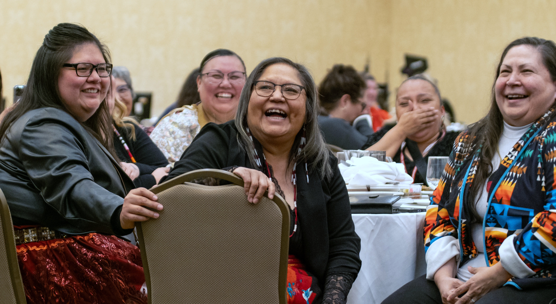

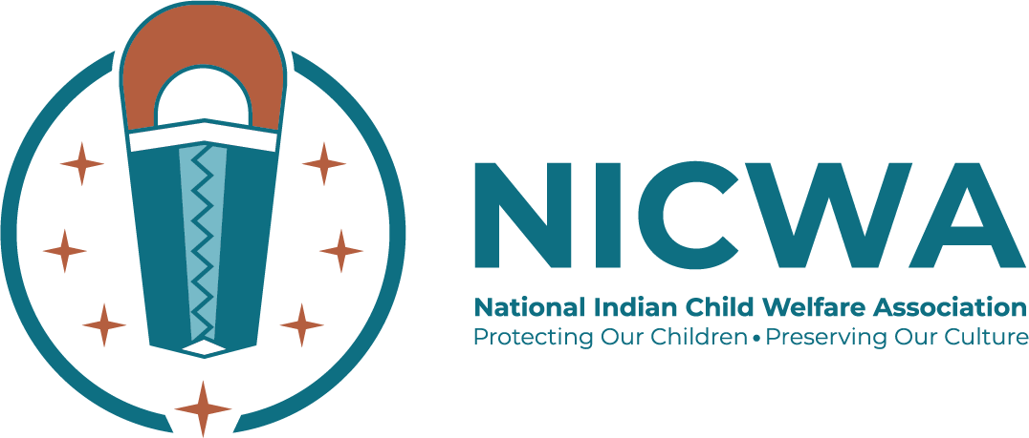
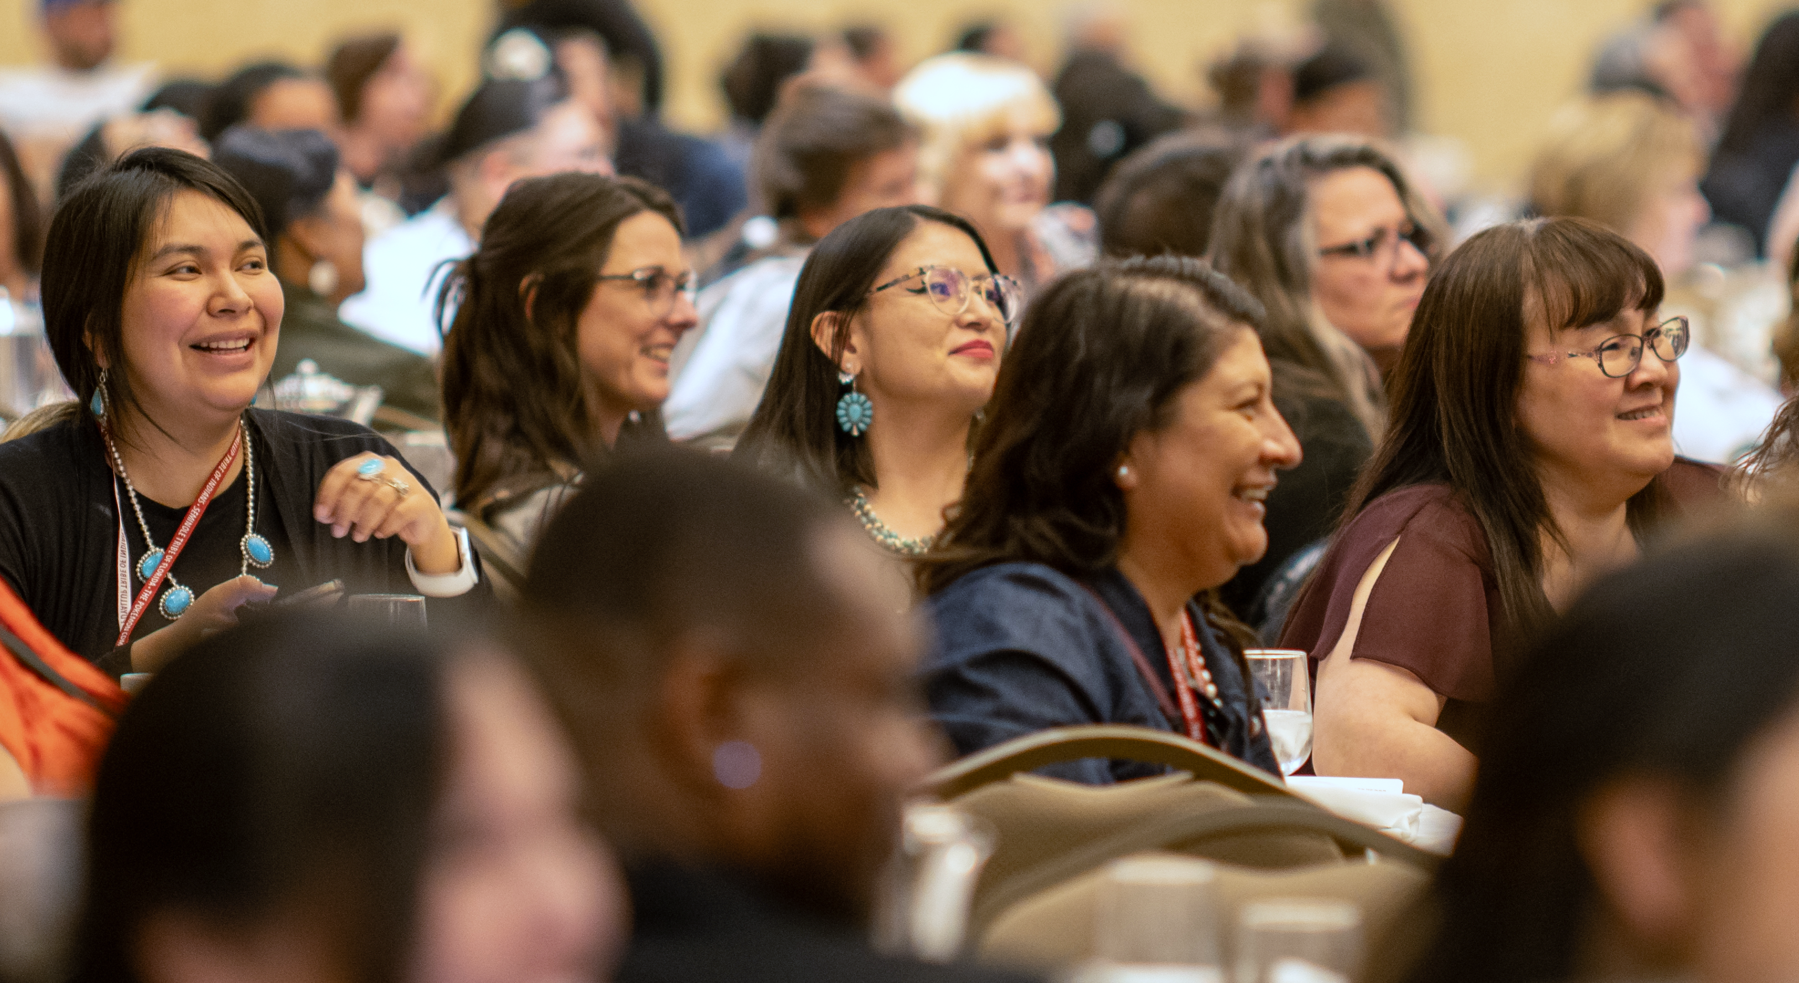
NICWA Membership
Becoming a NICWA member means becoming part of a strong community that advocates to protect Native children and families.
Membership Levels
Our members are the heart of NICWA
Sweetgrass Individual
Individual access to benefits.
Cedar Tribal and Organizational
Access to up to two members.
Sage Tribal and Organizational
Access to up to four members.

Slide 47
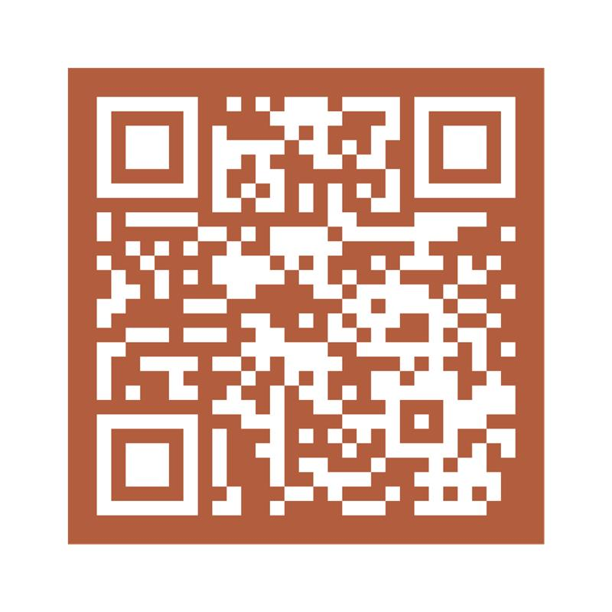
Join our Network of Advocates for Native children and families
Notes:
Information about becoming a member – QR Code
We offer Organizational and Individual memberships
Elders and students are eligible for a steep discount.
Membership helps to keep you connected to our work including training and advocacy. By being a member you join our network of Advocates for Native children and families
Be the first to know about our trainings and what is going on in Government Affairs.

Slide 48
Misty Flowers (Isanti Dakota/Tlingit)
misty@nicwa.org
503-222-4044 ext. 107
Pidamaye
Guanalcheesh
Notes:
Thank you to all of you for the work that you do! It is extremely tough and I hope that you have been able to get some time to refresh and renew through the conference!

Slide 49
Connect with NICWA!
Notes:
Feel free to connect with us on any of our Socials as well!

